Slide 1
The Most Iconic Paintings in the World
Exploring the Artworks That Have Stood the Test of Time

Slide 2
Introduction
• Only a small percentage of the millions of paintings created throughout history are truly memorable.
• These iconic artworks shape our history and culture.
• In this presentation, we will delve into a group of paintings that are beloved and recognized worldwide.
• These renowned paintings will likely continue their legacy into the future.
Photo by Pexels

Slide 3
1. Mona Lisa by Leonardo da Vinci
• Considered the most famous painting in the world.
• Located in the Louvre Museum, attracting 6 million visitors annually.
• Painted by Leonardo da Vinci in 1503-1504.
• Captivates viewers with its enigmatic smile.
Photo by Pexels

Slide 4
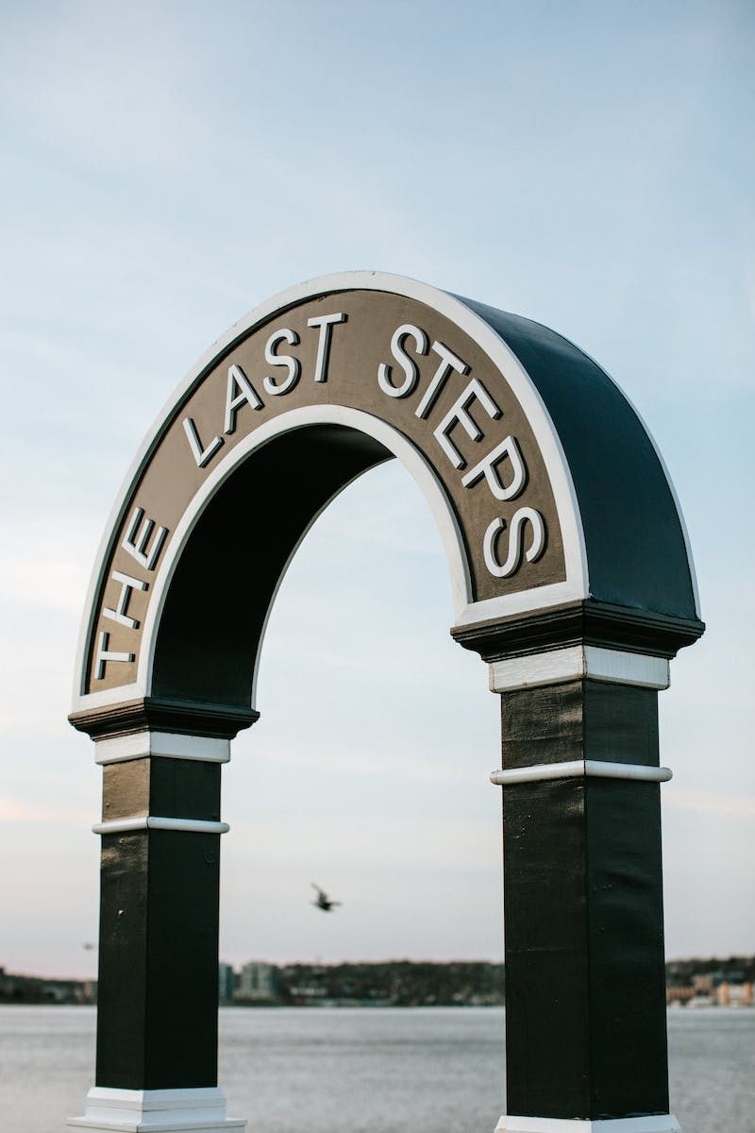
2. The Last Supper by Leonardo da Vinci
• One of the most famous paintings in the world.
• Depicts the dramatic scene of Jesus and his disciples during their final meal.
• Located on the wall of a monastery in Milan.
• Created between 1495 and 1498.
Photo by Pexels

Slide 5
3. The Creation of Adam by Michelangelo
• Featured on the ceiling of the Sistine Chapel in the Vatican City.
• Created by Michelangelo between 1508 and 1512.
• Depicts the iconic scene from the Book of Genesis.
• Symbolizes the relationship between God and humanity.
Photo by Pexels

Slide 6
4. The Starry Night by Vincent van Gogh
• Created by Vincent van Gogh in 1889.
• One of the most recognizable paintings in the world.
• Part of the collection at the Museum of Modern Art in New York.
• Depicts a mesmerizing, dreamlike landscape.
Photo by Pexels

Slide 7
5. The Scream by Edvard Munch
• Painted by Edvard Munch in 1893.
• Among the most famous artworks ever created.
• Belongs to the National Gallery in Oslo, Norway.
• Evokes feelings of fear, anxiety, and existential dread.
Photo by Pexels

Slide 8
6. The Persistence of Memory by Salvador Dalí
• Painted by Salvador Dalí in 1931.
• Considered one of the most powerful paintings in the world.
• Features melting clocks and symbolic elements.
• Invites contemplation of personal perception and the passage of time.
Photo by Pexels

Slide 9
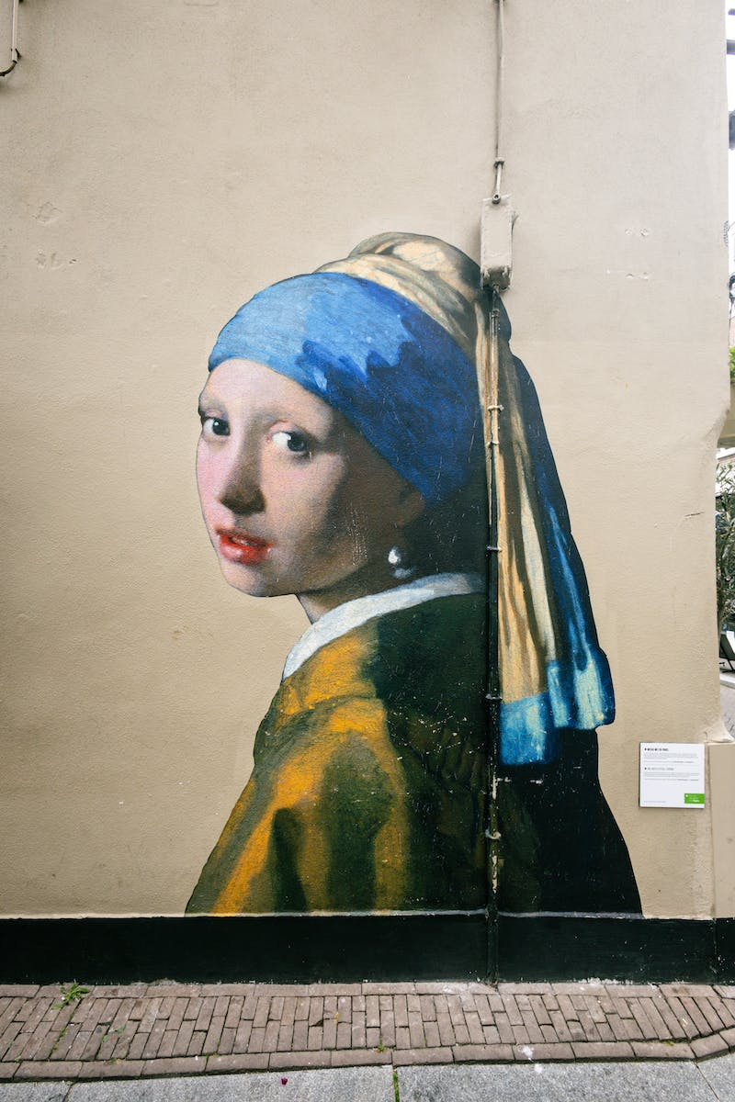
7. Girl with a Pearl Earring by Johannes Vermeer
• Regarded as the 'Mona Lisa of the North'.
• Painted by Johannes Vermeer.
• Depicts a young woman with a pearl earring.
• Currently displayed in the Mauritshuis museum in the Netherlands.
Photo by Pexels

Slide 10
8. The Night Watch by Rembrandt van Rijn
• One of Rembrandt's most famous and captivating paintings.
• Completed in 1642 and known as Rembrandt's masterpiece.
• Depicts a lively group portrait of Amsterdam militia guards.
• Captures an atmosphere of action and anticipation.
Photo by Pexels

