Slide 1
Understanding Meiosis: The Process of Genetic Variation
Exploring the Key Stages and Differences between Asexual and Sexual Reproduction

Slide 2
Introduction: Asexual and Sexual Reproduction
• All organisms reproduce to add new individuals to the population
• Reproduction occurs through asexual or sexual modes
• Lower organisms prefer asexual reproduction through mitosis
• Sexually reproducing organisms use meiosis to increase their population
Photo by Pexels

Slide 3
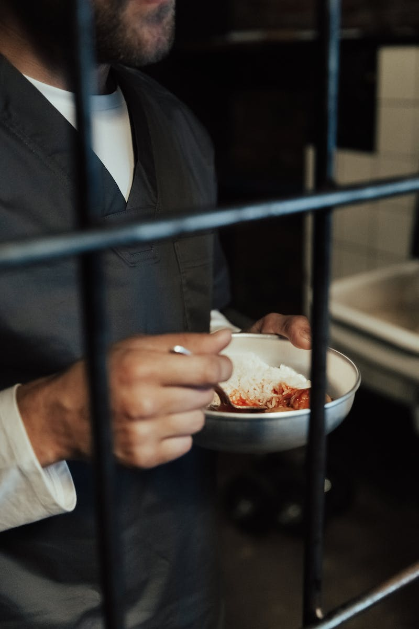
The Interface: Preparatory Phase
• Cell goes through G1, S, and G2 phases to grow and prepare for division
• Genetic material (DNA) is replicated during interphase
• Centrosome duplication is important for spindle fiber formation
Photo by Pexels

Slide 4
Meiosis I: Prophase I and Metaphase I
• Prophase I is the longest phase with sub-stages: leptotene, zygotene, pachytene, diplotene, and diakinesis
• Crossing over occurs during pachytene, resulting in genetic recombination
• Metaphase I sees alignment of homologous chromosome pairs on the equator

Slide 5
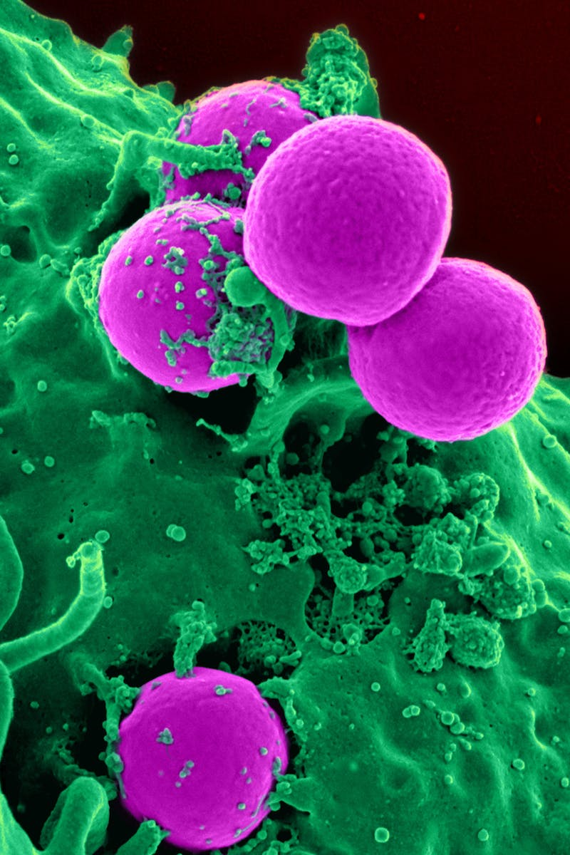
Meiosis I: Anaphase I and Telophase I
• Anaphase I separates homologous chromosome pairs
• Telophase I involves nuclear membrane formation and cytokinesis
• Two haploid cells are formed at the end of Meiosis I
Photo by Pexels

Slide 6
Meiosis II: Prophase II and Metaphase II
• Prophase II involves condensing of chromosomes and disappearance of nuclear membrane
• Metaphase II sees alignment of chromosomes on the equator again

Slide 7
Meiosis II: Anaphase II and Telophase II
• Anaphase II separates sister chromatids
• Telophase II involves nuclear membrane formation and cytokinesis
• Four haploid cells (gametes) are formed at the end of Meiosis II
Photo by Pexels

Slide 8
Mitosis vs Meiosis: Key Differences
• Mitosis results in two identical diploid cells
• Meiosis results in four genetically diverse haploid cells
• Meiosis involves genetic recombination through crossing over
Photo by Pexels

