Slide 1
Wednesday's World of Music
Discover the Dark Melodies of Wednesday

Slide 2
Wednesday's Favorite Color
• Is it black, red, or blue?
• Answer: Black
Photo by Pexels

Slide 3
Wednesday's Accomplice
• Who is Wednesday's accomplice?
• Answer: Hand
Photo by Pexels

Slide 4
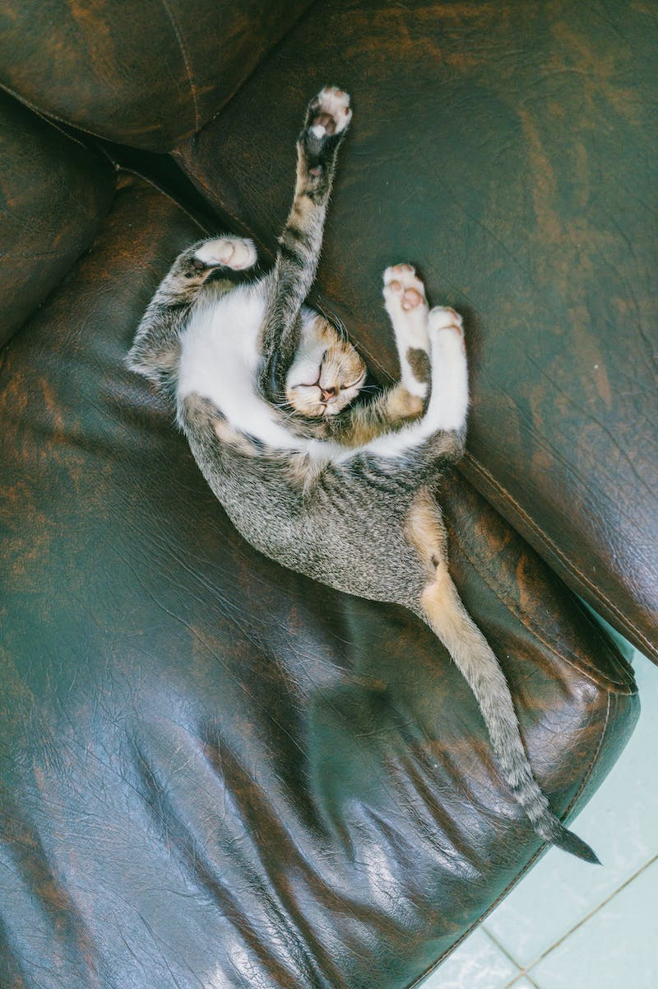
Wednesday's Allergy
• What was Wednesday allergic to?
• Answer: Cats
Photo by Pexels

Slide 5
Wednesday's Brother
• What is Wednesday's brother's name?
• Answer: Brandon
Photo by Pexels

Slide 6
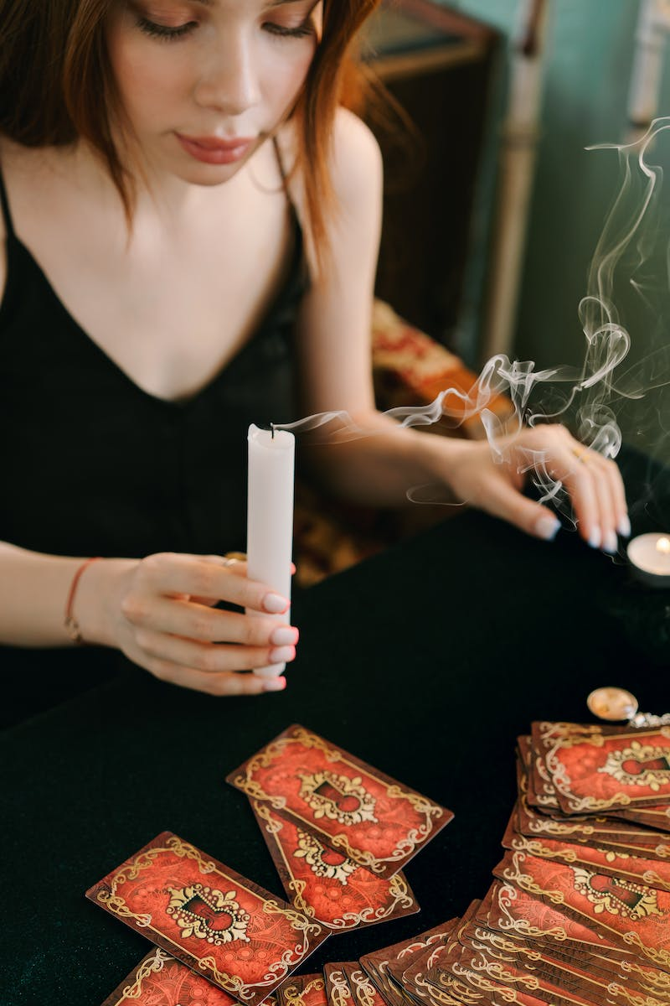
Wednesday's Powers
• What are Wednesday's powers?
• Answer: Psychic abilities
Photo by Pexels

Slide 7
Wednesday's Mother
• What is Wednesday's mother's name?
• Answer: Morticia
Photo by Pexels

Slide 8
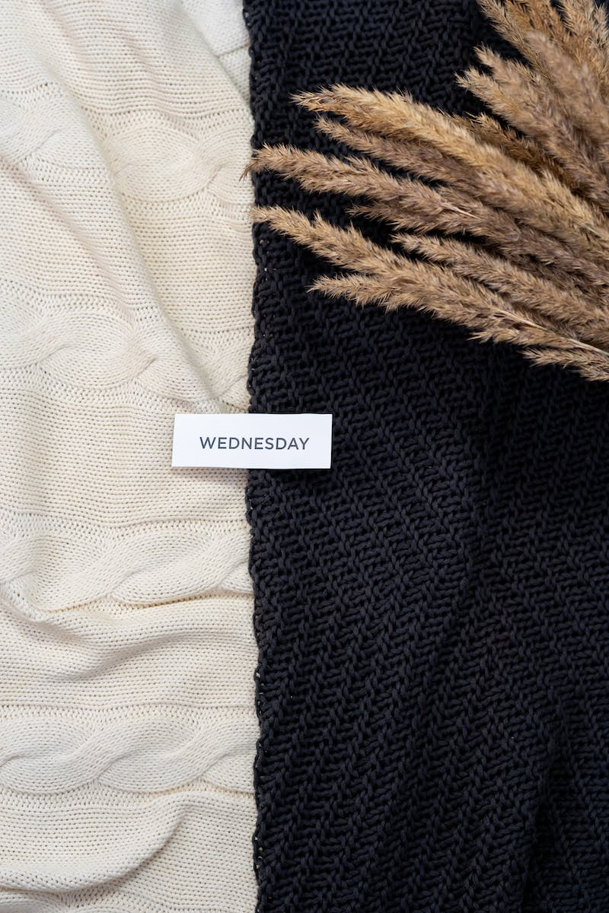
Enix's Best Friend
• Who was Enix's best friend?
• Answer: Wednesday
Photo by Pexels

Slide 9
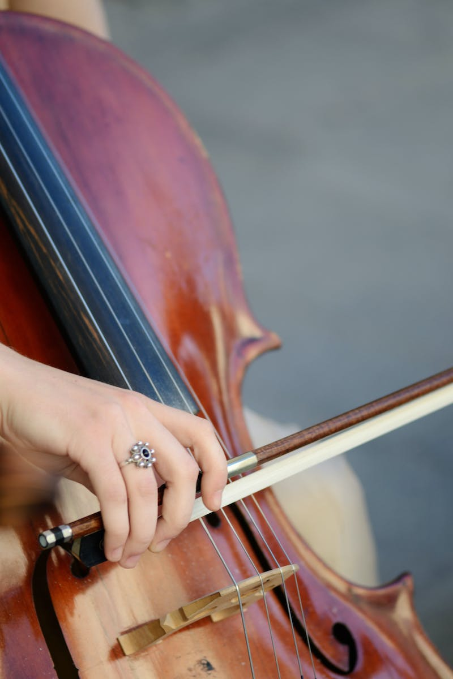
Wednesday's Musical Instrument
• Which music instrument did Wednesday play?
• Answer: Cello
Photo by Pexels

Slide 10
Wednesday's School
• What was the name of the school Wednesday attended?
• Answer: Nethermore Academic
Photo by Pexels

Slide 11
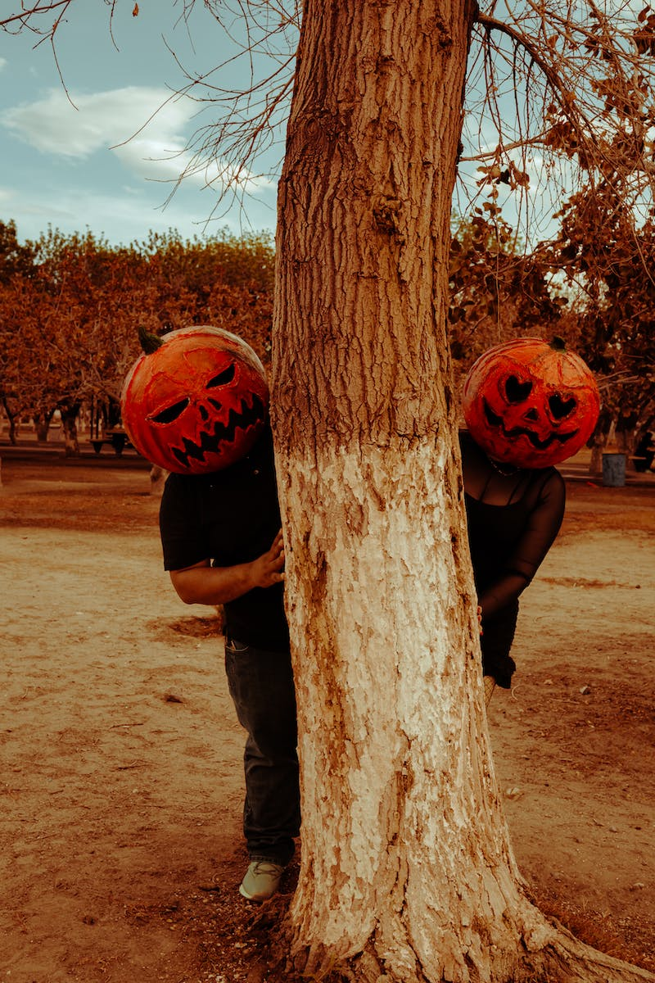
Wednesday's Family
• How many kids are in Wednesday's family?
• Answer: Two
Photo by Pexels

Slide 12
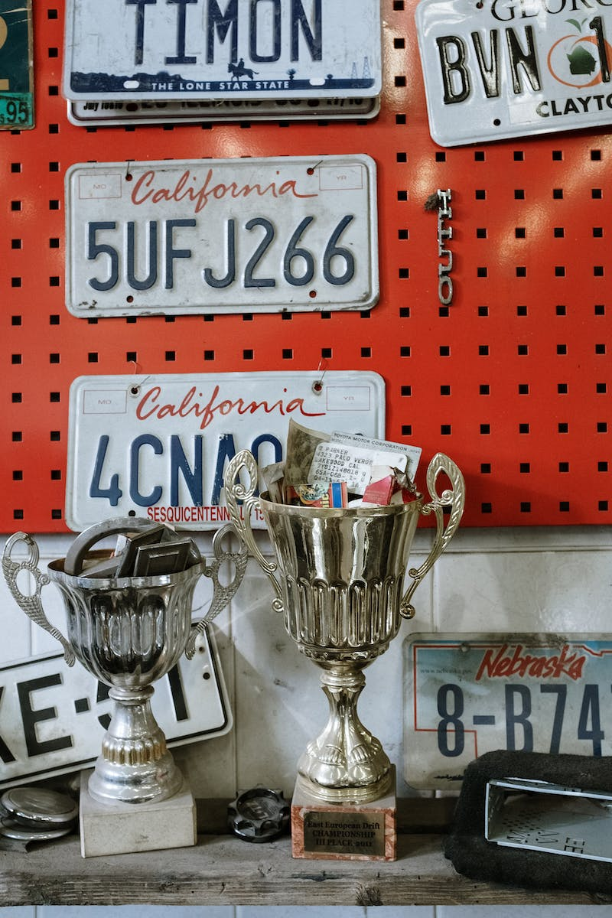
Winner Announcement
• And the winner is...
• Answer: Running
Photo by Pexels

