Slide 1
Exploring Animal Classification
Understanding the Different Groups of Animals

Slide 2
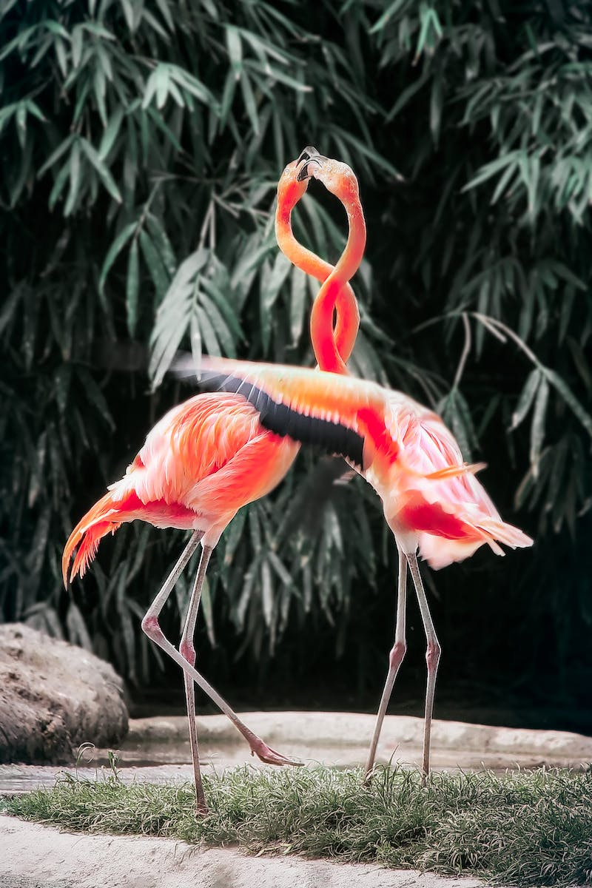
Introduction
• The world is filled with a diverse range of animals.
• Scientists classify animals into groups to understand their differences.
• The two largest groups are vertebrates and invertebrates.
• Vertebrates have a spine or backbone, while invertebrates do not.
Photo by Pexels

Slide 3
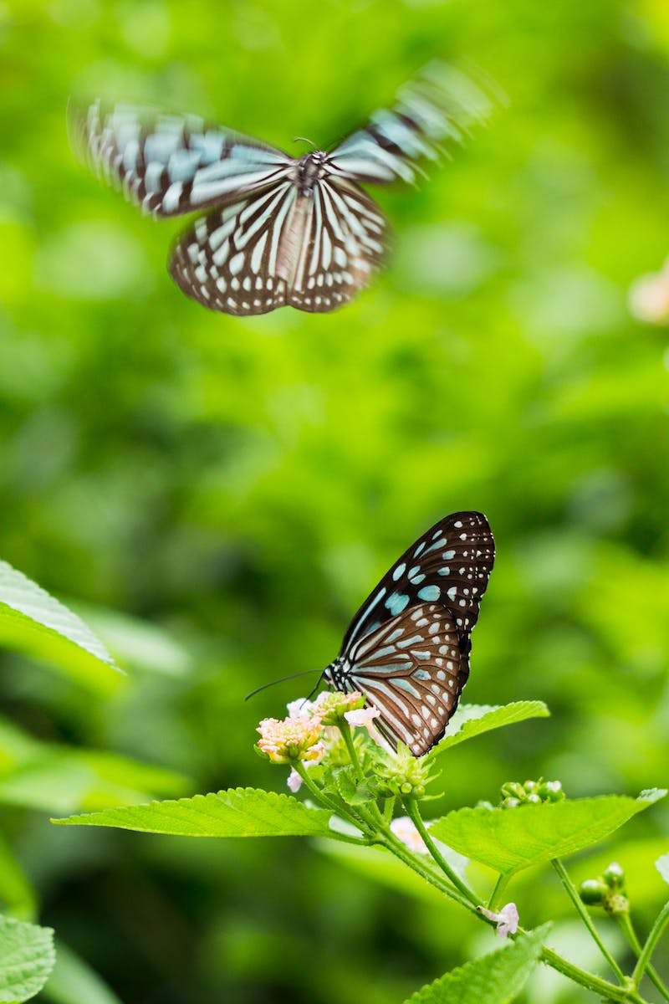
Invertebrates
• Invertebrates make up the majority of animal species.
• Examples of invertebrates include octopus, insects, starfish, jellyfish, and clams.
• In water, invertebrates can grow larger due to the support of water without a skeleton.
• On land, most invertebrates are small.
Photo by Pexels

Slide 4
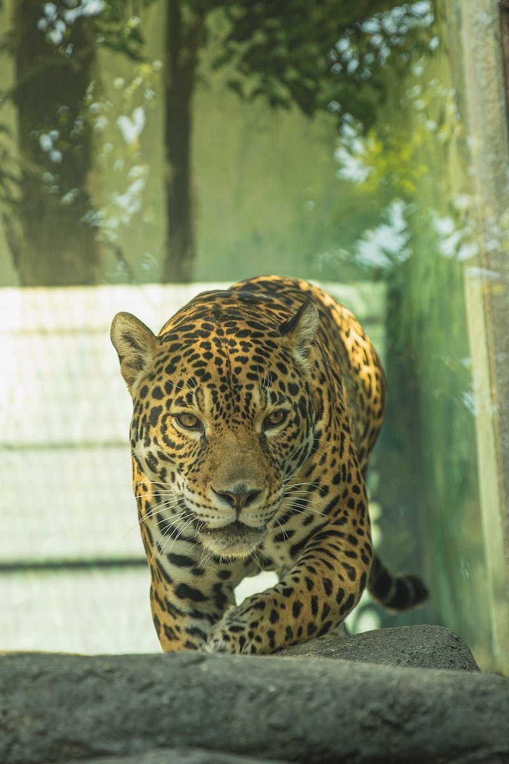
Vertebrates
• Vertebrates make up less than five percent of animal species.
• Vertebrates have a backbone and are divided into different classes.
• Some classes of vertebrates include fish, amphibians, reptiles, birds, and mammals.
• Fish, amphibians, and reptiles are cold-blooded.
Photo by Pexels

Slide 5
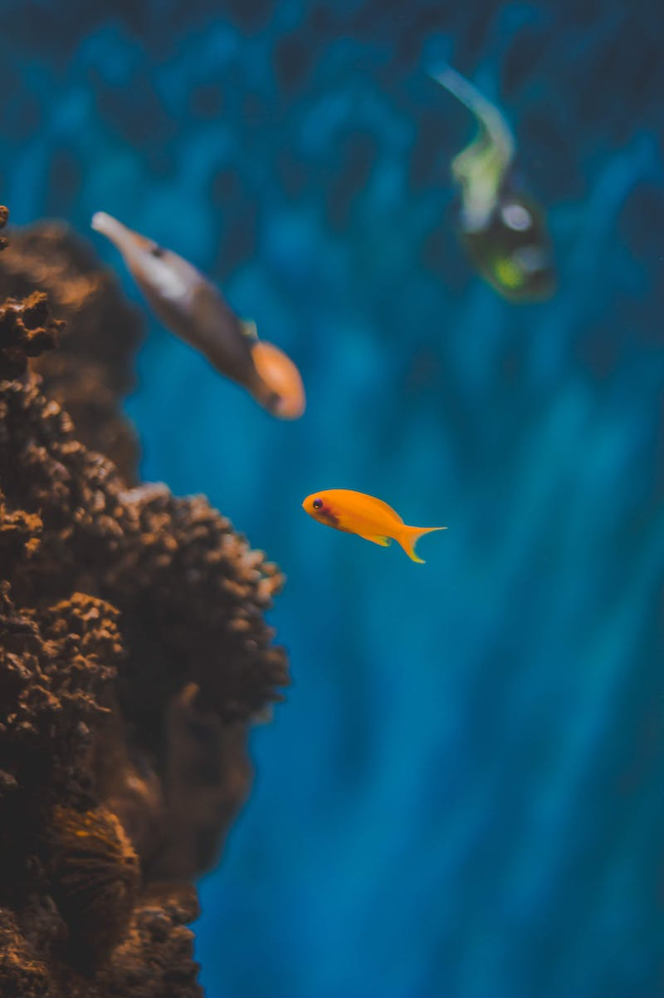
Fish
• Fish live in water and have gills to breathe underwater.
• They have scales, fins, and are cold-blooded.
• Most fish lay eggs as a method of reproduction.
• They cannot control their body temperature and rely on the environment.
Photo by Pexels

Slide 6
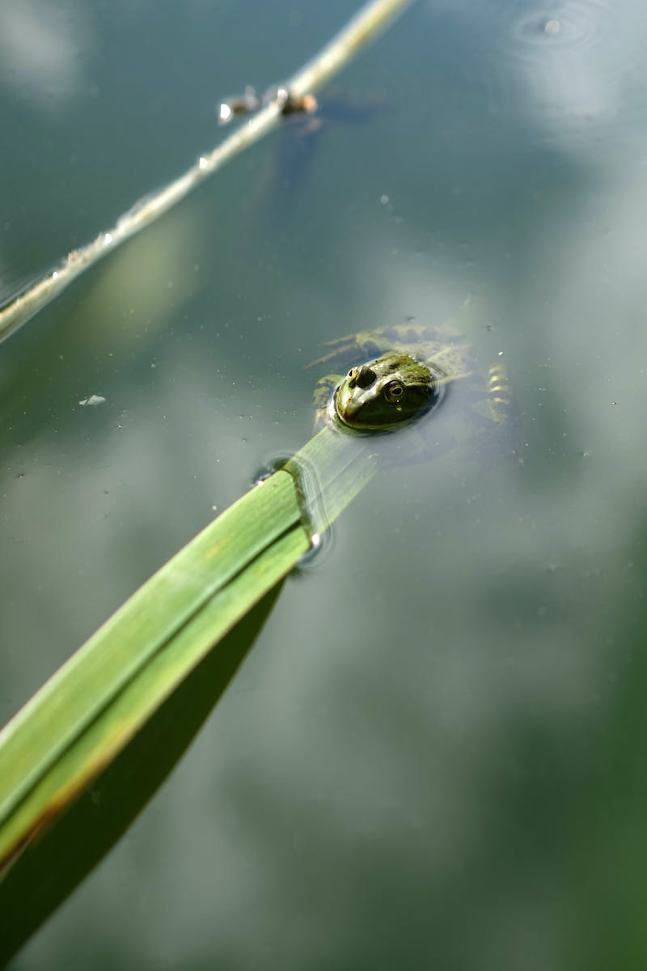
Amphibians
• Amphibians include frogs, toads, and salamanders.
• They are cold-blooded and can live on both land and in water.
• Amphibians have smooth, moist skin and lay jelly-covered eggs.
• They undergo metamorphosis to reach adulthood.
Photo by Pexels

Slide 7
Reptiles
• Reptiles include turtles, snakes, crocodiles, and lizards.
• Like fish and amphibians, reptiles are cold-blooded.
• They are air-breathing animals and cannot breathe underwater.
• Reptiles lay eggs with a protective shell, usually on land.
Photo by Pexels

Slide 8
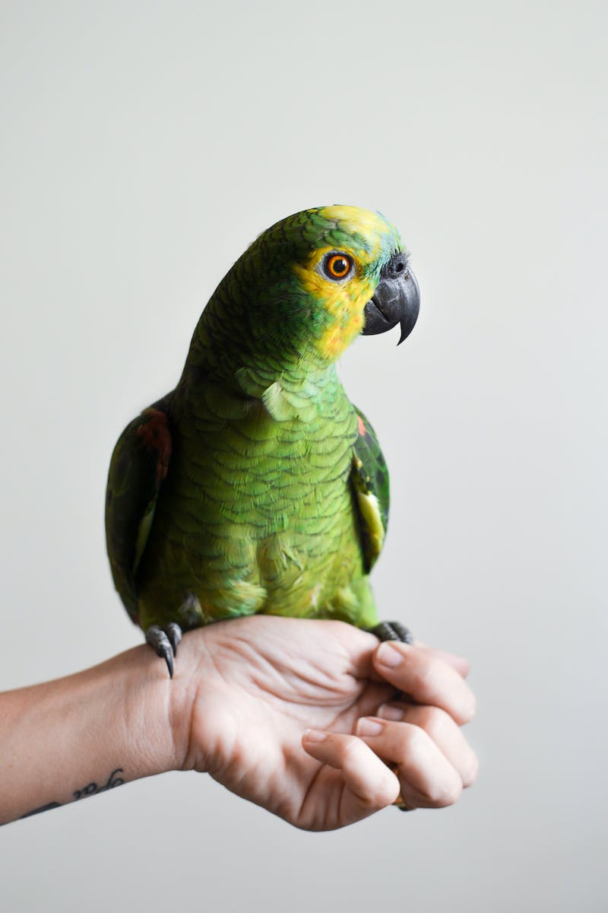
Birds
• Birds are the only animals with feathers.
• They breathe air and are warm-blooded.
• All birds have two legs and wings, but not all of them fly.
• Birds lay eggs with hard shells.
Photo by Pexels

Slide 9
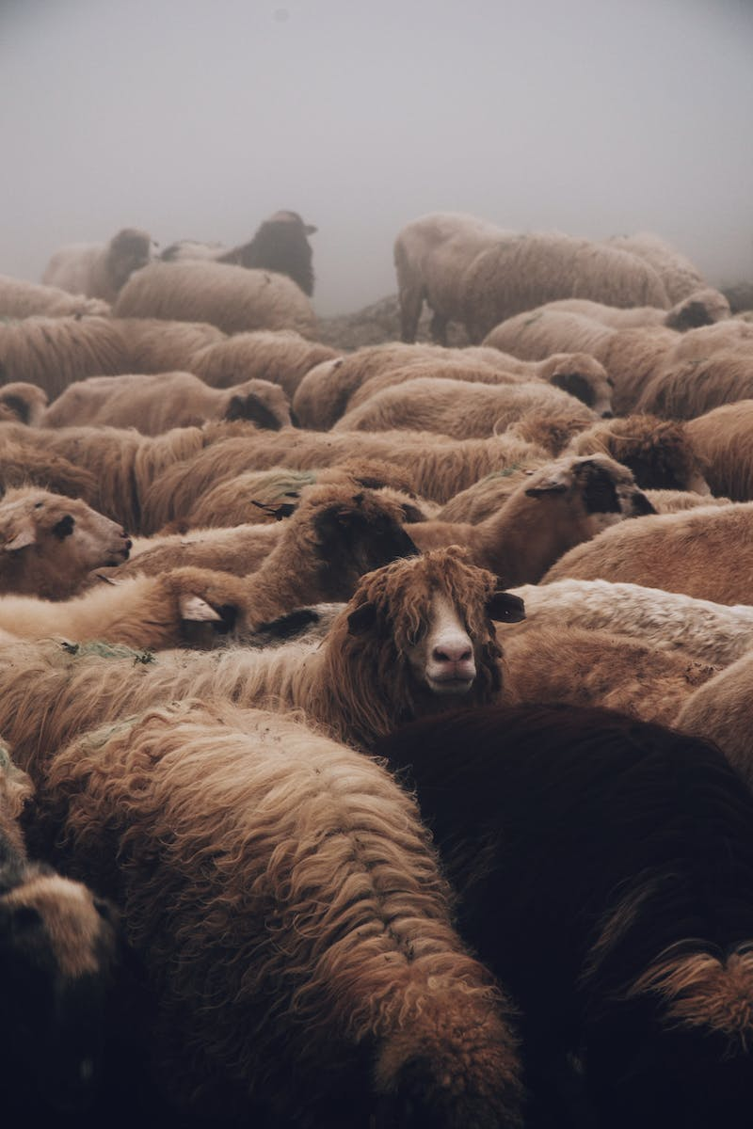
Mammals
• Mammals include humans and a wide range of other animals.
• They are warm-blooded and breathe air.
• Mammals have fur or hair and give birth to live young.
• All mammals feed their babies milk.
Photo by Pexels

Slide 10
Conclusion
• Animal classification helps us understand the world around us.
• Different groups provide insights into an animal's needs and behavior.
• Classification includes invertebrates, vertebrates, fish, amphibians, reptiles, birds, and mammals.
• We hope you enjoyed learning about animal classification today!
Photo by Pexels

