Slide 1
The Pioneer Movement in the USSR
A Brief History and Impact

Slide 2
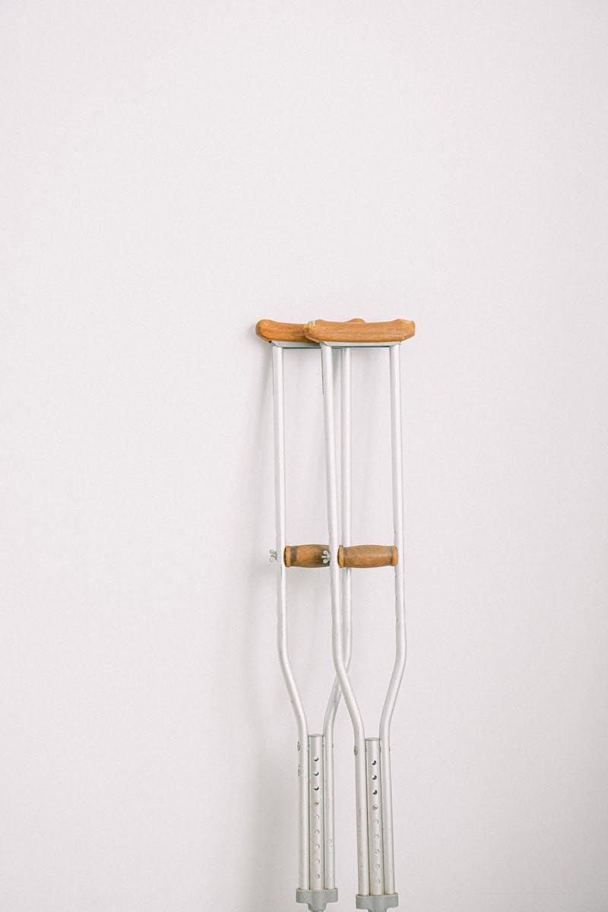
Introduction
• The pioneer movement in the USSR was a unique youth organization.
• It started as a structured club and grew into a nationwide organization.
• Pioneers had their own ideology, regulations, and symbols.
• The movement aimed to unite millions of teenagers and instill values of patriotism and social responsibility.
Photo by Pexels

Slide 3
Founding of the Pioneer Movement
• The pioneer movement was created in 1922 by the Russian Komsomol.
• Initially, the ruling elite viewed it negatively due to its association with scouting.
• However, it gained approval and recognition, and on May 19th, 1922, pioneer detachments were established throughout the Soviet Union.
• The term 'pioneer' translates to 'first explorer or trailblazer' in French.
Photo by Pexels

Slide 4
Activities and Achievements
• Pioneers participated in various activities and initiatives.
• They contributed to literacy campaigns, fought against child homelessness, and organized community service events.
• During World War II, pioneers supported the war effort and assisted in caring for wounded soldiers.
• Over 20,000 young pioneers received medals for their bravery and contributions to the defense of Moscow.
Photo by Pexels

Slide 5
Pioneer Organization and Numbers
• The All-Union Pioneer Organization united millions of children and adolescents.
• By 1970, it had over 23 million pioneers and more than 118,000 pioneer teams.
• Pioneers engaged in sports competitions, such as the 'Zarnitsa Games' and 'Mash Cup.'
• Outstanding pioneers received prestigious awards and recognition.
Photo by Pexels

Slide 6
Legacy and Transformation
• In the late 1980s, the pioneer organization abandoned its political orientation.
• The movement adopted a new slogan: 'For the Motherland, Good, and Justice.'
• The All-Union Pioneer Organization served as a powerful and formative experience for millions of young people for several decades.
Photo by Pexels

