Slide 1
The Future of Transportation: Unlocking the Potential of Rocket-Boosted Bikes
Revolutionizing Commuting and Adventure

Slide 2
Introduction
• Combining the power of rockets and bikes
• Efficient and eco-friendly transportation
• Exploring new frontiers of speed and adventure
• A glimpse into the future of commuting
Photo by Pexels

Slide 3
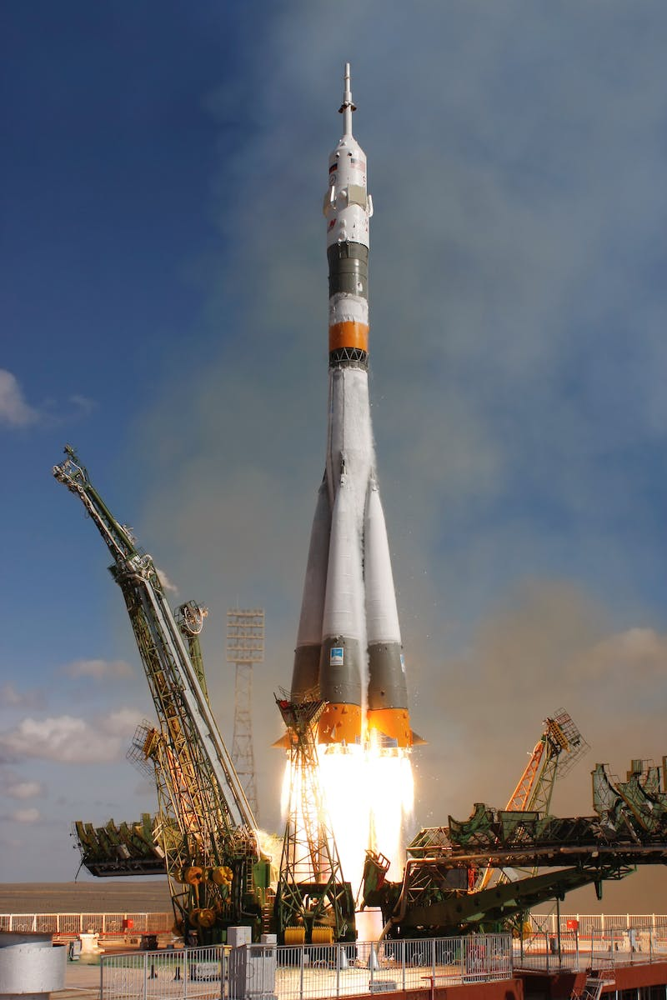
The 10% Connection
• Unleashing the power of speed
• Achieving up to 10 times the speed of traditional bikes
• Revolutionizing the concept of short-distance commuting
• Reducing travel time and increasing productivity
Photo by Pexels

Slide 4
Bike Shitting Rocket
• Effortless acceleration and propulsion
• Seamless integration of rocket technology
• Enhancing rider experience and safety
• Maximizing energy efficiency
Photo by Pexels

Slide 5
Wishing for a Boost
• Powerful boost at the rider's command
• Overcoming difficult terrains effortlessly
• Enhancing biking capabilities and exploring new routes
• Unlocking greater possibilities for adventure
Photo by Pexels

Slide 6
Sword of the Future
• Cutting through traffic congestion
• Redesigning urban transportation
• Improving efficiency and reducing carbon footprint
• Building a sustainable city ecosystem
Photo by Pexels

Slide 7
Final Thoughts
• Unleashing the full potential of rocket-boosted bikes
• Changing the way we commute and explore
• Embracing a future of speed, adventure, and sustainability
• Redefining transportation norms
Photo by Pexels

