Slide 1
Introduction to Computer Systems
Understanding the Components and Functions

Slide 2
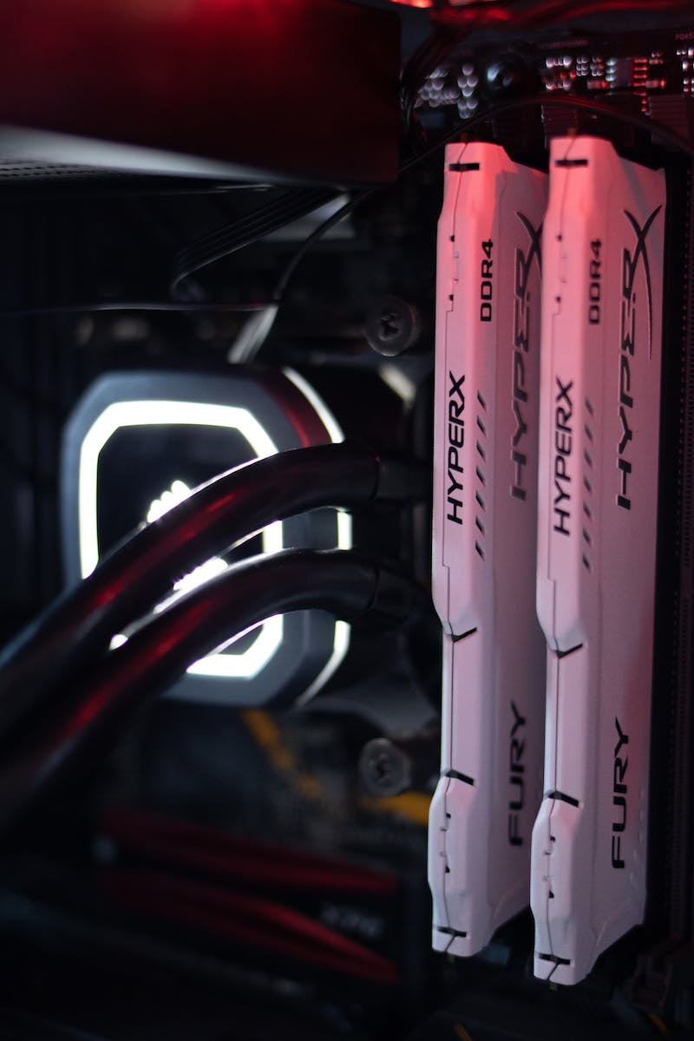
Header and Software
• Merakit komputer
• Menginstal software
• Memahami konsep dual boot
• Menangani masalah umum pada komputer
Photo by Pexels

Slide 3
Computer System Components
• Perangkat keras (hardware)
• Perangkat lunak (software)
• Brainware (pengguna komputer)
Photo by Pexels

Slide 4
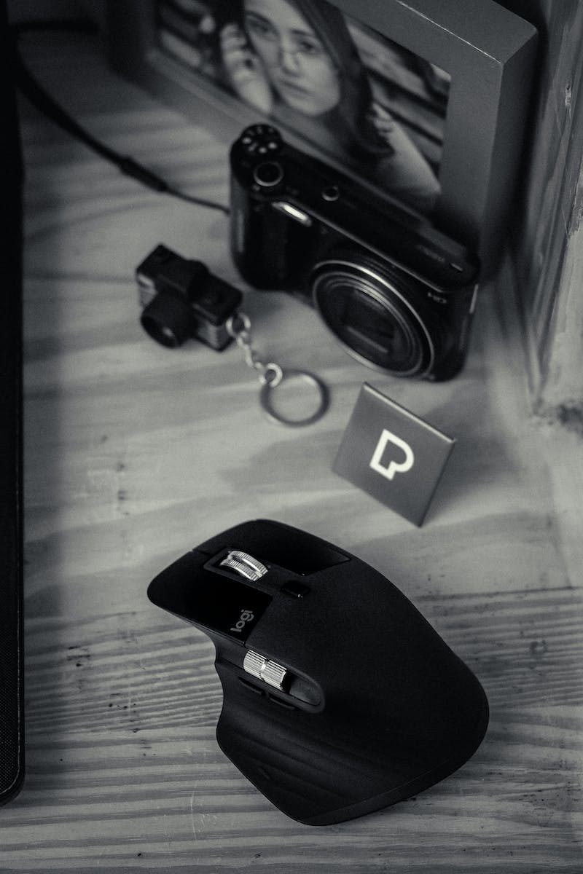
Hardware Components
• Header
• Alat input: keyboard, mouse, microphone, scanner
• Alat proses: prosesor, motherboard, interface
• Alat output: printer, monitor, speaker
• Alat input dan output: harddisk, flash disk, CD/DVD, disket
Photo by Pexels

Slide 5
Software Components
• Sistem operasi: Windows, Linux
• Aplikasi: word processor, spreadsheet software, image editing software, web browser
• Bahasa pemrograman: Java, C++, Python
Photo by Pexels

Slide 6
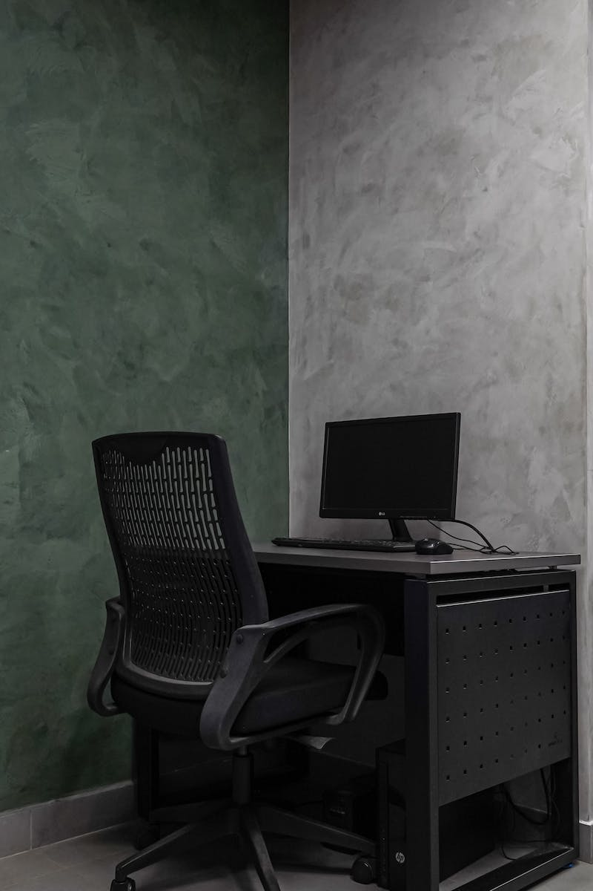
Brainware: Computer Users
• Operator
• Programmer
• Komputer engineer
• Sistem analyst
Photo by Pexels

Slide 7
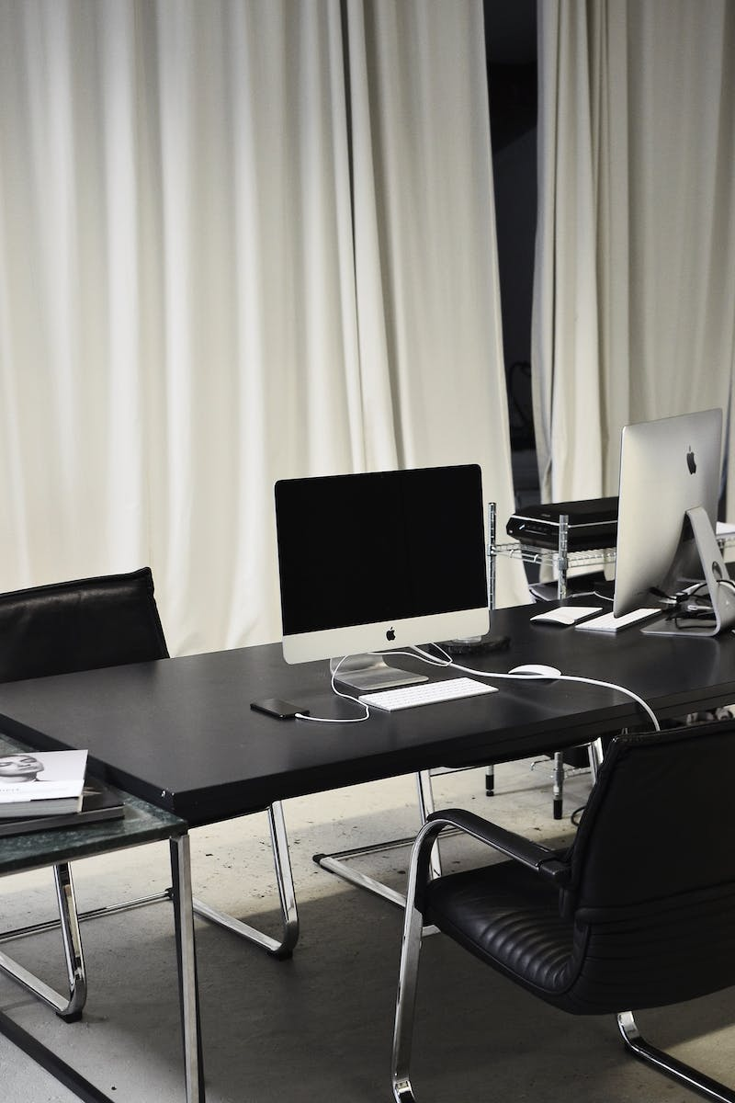
Conclusion
• Hardware, software, and brainware are interconnected and essential components of a computer system.
• Without software, hardware is non-functional.
• Without brainware, both hardware and software are useless.
• Understanding and utilizing all three components is crucial for effective computer usage.
Photo by Pexels

