Slide 1
The Israeli-Palestinian Conflict: A Struggle for Justice and Peace
Understanding the Historical Context and Seeking a Sustainable Solution

Slide 2
Introduction
• Exploring the moral quandary of building a refuge for persecuted people amid an existing population
• The Israeli-Palestinian conflict as a result of this complex situation
• A call for achieving a just peace for everyone in the region
• Understanding the key factors at play
Photo by Pexels

Slide 3
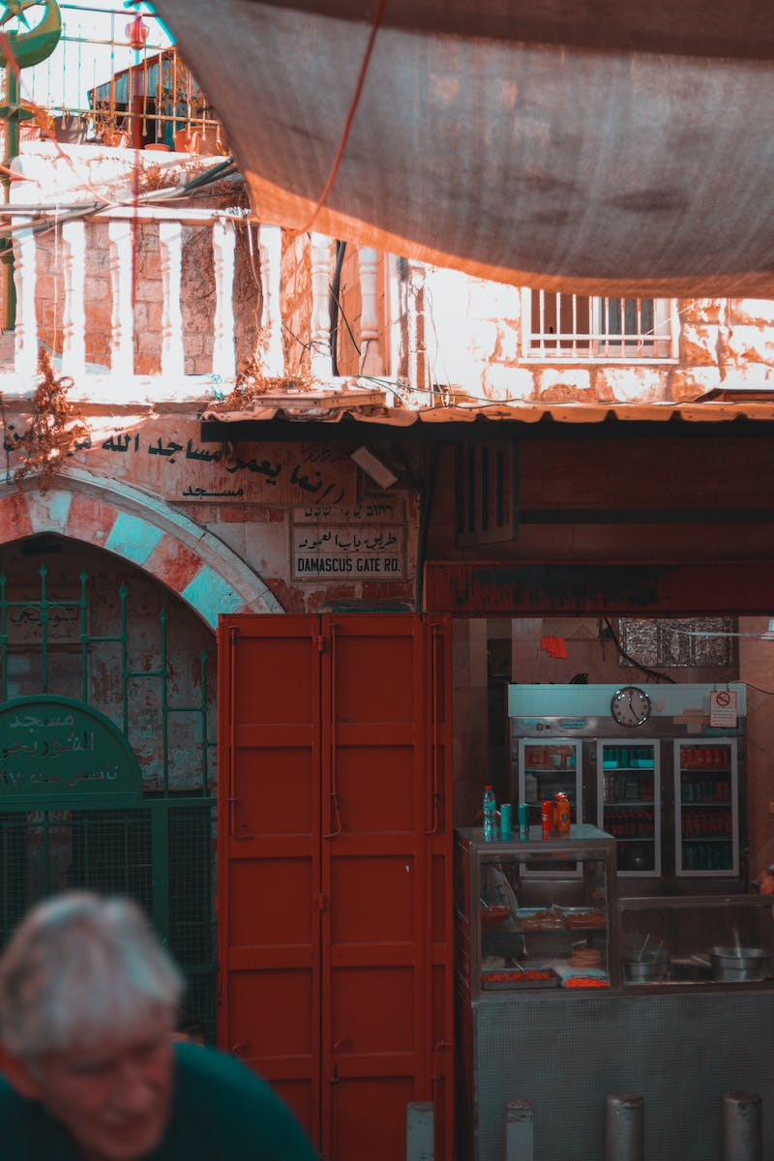
Historical Background
• Jewish immigration to historic Palestine in response to anti-Semitic persecution in Europe
• The UN's partition plan and the creation of the state of Israel
• The displacement and expulsion of Palestinians
• Creation of Palestinian refugees
Photo by Pexels

Slide 4
Institutional Discrimination
• Israel as a Jewish state and its implications
• Inequality and exclusion faced by non-Jewish citizens
• Land and resource disparities
• Israeli settlements in the West Bank
Photo by Pexels

Slide 5
Occupation and Oppression
• Israeli control and repression in occupied territories
• Separate legal systems for Jewish settlers and Palestinians
• Disproportionate access to resources
• The impact of military actions on Palestinians
Photo by Pexels

Slide 6
Peace Talks: Illusion or Solution?
• Decades of U.S.-backed peace talks
• Failure to halt Israel's expansion and settlement activities
• Criticism of peace talks as cover for land grab
• The need for genuine negotiations
Photo by Pexels

Slide 7
The Power of People
• The role of grassroots movements
• International pressure through activism and non-violent means
• Support for Palestinian rights and freedoms
• Working towards equality, human rights, and democracy
Photo by Pexels

Slide 8
Conclusion
• Summary of the Israeli-Palestinian conflict's roots and consequences
• The need to end the occupation and discrimination
• A call for a peaceful and secure future for both Israelis and Palestinians
• The possibility of changing history through collective action
Photo by Pexels

