Slide 1
The Power of Persistence: Achieving Your Dreams
Taking action, finding joy, and defining success on your own terms

Slide 2
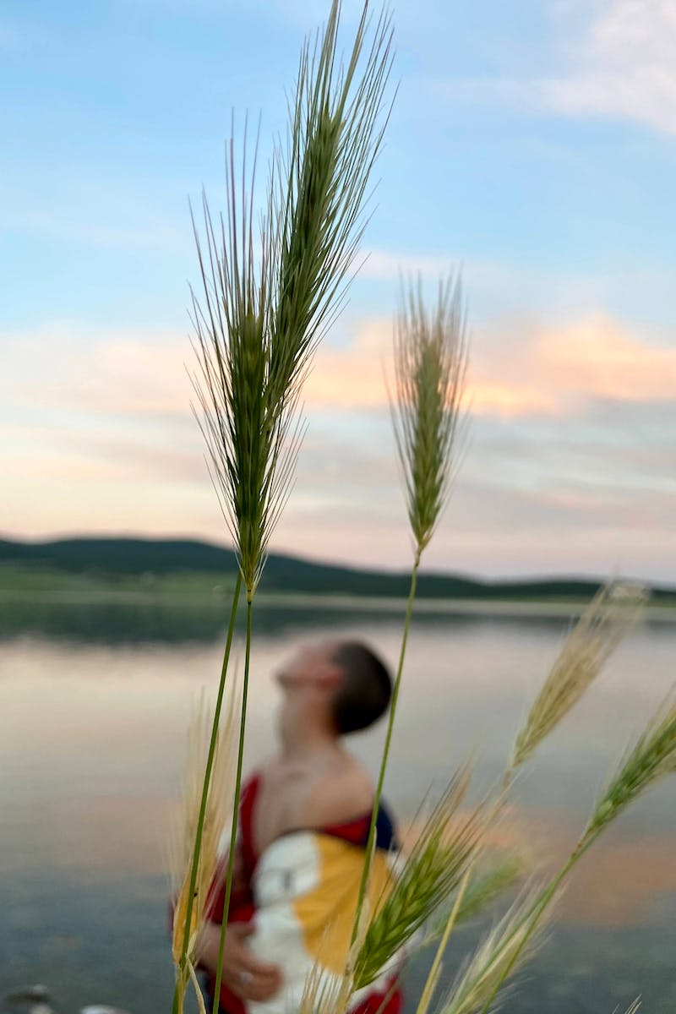
Introduction
• You can fail at what you don't want, so take a chance on doing what you love
• Without commitment, you'll never start; without consistency, you'll never finish
• 99% of people are not willing to do what it takes to make their dreams come true
Photo by Pexels

Slide 3
Overcoming Challenges and Defying Limitations
• When others say 'it can't be done', hear 'it can be done'
• When others say 'no', hear 'yes'
• When others say 'it's impossible', hear 'it is possible'
Photo by Pexels

Slide 4
Intentionality and Drive
• Have a clear sense of intentionality and real drive and purpose
• Define your daily actions, words, and mindset towards your legacy
• Be a greater threat to progress than hardship
Photo by Pexels

Slide 5
Finding Purpose and Meaning
• Having a problem worth solving gives a reason to get out of bed
• Struggles and hard work bring great rewards
• Execution is a fact, not just a feeling
Photo by Pexels

Slide 6
Self-Reflection and Growth
• Learn from failures and reflect on your own mistakes
• Define yourself by lessons learned, not by failures
• Tragedy can be a source of growth and appreciation
Photo by Pexels

Slide 7
Action and Consistency
• Take action and avoid procrastination
• Maintain a balance between action and thinking
• Consistency and perseverance lead to success
Photo by Pexels

Slide 8
Happiness vs. Joy
• Happiness is result-dependent, joy is a constant
• Joy comes from doing what we are meant to do
• Define yourself by what you are not to discover who you are
Photo by Pexels

Slide 9
Defining Success and Prioritizing Yourself
• Define your own definition of success
• Prioritize your own well-being and character
• Don't spend time with anything that goes against who you want to be
Photo by Pexels

Slide 10
The Power of Hard Work and Dedication
• Hard work brings great rewards
• Be relentless in the pursuit of your goals
• Put in the work, dream about it, visualize success
Photo by Pexels

Slide 11
Conclusion
• Live life to the best of your ability
• Continuously evolve and adapt
• Leave a positive impact in the world
Photo by Pexels

