Slide 1
The Impact of Millimeter Wave Technology
Revolutionizing Connectivity and Communication

Slide 2
Introduction to Millimeter Wave Technology
• Millimeter wave refers to the electromagnetic spectrum between 30 GHz and 300 GHz.
• It offers higher bandwidth and faster data transfer rates compared to traditional wireless technologies.
• Applications include 5G wireless communication, autonomous vehicles, and high-speed internet access.
• Challenges such as signal attenuation and limited range have been overcome through advancements in antenna and signal processing technologies.
Photo by Pexels

Slide 3
Benefits of Millimeter Wave Technology
• Significantly higher data transfer speeds enable real-time streaming, seamless VR experiences, and rapid file downloads.
• Lower latency ensures instant response times, crucial for applications like online gaming and telemedicine.
• More efficient use of the spectrum allows for better network capacity and reduced congestion.
• Massive MIMO (Multiple Input Multiple Output) technology enables simultaneous transmission and reception of multiple data streams, increasing network efficiency.
Photo by Pexels

Slide 4
Potentials and Applications
• 5G networks powered by millimeter wave technology will transform industries like healthcare, transportation, and entertainment.
• Medical professionals can remotely perform surgeries with minimal latency, saving lives in emergency situations.
• Autonomous vehicles will rely on millimeter wave communication for real-time data exchange, enhancing safety and efficiency.
• Interactive virtual reality experiences will become mainstream, revolutionizing entertainment and gaming.
Photo by Pexels

Slide 5
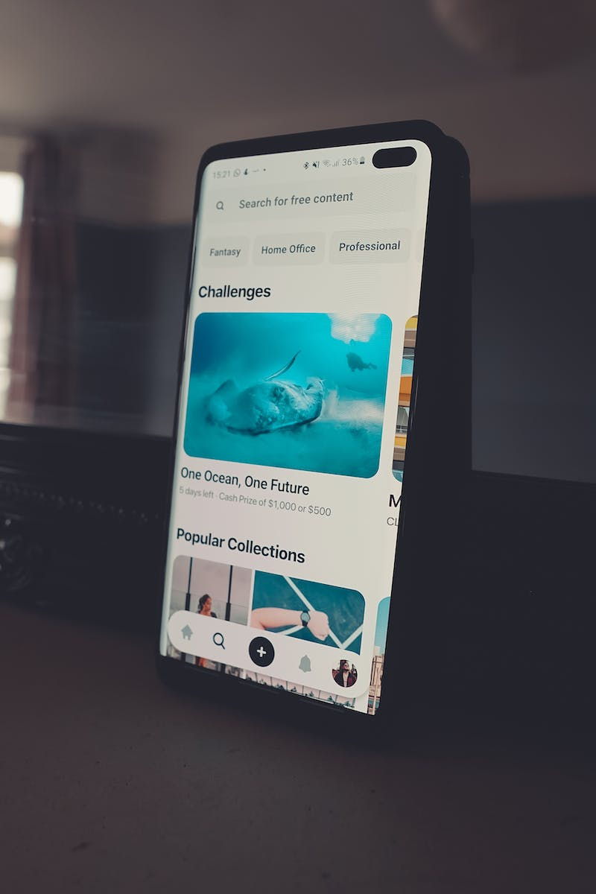
Implementation Challenges
• Millimeter wave signals are more susceptible to interference from obstacles like buildings and trees.
• High-frequency signals have limited range and require more base stations for coverage.
• Reflection and scattering pose challenges in maintaining reliable connectivity in urban environments.
• Weather conditions, especially rain and fog, can attenuate millimeter wave signals.
Photo by Pexels

Slide 6
Future Developments and Research
• Ongoing research focuses on improving signal propagation, coverage, and range through advanced antenna designs.
• Beamforming and beamtracking techniques help overcome signal blockage and maintain connectivity.
• Integration with existing wireless technologies like Wi-Fi and cellular networks enhances seamless handovers and interoperability.
• Regulatory frameworks need to be established to ensure effective utilization of millimeter wave spectrum.
Photo by Pexels

Slide 7
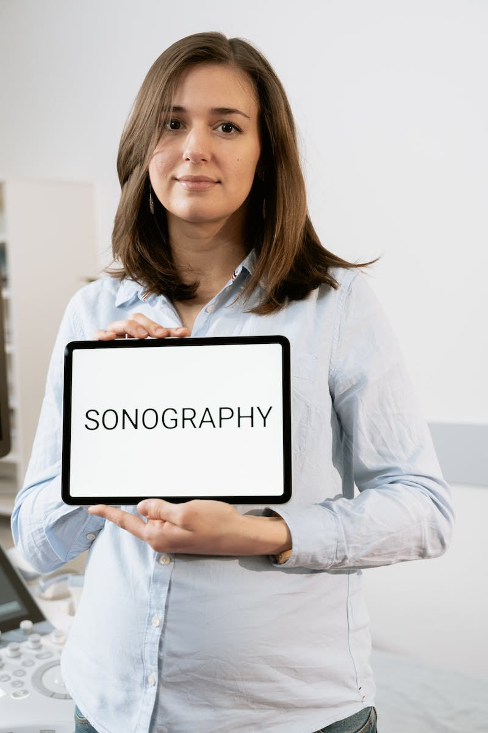
Conclusion
• Millimeter wave technology holds immense potential for transforming connectivity and communication.
• Its high-speed data transfer, low latency, and capacity benefits will revolutionize various industries.
• Challenges related to implementation and signal propagation are being actively addressed through research and development.
• With continued advancements, millimeter wave technology will redefine the way we connect and communicate.
Photo by Pexels

