Slide 1
The Counselor as a Therapeutic Person
Exploring the Personal Characteristics of Effective Counselors

Slide 2
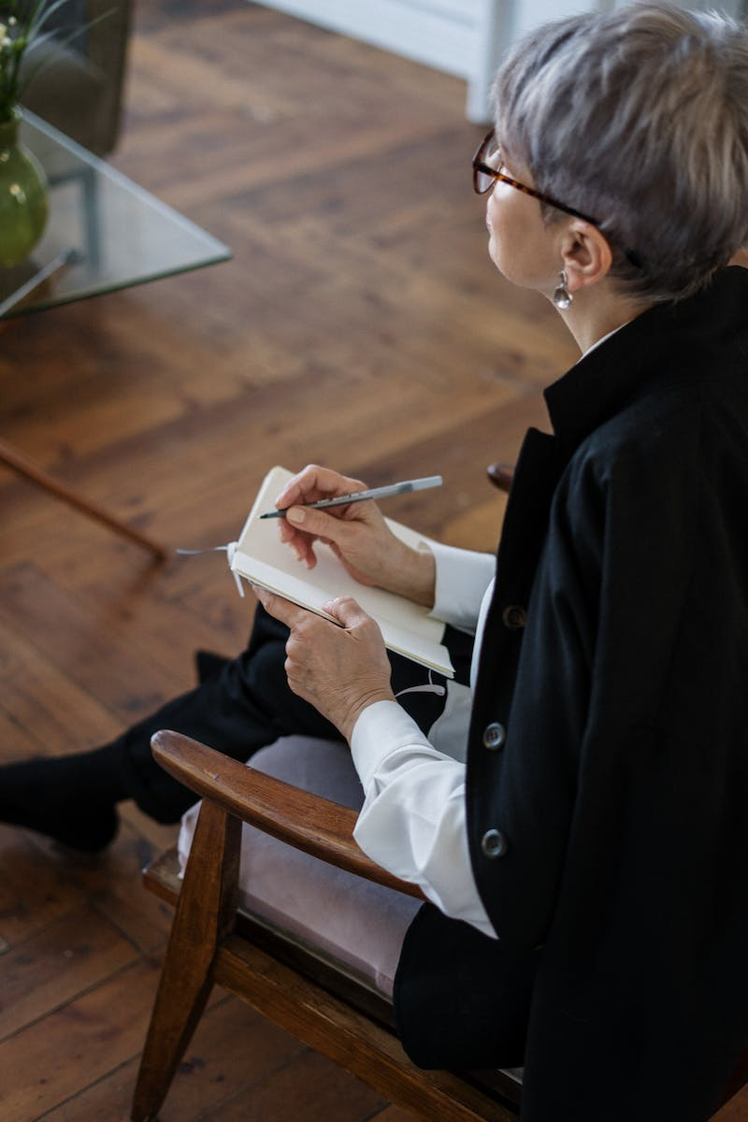
Introduction: The Counselor's Role
• Being an effective helper is essential in counseling
• The counselor as a therapeutic person, not just a trained professional
• The importance of personal components in the client-counselor relationship
• Authenticity, wholesomeness, and the intertwining of the personal and professional
Photo by Pexels

Slide 3
Key Personal Characteristics
• Have a clear identity and strong sense of self
• Be open to change and model it to clients
• Make life-oriented choices instead of settling for less
• Be authentic, sincere, and honest with clients
• Maintain a sense of humor while dealing with challenging topics
• Admit and learn from mistakes to promote growth
• Appreciate and adapt to different cultural influences
• Have a genuine interest in the welfare of others
Photo by Pexels
• Possess effective interpersonal skills for effective communication
• Find meaning and purpose in your work while maintaining healthy boundaries

