Slide 1
The Elements of Visual Arts: Part 2
Exploring Space, Texture, Color, and Value

Slide 2
Introduction to Space
• Space is where the artwork is organized
• Two types of space: positive and negative space, and three-dimensional space
• Positive space is the main focus, while negative space surrounds and separates the subject
• Three-dimensional space indicates the length, height, and depth of an artwork
Photo by Pexels

Slide 3
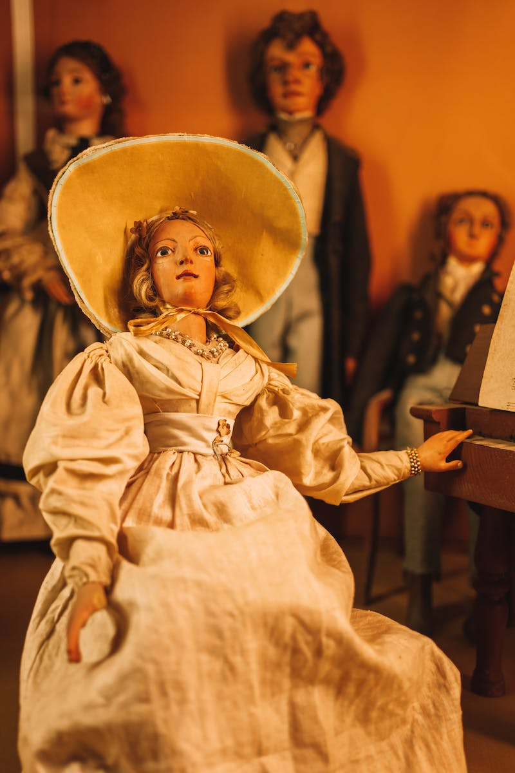
Special Indicators in Space
• Size: the relative scale of objects within the artwork
• Position: the location of objects within the plane of the artwork
• Transparency: the clarity of objects in the image
• Fractional representation: showing parts of an object in the artwork
• Sharp and diminishing detail: level of detail based on proximity to the foreground
• Converging parallels: lines that guide the viewer's focus to the focal point
• Linear perspective: a technique for creating depth in a flat surface
Photo by Pexels

Slide 4
Types of Linear Perspective
• One-point perspective: a single vanishing point on the horizon
• Two-point perspective: two vanishing points on the horizon
• Three-point perspective: three vanishing points on the horizon
Photo by Pexels

Slide 5
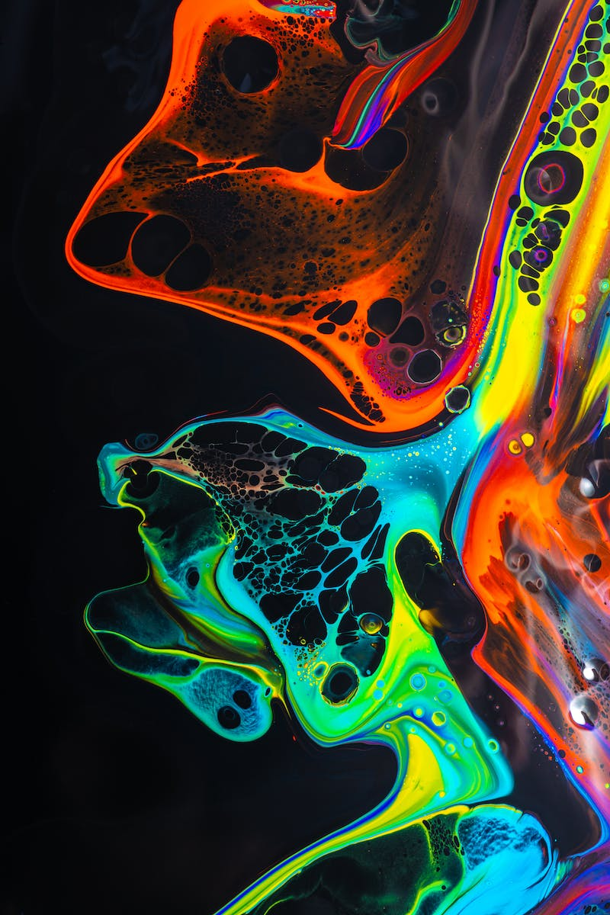
Understanding Texture
• Texture is the look or feel of a surface
• Experienced optically through sight and physically through touch
• Actual texture: physical texture in the artwork (e.g. Alfonso So's textured artwork)
• Simulated texture: optical texture that tricks the eye into perceiving texture (e.g. hyper-realistic paintings)
• Invented texture: texture created from the artist's imagination (e.g. glitch art)
Photo by Pexels

Slide 6
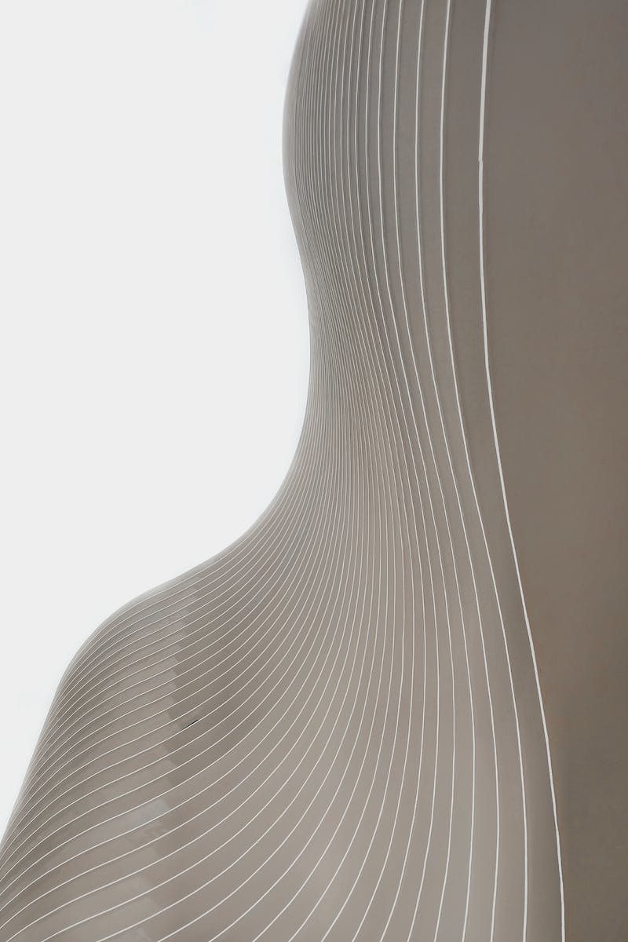
Understanding Color
• Colors are light waves absorbed or reflected
• Color has three qualities: hue, value, and saturation
• Color wheel: primary, secondary, and tertiary colors
• Warm colors: advancing and stimulating; cool colors: receding and relaxing
• Color harmonies: complementary, analogous, and triadic
Photo by Pexels

Slide 7
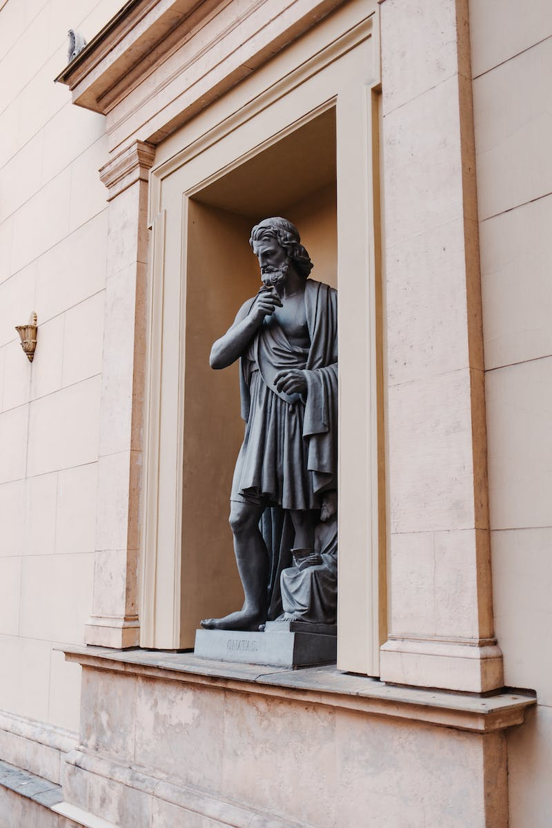
Revealing Colors in Ancient Greek Sculptures
• Research shows that ancient Greek sculptures were originally painted
• X-ray scans and advanced technology reveal the use of bright colors
• Examples of colored Greek sculptures and their discoveries
Photo by Pexels

Slide 8
Exploring Value
• Value is the lightness to darkness of a color
• Differentiating shades, tints, and tones
• Value scale: highlights, midtones, and shadows
• Low contrast vs high contrast
Photo by Pexels

Slide 9
Conclusion: Recap of the Elements of Visual Arts
• Recap of the elements discussed: space, texture, color, and value
• Highlighting the key points of each element
• Emphasizing the interconnectedness and significance of these elements in creating visual art
Photo by Pexels

