Slide 1
The Tale of Ti the Fish
A Journey of Imagination and Adventure

Slide 2
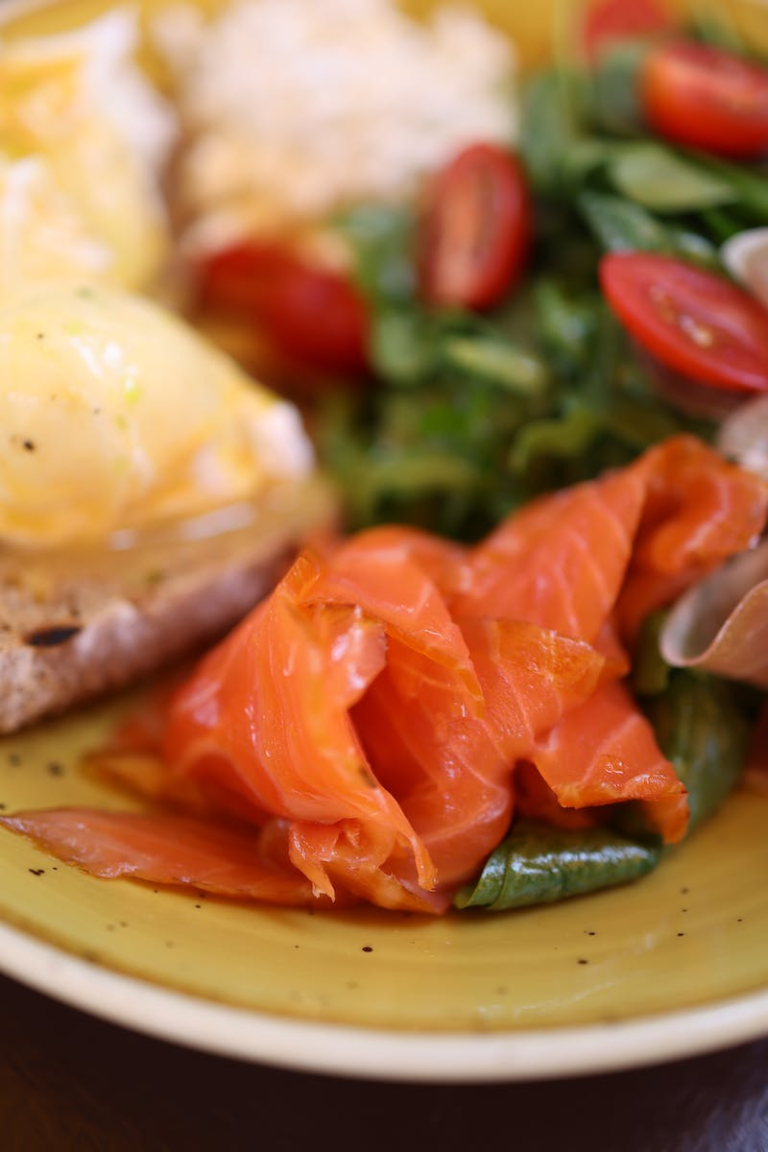
Introducing Ti: A Fish with a Big Imagination
• Ti is a fish with plain grey scales
• He blows small bubbles and tells tales
• Every day, Ti shares a different story
• His friends don't always believe him
Photo by Pexels

Slide 3
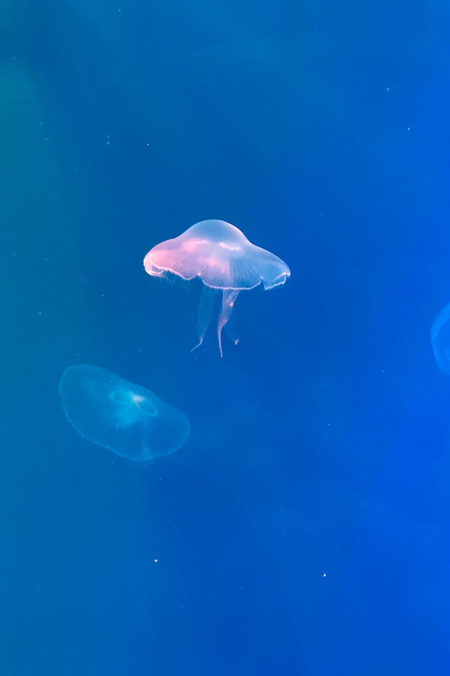
Ti's Excuses for Being Late
• Ti was late for school on Monday
• Blamed it on riding a sea horse
• Ti was late on Tuesday too
• Claimed he was captured by a squid
Photo by Pexels

Slide 4
Ti's Stories Become Popular
• Little Johnny Do loves Ti's stories
• Shares them with his granny and others
• Ti's stories spread across the ocean
• Becoming more popular with each telling
Photo by Pexels

Slide 5
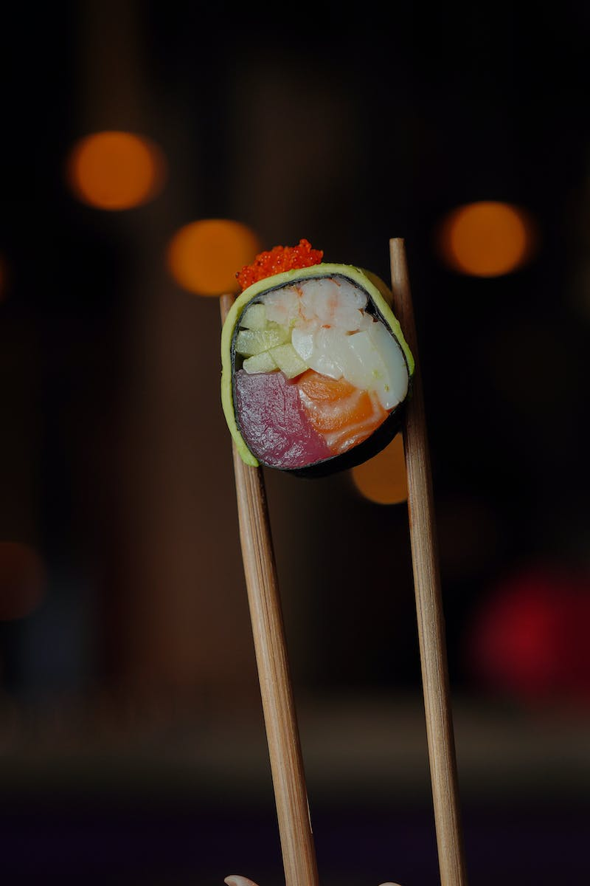
Ti Goes Missing
• Ti doesn't show up for school
• His friends worry and search for him
• Ti is lost in the middle of the ocean
• Unknown to anyone, he is in danger
Photo by Pexels

Slide 6
Ti Finds His Way Home
• Ti listens to a story in the ocean
• Recognizes the story and gets led home
• Ti returns to school late but safe
• His friends are relieved to see him
Photo by Pexels

