Slide 1
The Power of Podcasting
Harnessing the Potential of Audio Content

Slide 2
Introduction to Podcasting
• Podcasting has become a popular medium for sharing information and entertainment.
• It offers a unique way to engage with audiences and build a loyal following.
• Podcasts can cover a wide range of topics, from education to storytelling.
• Listeners can easily access podcasts from various devices and platforms.
• Audio content allows for multitasking, enabling listeners to consume information while performing other tasks.
Photo by Pexels

Slide 3
Benefits of Podcasting
• Podcasts can reach a global audience, breaking geographical barriers.
• They provide an intimate and immersive experience for listeners.
• Podcasting offers a platform for underrepresented voices and marginalized communities.
• Listeners can engage with podcasts at their convenience, without the pressure of real-time consumption.
• Podcasts can be a lucrative venture, attracting sponsorships and monetization opportunities.
Photo by Pexels

Slide 4
The Avi Podcast Machine
• The Avi Podcast Machine is a cutting-edge tool for podcast production.
• It simplifies the recording, editing, and distribution process.
• The Avi Podcast Machine offers a user-friendly interface and intuitive features.
• Users can choose from a variety of audio effects and enhancements.
• Podcasters can easily schedule episodes and manage their podcast library.
Photo by Pexels

Slide 5
Maximizing Podcast Engagement
• Engaging titles and compelling cover art attract potential listeners.
• Consistency in episode release schedule keeps the audience hooked.
• Promoting episodes on social media and relevant platforms increases visibility.
• Encouraging audience interaction through comments and reviews fosters a sense of community.
• Collaborating with influencers and experts expands the podcast's reach.
Photo by Pexels

Slide 6
Future Trends in Podcasting
• The podcast industry is projected to continue growing rapidly in the coming years.
• Interactive podcast experiences, with live chats and audience participation, are gaining popularity.
• Personalized podcast recommendations based on listener preferences are becoming more advanced.
• Transcript availability and language translation are improving accessibility for diverse audiences.
• Advertisers are increasingly investing in podcast sponsorships and targeted ad placements.
Photo by Pexels

Slide 7
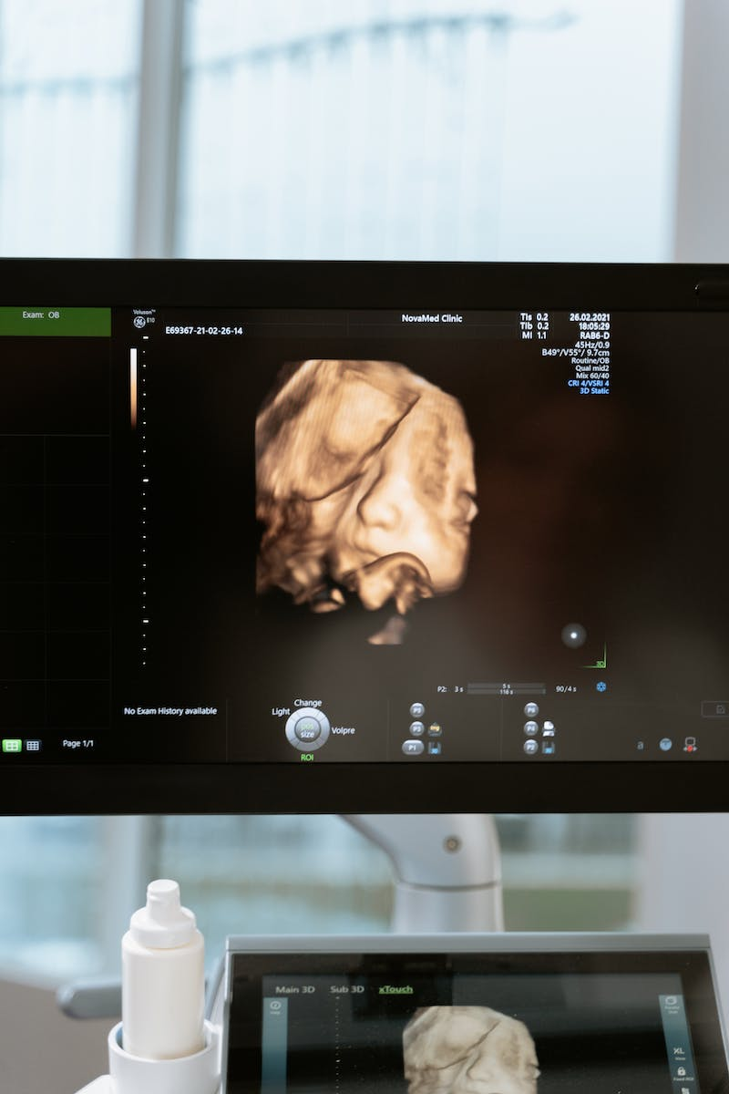
Conclusion
• Podcasting offers a unique and powerful way to share ideas and stories.
• It has the potential to influence and inspire audiences on a global scale.
• With the right tools and strategies, anyone can create a successful podcast.
• Embrace the power of podcasting and unlock a world of possibilities.
Photo by Pexels

