Slide 1
The Impact of Climate Change on Wildlife Conservation
Exploring the challenges and solutions in preserving biodiversity

Slide 2
Introduction
• The Earth is experiencing unprecedented climate change.
• Warming temperatures and disrupted ecosystems pose a threat to wildlife.
• Conservation efforts are crucial to protect biodiversity.
• Actions must be taken to mitigate the impacts and preserve endangered species.
Photo by Pexels

Slide 3
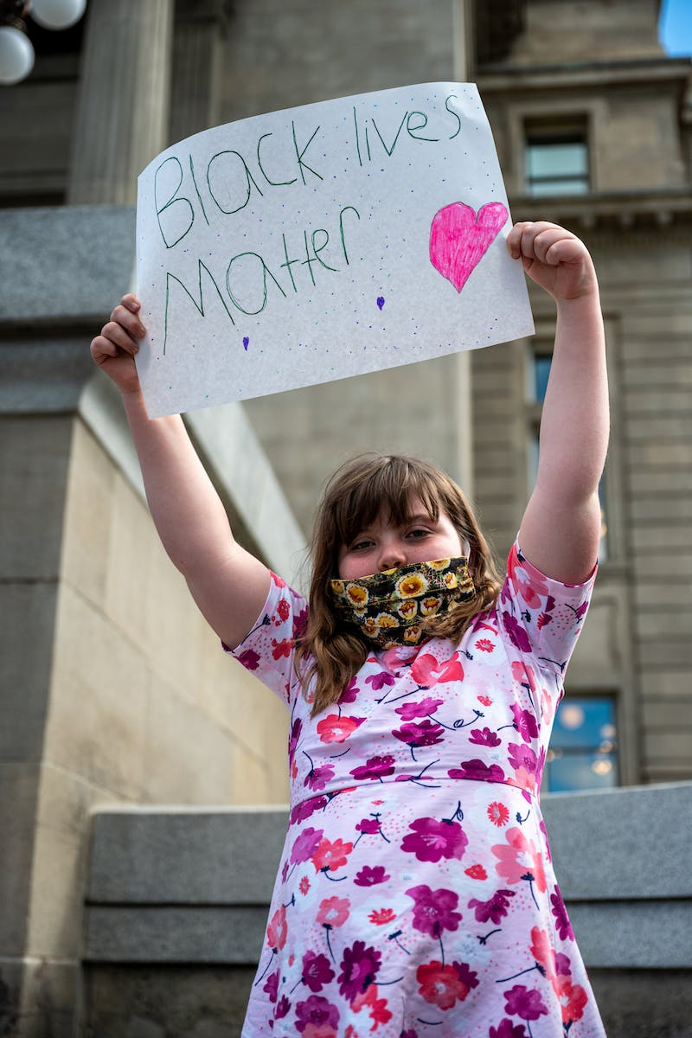
Understanding the Impact
• Rising temperatures affect the reproductive patterns of many species.
• Shifts in habitats force wildlife to adapt or face extinction.
• Changing weather patterns influence migration routes and food availability.
• Ocean acidification threatens marine life and coral reef ecosystems.
Photo by Pexels

Slide 4
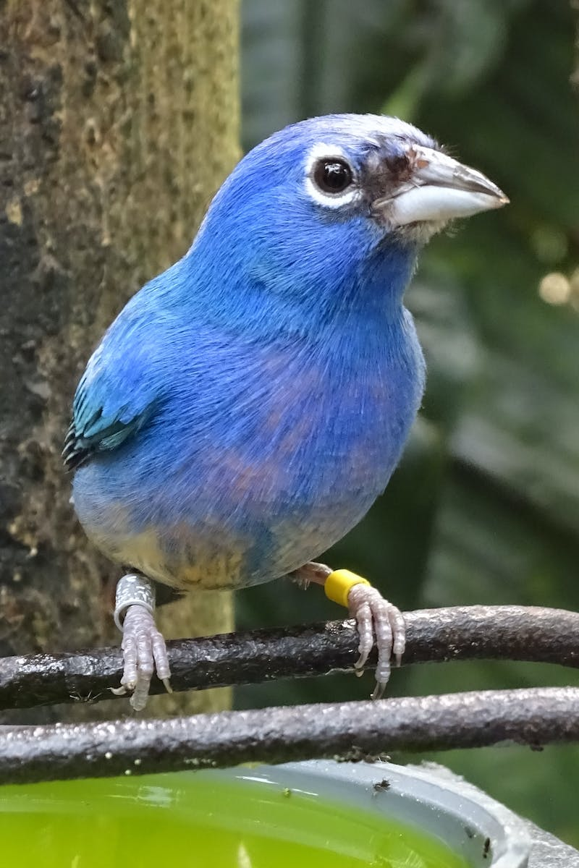
Conservation Strategies
• Protected areas and wildlife reserves help safeguard vulnerable species.
• Restoration of degraded habitats supports ecosystem resilience.
• Promoting sustainable practices minimizes human impact on wildlife.
• Collaboration between scientists, policymakers, and communities is essential.
Photo by Pexels

Slide 5
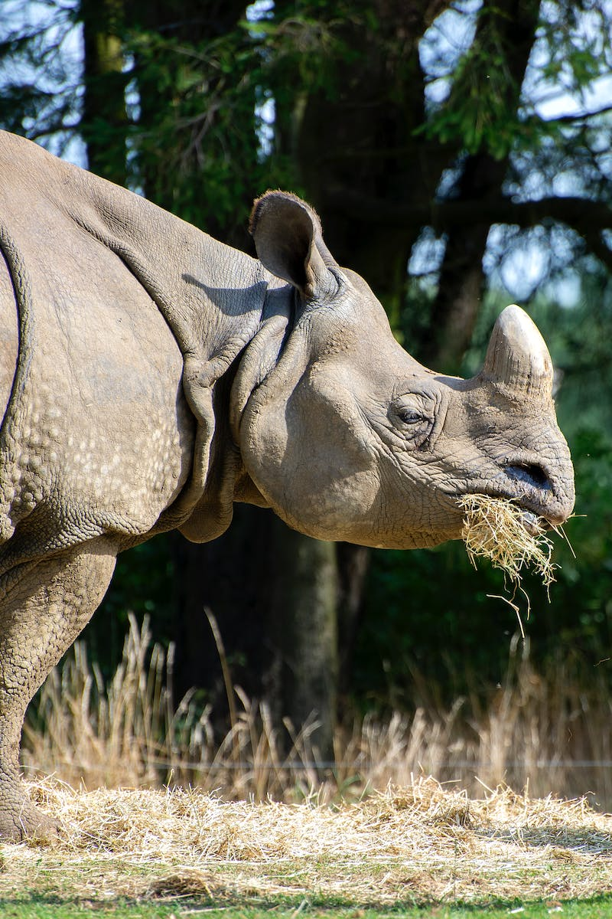
Innovative Technologies
• Satellite tracking enables monitoring of wildlife movements and behavior.
• Genetic technologies aid in the conservation of endangered species.
• Remote sensing and data analysis inform conservation strategies.
• Artificial intelligence helps identify and protect at-risk wildlife populations.
Photo by Pexels

Slide 6
Conclusion
• Climate change poses significant challenges to wildlife conservation.
• Combining science, policy, and public engagement is crucial to finding solutions.
• The preservation of biodiversity is essential for the well-being of ecosystems and future generations.
Photo by Pexels

