Slide 1
Making Products Users Love
How to Build a Remarkable Product and Delight Your Users

Slide 2
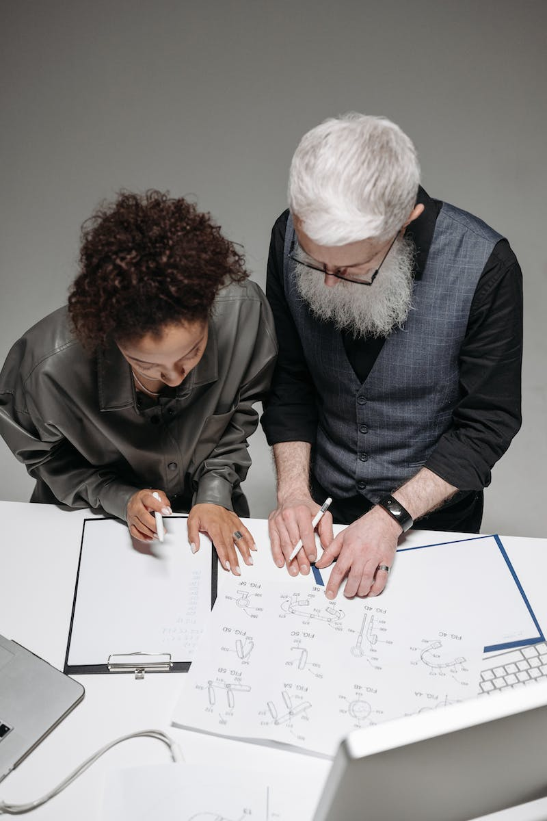
Introduction
• Focus on creating products that have a passionate user base
• Importance of building products that users want to be successful
• Use intimate user interactions in early stages of startup
• Different perspective on growth at a human scale
Photo by Pexels

Slide 3
The Importance of First Impressions
• First impressions are crucial for building relationships
• Create memorable first moments to seduce users
• Examples of companies that nail first impressions
• Using the concept of 'ata' and 'midokkutsu' for product quality
Photo by Pexels

Slide 4
Building Long-Term Relationships
• Learn from research on successful marriages
• Address common issues in customer support
• Foster a culture of responsibility, accountability, humility, and modesty
• Support-driven development to build high-quality software
Photo by Pexels

Slide 5
Remarkable Features and Delighting Users
• Create remarkable first moments to seduce users
• Inject emotion and wit into product design
• Examples of companies with exceptional features
• Importance of documentation and user-friendly tools
Photo by Pexels

Slide 6
Scaling with Support-Driven Development
• Implement support-driven development for better software
• Make everyone do customer support to fix feedback loop
• Focus on customer intimacy and responsiveness
• Deliver exceptional customer support as a growth strategy
Photo by Pexels

Slide 7
Creating Customer Intimacy for Market Dominance
• Explanation of the three paths towards market dominance
• Customer intimacy as the path to market dominance
• Balancing product focus with marketing and sales efforts
• Importance of scalability and remarkable experiences
Photo by Pexels

Slide 8
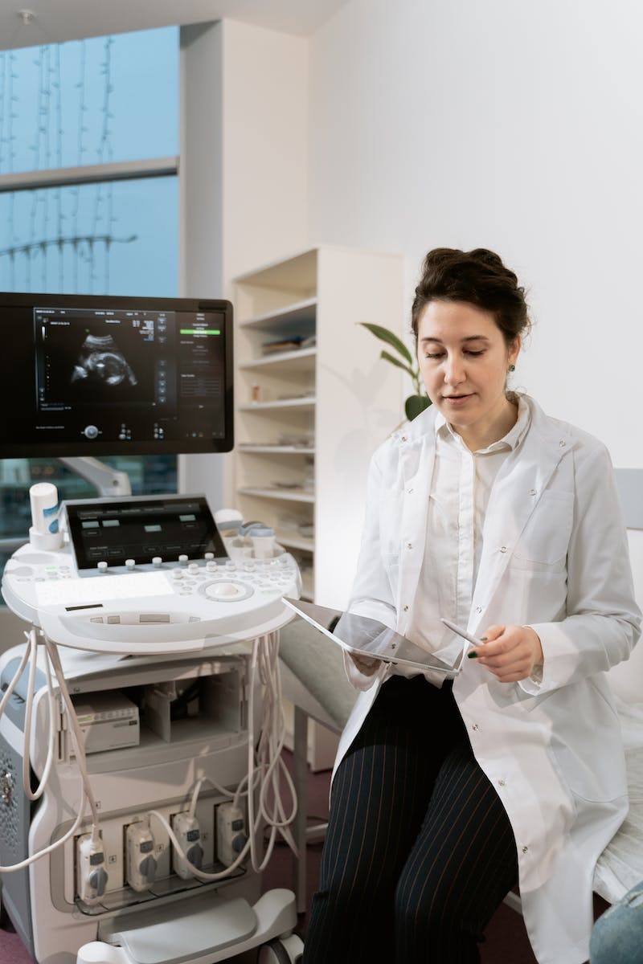
Conclusion
• Focus on creating products that users love
• The power of first impressions and remarkable experiences
• Support-driven development for better software and growth
• Customer intimacy as a path to market dominance
Photo by Pexels

