Slide 1


April 2025
Discovering Cambodia: Ancient Wonders & Modern Charms
A Journey Through the Kingdom of Cambodia's Rich History and Culture

Slide 2


Table of Contents
1
Cambodia: A Journey Awaits
5
Phnom Penh: Pearl of Asia
2
Cambodia: Rising Tourism Star
6
Royal Palace: A Majestic View
3
Angkor's Majestic Temples
7
Wat Phnom: Phnom Penh's Cradle
4
Sihanoukville & Islands
8
Cambodia: Tourism's Economic Impact

Slide 3
Table of Contents
9
Cambodia: Culture Unveiled
10
Cambodia: A Journey of Discovery

Slide 4

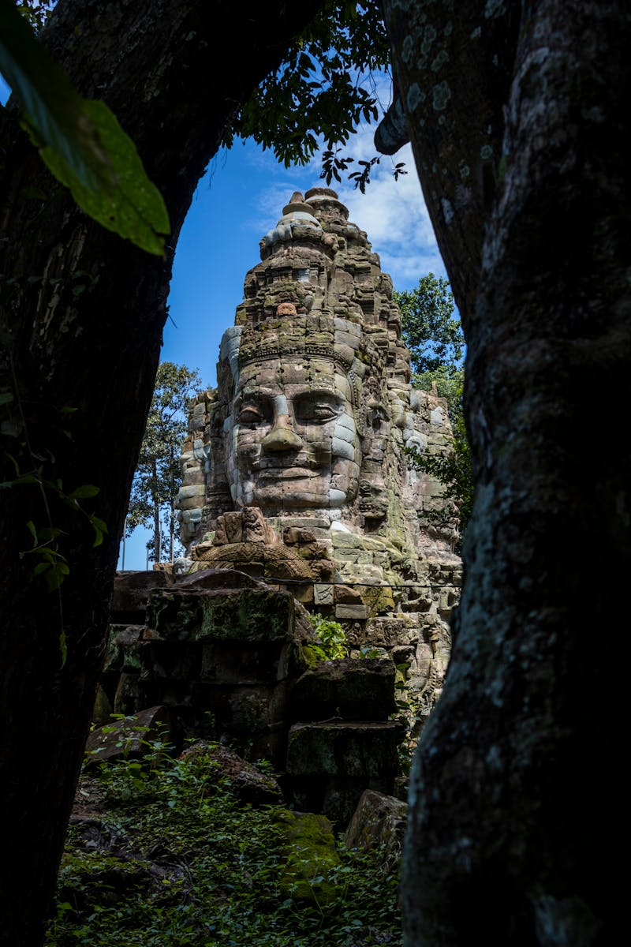
Cambodia: A Journey Awaits
Explore the majestic temples of Angkor, remnants of a powerful empire, showcasing intricate carvings and architectural brilliance.
From lush jungles to pristine beaches, Cambodia's diverse landscapes offer breathtaking scenery and opportunities for adventure.
Immerse yourself in Cambodia's vibrant culture, experiencing traditional dances, delicious cuisine, and warm hospitality.
Nestled between Vietnam, Thailand, and Laos, Cambodia shares borders showcasing unique cultural interactions and influences.

Slide 5

1975
✓
Cambodia: Rising Tourism Star
Khmer Rouge Reign
The Khmer Rouge regime takes power, leading to widespread violence, forced labor, and the destruction of Cambodian society. This devastating period severely impacted the nation's infrastructure and its ability to develop a tourism industry.
Cambodia's tourism sector has experienced remarkable growth.
Attracting visitors with its ancient temples and culture.
✓
1979
Vietnamese Intervention
Vietnamese forces intervene, ousting the Khmer Rouge regime. The country begins a slow and challenging recovery process, facing political instability, economic hardship, and the ongoing threat of landmines, all hindering tourism development.
1991
✓
Paris Peace Accords
The Paris Peace Accords are signed, paving the way for a ceasefire and UN-supervised elections. This marked a crucial step towards stability and opened doors for international aid and eventual tourism growth, focused initially on cultural heritage.

Slide 6
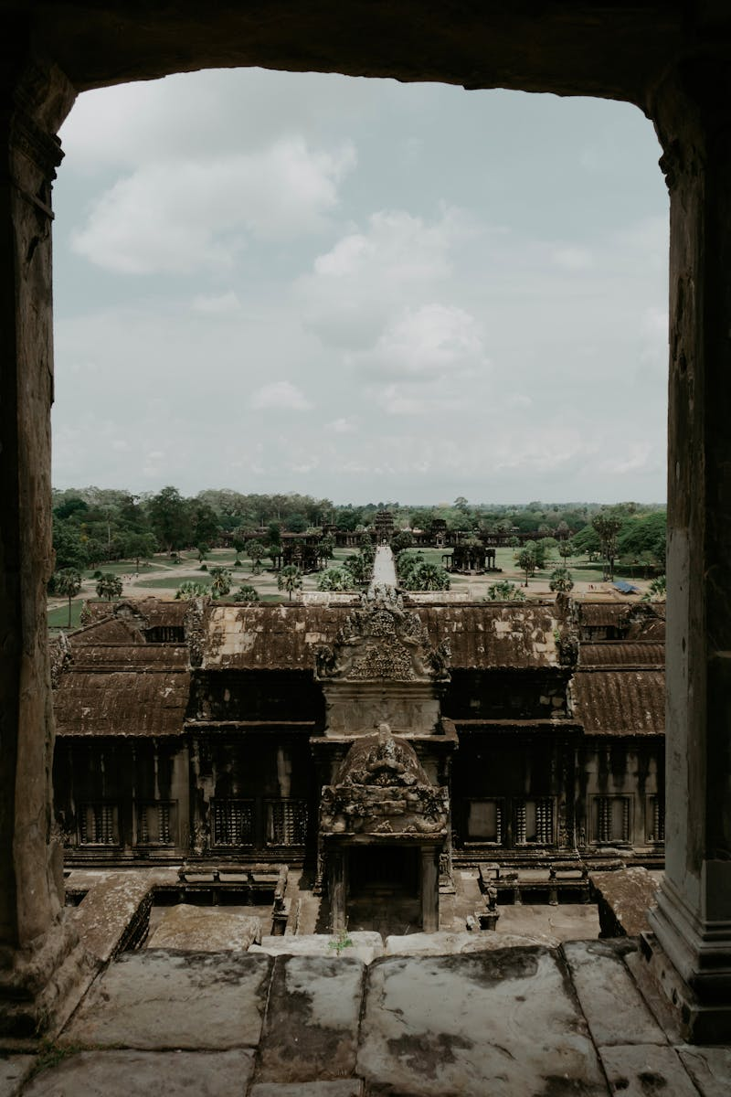
Angkor's Majestic Temples
Angkor stands as a powerful symbol of the Khmer empire, reflecting its cultural and political influence across Southeast Asia.
Intricate carvings, towering structures, and masterful engineering demonstrate the advanced skills of the ancient Khmer civilization.
Recognized for its universal value, Angkor is a protected site, ensuring its preservation for future generations to appreciate.
Millions of tourists journey to Angkor each year, drawn by its beauty and the opportunity to explore its sacred spaces.

Slide 7




Sihanoukville & Islands
Coastal Charms
Tourism Tradeoffs
Stunning beaches and crystal-clear waters create a picturesque and relaxing vacation environment for all travelers.
A variety of islands offer unique experiences, from secluded retreats to vibrant party destinations catering different needs.
Delicious and fresh seafood is readily available at affordable prices, providing a delightful culinary experience for visitors.
Rapid development and construction have led to environmental concerns, including pollution and habitat destruction near coastal areas.
Increased tourism has resulted in some areas becoming overcrowded, especially during peak seasons, impacting the tranquil atmosphere.
Infrastructure limitations, such as unreliable electricity and water supply, can occasionally disrupt the travel experience for tourists.

Slide 8
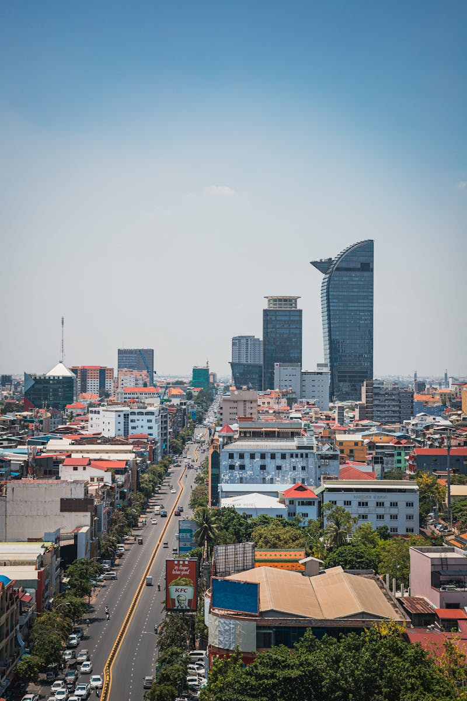
Phnom Penh: Pearl of Asia
Witness the elegance of French colonial architecture, a reminder of Phnom Penh's vibrant past and European influence.
Discover the Royal Palace, a dazzling complex showcasing Khmer artistry and the seat of Cambodia's monarchy.
Marvel at the Silver Pagoda, home to precious artifacts, including a shimmering emerald Buddha, steeped in history.
Visit Wat Phnom, the city's namesake temple, perched atop a hill, offering panoramic views and spiritual significance.

Slide 9


Royal Palace: A Majestic View
Construction Years
1866
Complex Area
174k m²
Throne Halls
5
Visitor Count
250k+

Slide 10
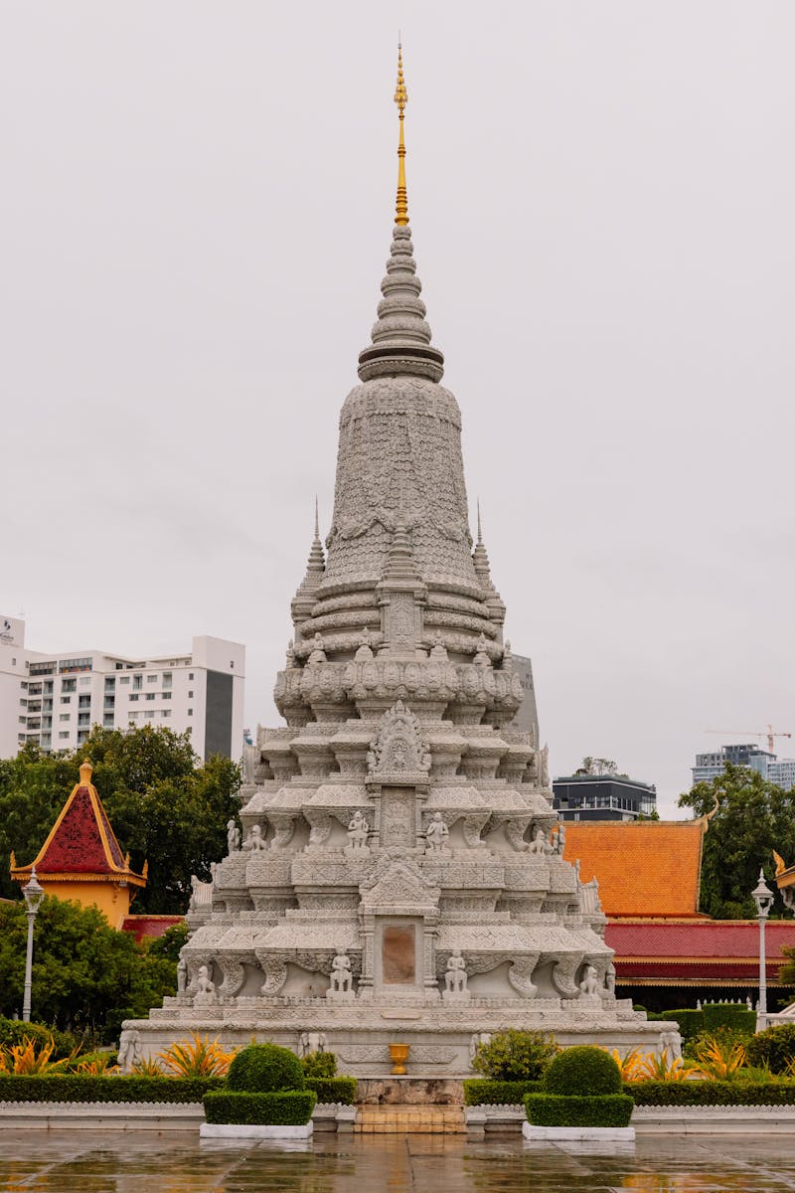
Wat Phnom: Phnom Penh's Cradle
Local legend says Lady Penh discovered Buddha statues in a tree, leading to the temple's construction and city's founding.
The temple showcases traditional Khmer architecture, with intricate details and a serene atmosphere atop a small hill.
Wat Phnom is a vital place of worship, attracting devotees seeking blessings and paying respect to the city's origins.
The temple hosts various festivals and celebrations throughout the year, offering cultural insights and vibrant displays of tradition.

Slide 11
Cambodia: Tourism's Economic Impact
GDP Contribution
12%
Visitor Increase
25%
Jobs Created
630k
Revenue Generated
5.3B$

Slide 12

Cambodia: Culture Unveiled
1.Warm Welcome
2.Ancient Traditions
Experience Cambodia's genuine hospitality, known for its warmth and welcoming spirit to every visitor.
Discover vibrant traditions passed down through generations, shaping Cambodian identity and daily life.
3.Khmer Heritage
4.Lasting Impressions
Explore Cambodia's unique cultural heritage, from majestic temples to intricate artistic expressions found nationwide.
Create unforgettable memories through immersive experiences, forging a deep connection with Cambodia's soul.

Slide 13
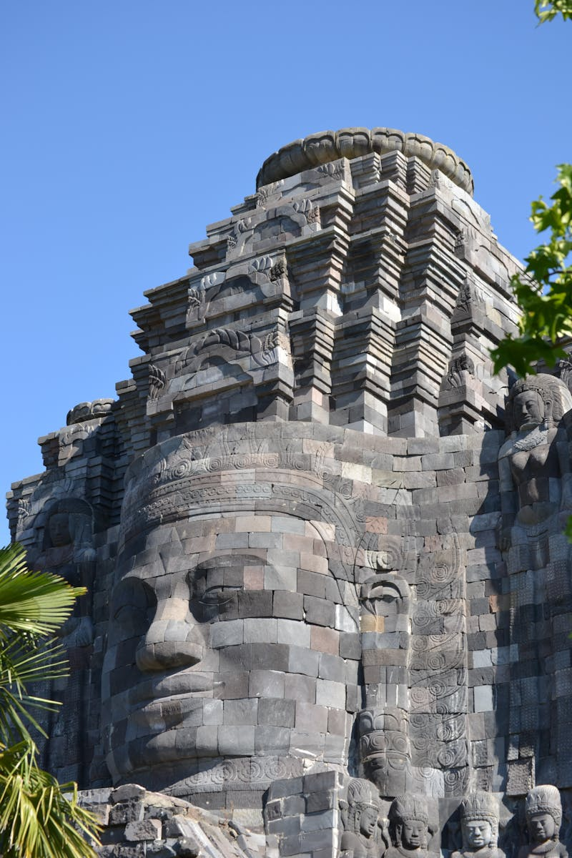
Cambodia: A Journey of Discovery
Discover the awe-inspiring temples of Angkor, a testament to the Khmer empire's architectural and artistic brilliance. A true wonder.
Experience the bustling capital, Phnom Penh, a city where tradition and modernity intertwine, offering a glimpse into Cambodia's present and future.
Relax on Cambodia's pristine beaches and explore its coastal towns, offering a tranquil escape and stunning natural beauty. Paradise awaits.
Immerse yourself in the warmth of Khmer culture, from its delicious cuisine to its traditional dance and crafts. A cultural immersion.

