Slide 1
Project Production Plan for Construction Companies
Streamline your work processes with PP-R

Slide 2
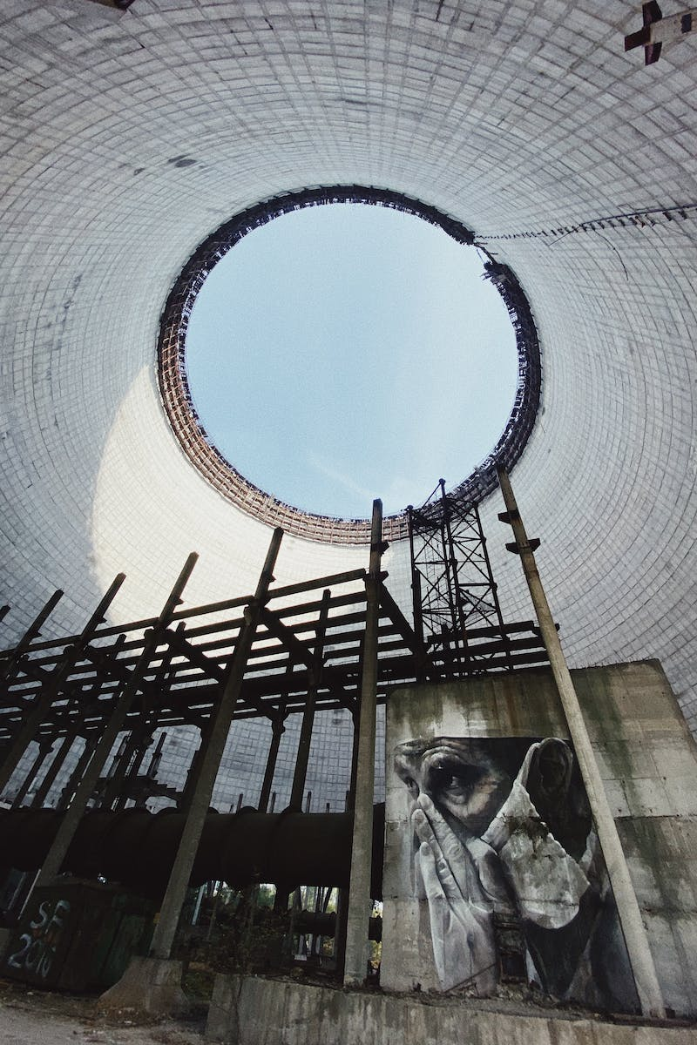
Introduction
• Most construction companies face the challenge of developing a project production plan (PP-R) before starting work on-site.
• This task requires time and effort, leading to distractions from core responsibilities.
• Errors in the document can also occur if not handled carefully.
• Stroi-Dog A&B offers a solution to simplify and expedite this process.
Photo by Pexels

Slide 3
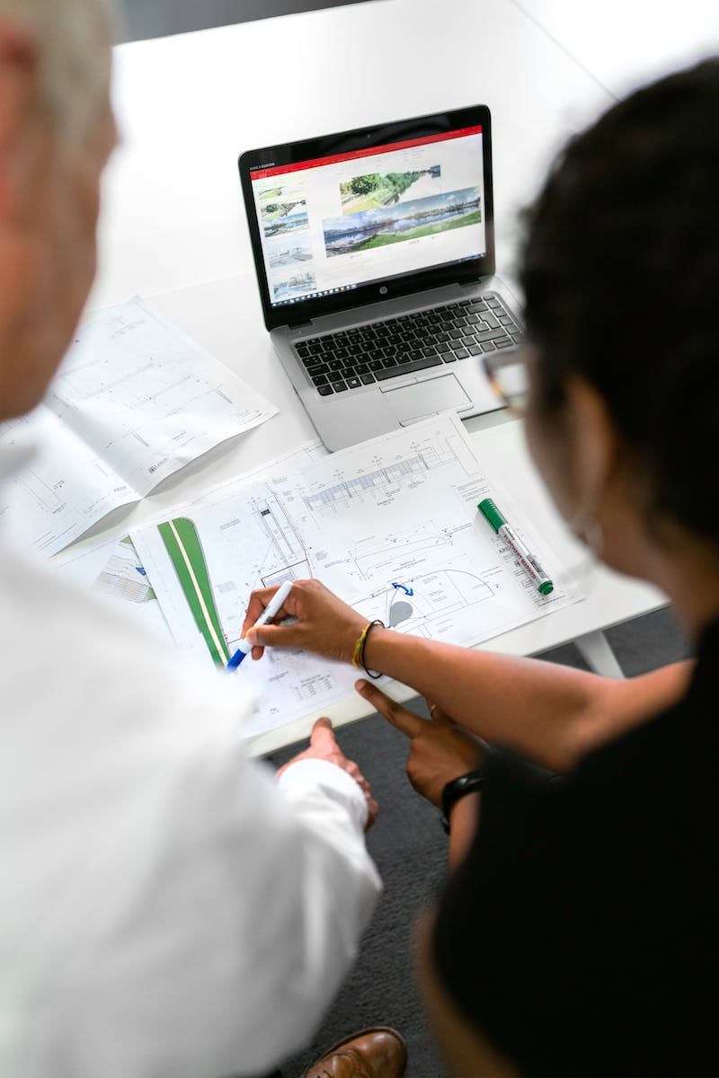
What is a Project Production Plan?
• A project production plan is a document that outlines the technology and organization for conducting preparatory and main construction and installation works.
• It includes quality control, occupational health and safety requirements, and schedules for work, material delivery, and resource allocation.
• Stroi-Dog A&B can develop detailed PP-Rs, including construction general plans and technological charts.
Photo by Pexels

Slide 4
Ordering PP-R
• To order a PP-R, simply send us an email at [email protected] with the project details or a work schedule.
• Even the procurement contract number is sufficient for our specialists to conduct calculations and provide cost and timeline estimates.
• The typical development time for a PP-R is 23 days, but complex projects can be completed within 5 days.
• For urgent orders, Stroi-Dog A&B offers a 1-day turnaround for preliminary agreement and subsequent revisions.
• We guarantee all our PP-R work until the facility is operational and ensure prompt response to feedback and adjustments.
Photo by Pexels

Slide 5
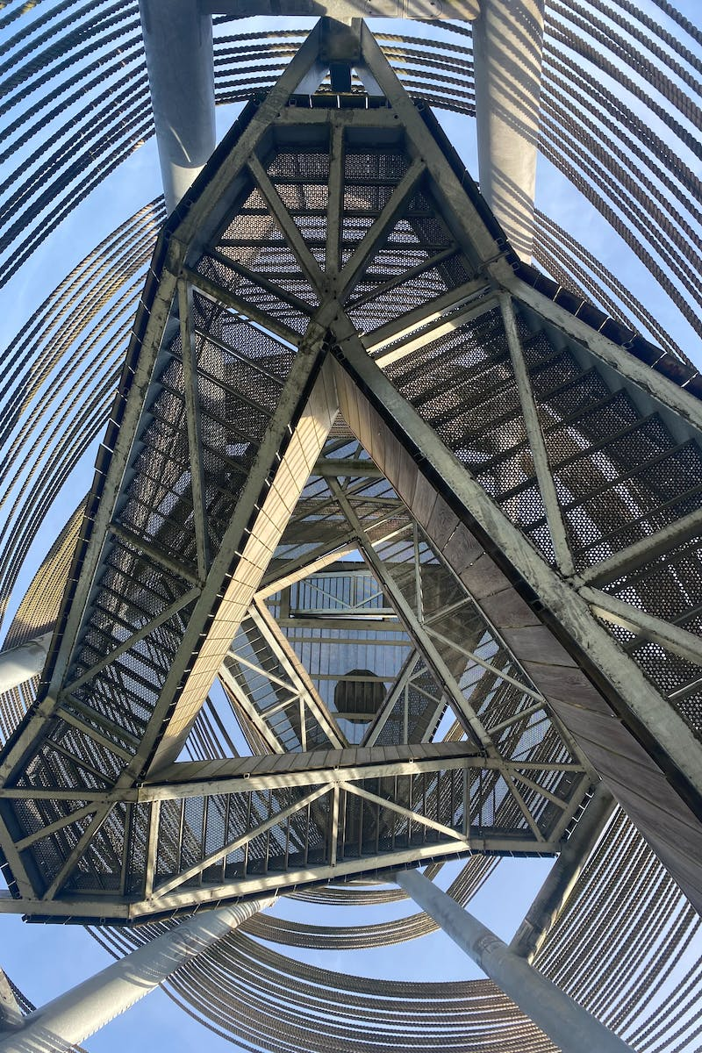
Stroi-Dog A&B's Expertise
• Stroi-Dog A&B has developed over 4000 PP-Rs of varying complexities.
• Our experience and knowledge enable us to deliver high-quality project production plans.
• We continue to innovate and provide effective solutions to meet clients' needs.
Photo by Pexels

Slide 6
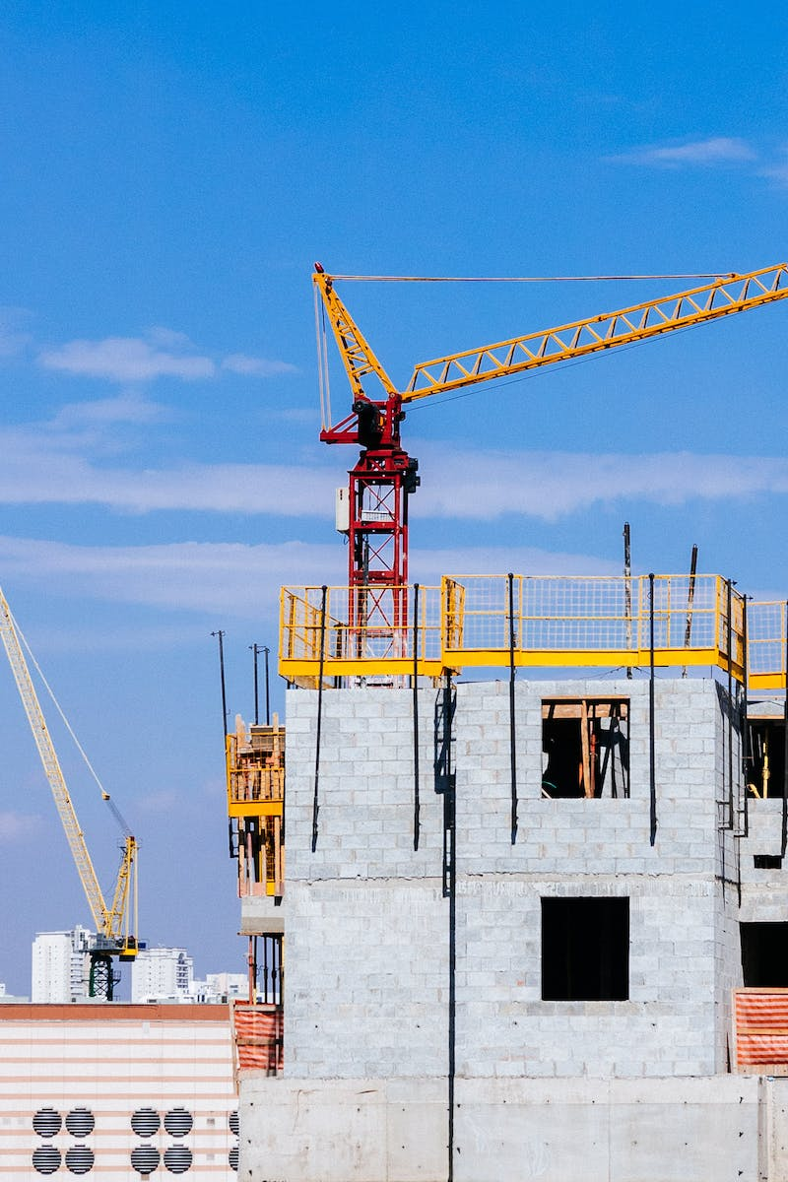
Make Your Order
• Still unsure? Take advantage of Stroi-Dog A&B's expertise and make your PP-R order today.
• Our team will ensure a smooth and efficient process, saving you time and resources.
• Contact us at [email protected] or visit our website at www.stroi-dog-a-b.ru.
Photo by Pexels

