Slide 1
The Art of Winemaking
From Vine to Bottle

Slide 2
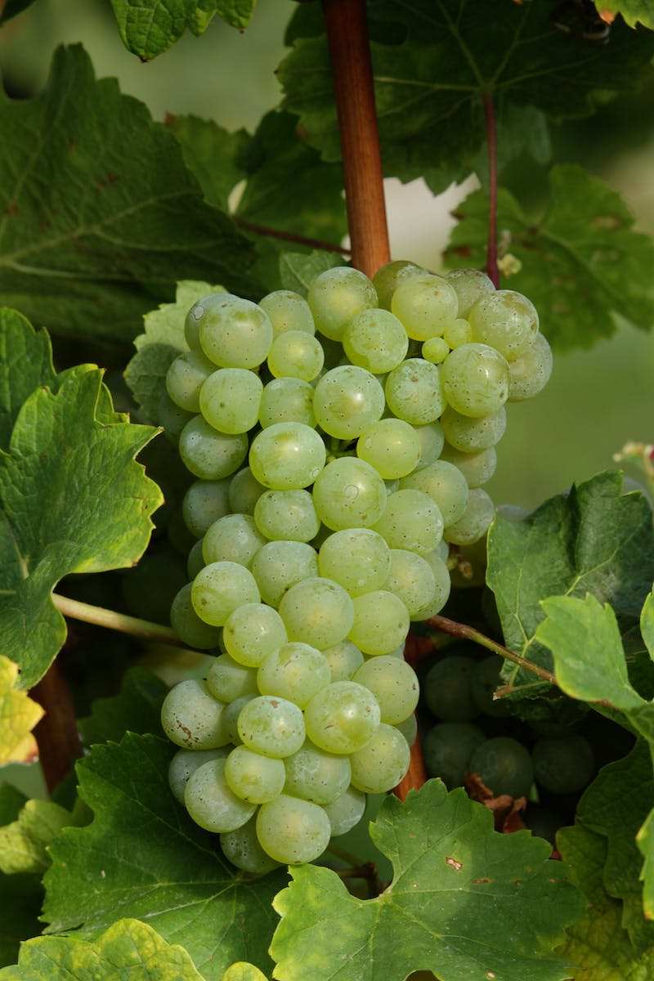
Introduction
• The art of winemaking
• Key elements: grapes, flavors, techniques
• Presented by Pavel Shvets, winemaker
• History and passion behind winemaking
Photo by Pexels

Slide 3
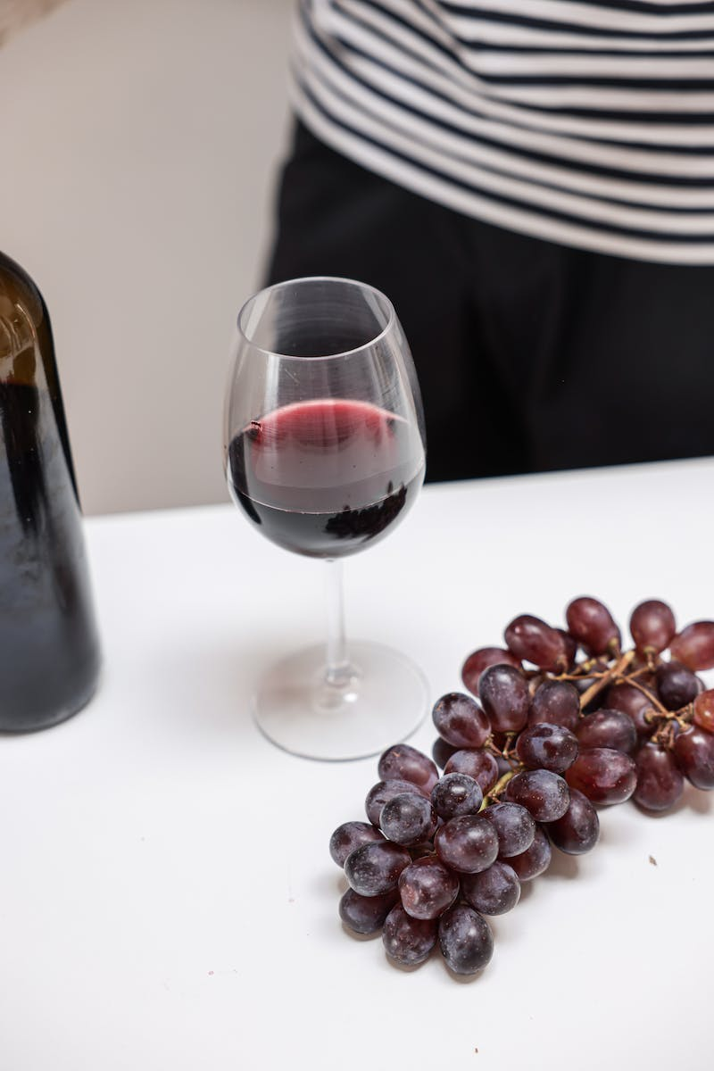
Grape Selection
• Different types of grapes
• Technical vs. table grapes
• Focus on Merlot
• Optimal grape quantity per person
Photo by Pexels

Slide 4
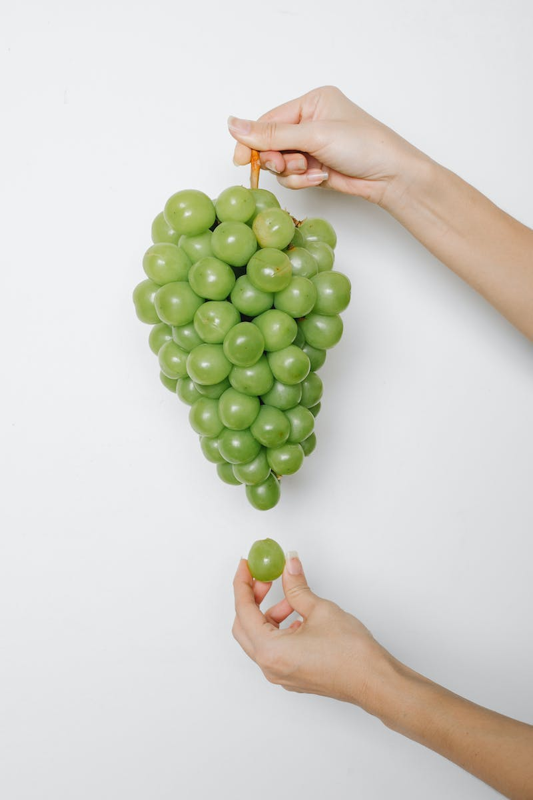
Grape Harvesting
• The grape harvesting process
• Maintaining the right sugar levels
• Importance of grape ripeness
• Labor-intensive process
Photo by Pexels

Slide 5
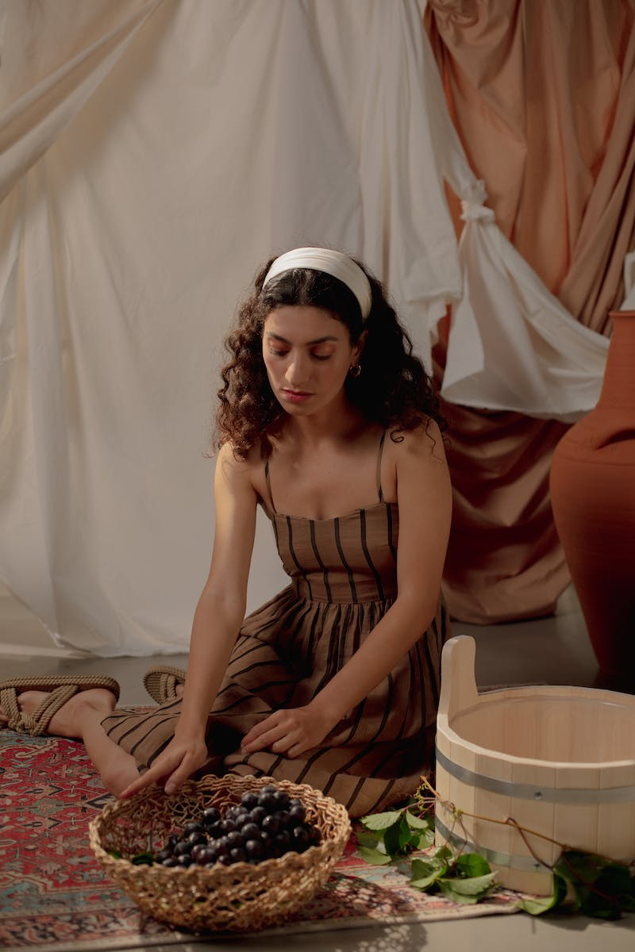
Winemaking Techniques
• White vs. red winemaking methods
• Fermentation and maturation
• Maceration for red wines
• Importance of balance and vineyard practices
Photo by Pexels

Slide 6
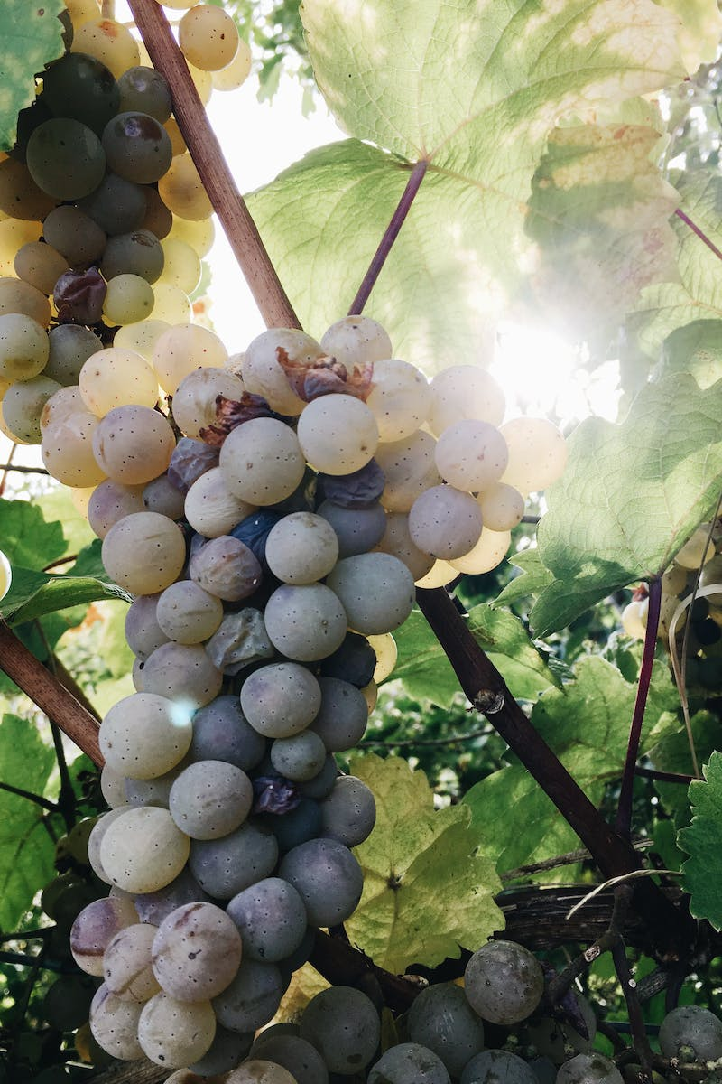
The Role of Terroir
• Understanding terroir in winemaking
• Soil, climate, and elevation
• Influence on grape quality
• Balancing leaf growth and grape production
Photo by Pexels

Slide 7
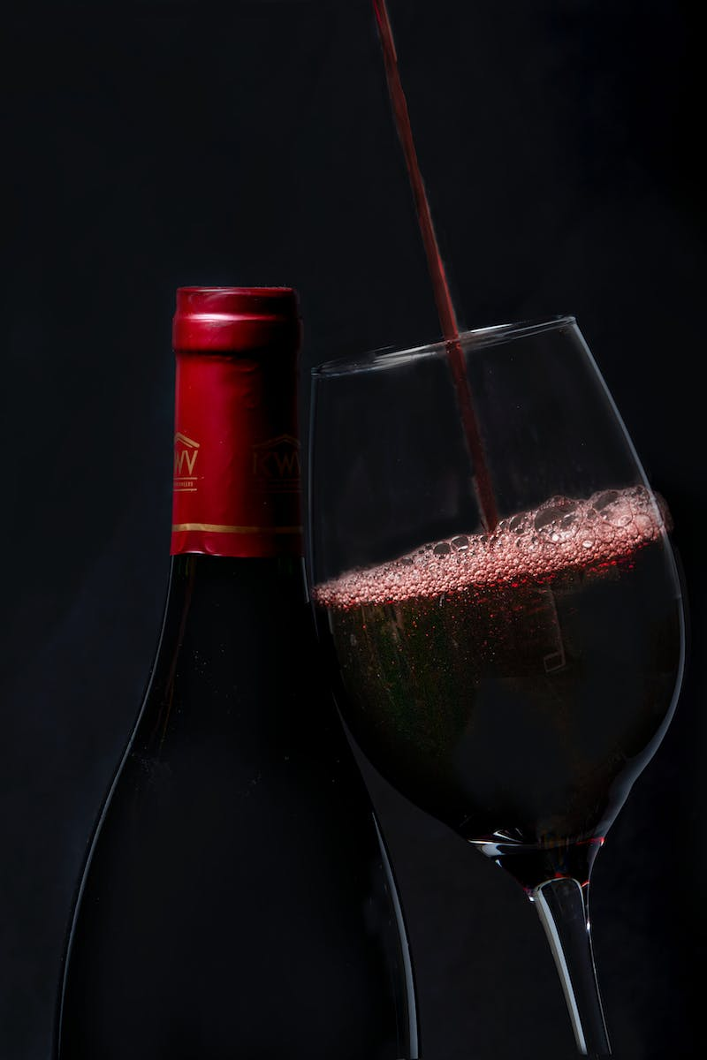
Wine Tasting Techniques
• The art of wine tasting
• Developing a discerning palate
• Understanding the sensory experience
• Choosing the right glassware
Photo by Pexels

Slide 8
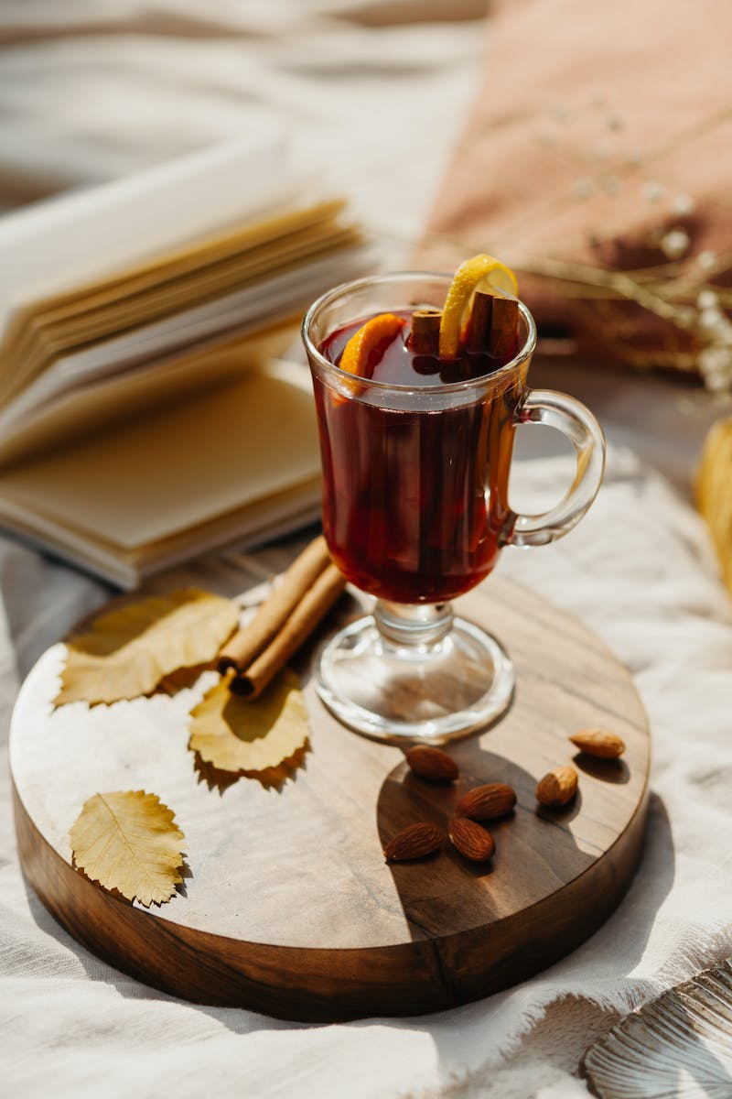
Food Pairings
• Enhancing the dining experience
• Choosing the right wine for each dish
• Achieving flavor balance
• Considering acidity and tannins
Photo by Pexels

Slide 9
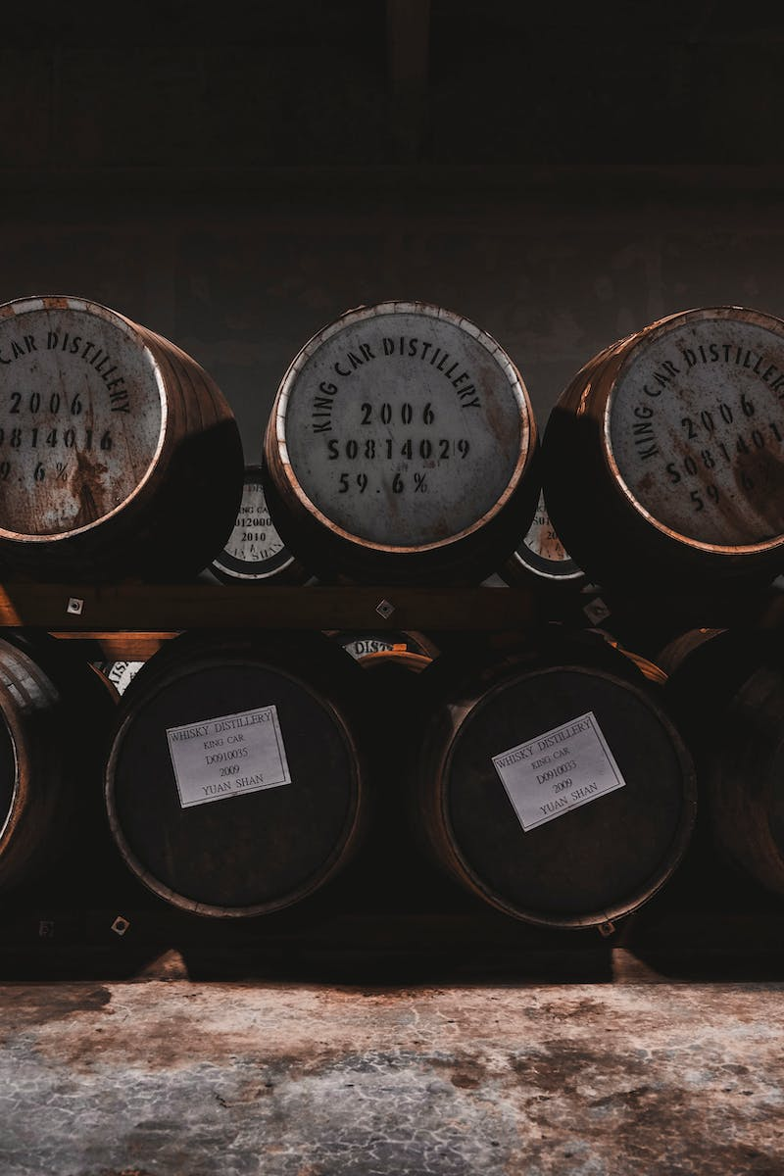
Cellaring and Preservation
• Proper wine storage and aging
• Importance of humidity and temperature
• How to properly store opened bottles
• Decanter versus direct pouring
Photo by Pexels

Slide 10
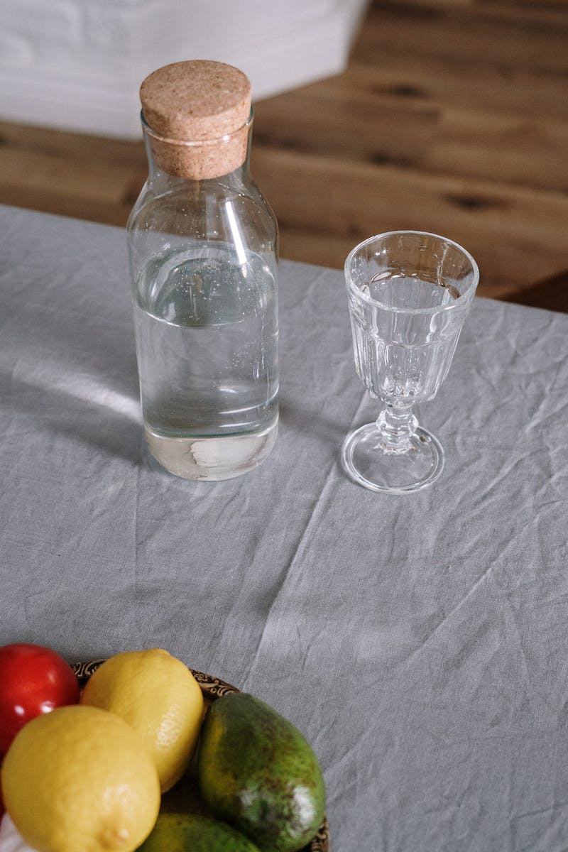
Wine and Health
• Moderation and health benefits
• The role of antioxidants
• Wine as part of a balanced lifestyle
• Alcohol intake guidelines
Photo by Pexels

Slide 11
Conclusion
• The artistry of winemaking
• Future prospects and challenges
• Continued passion for viniculture
• Inspiration for future generations
Photo by Pexels

