Slide 1
The Importance of Environmental Conservation
Working Together for a Sustainable Future

Slide 2
Slide 1: The Current State of our Environment
• Rapid deforestation and habitat destruction
• Increasing pollution and waste accumulation
• Dwindling natural resources
• Global climate change
• Loss of biodiversity
Photo by Pexels

Slide 3
Slide 2: Benefits of Environmental Conservation
• Preservation of biodiversity and ecosystems
• Cleaner air and water
• Sustainable use of natural resources
• Stability in climate patterns
• Improved human health and well-being
Photo by Pexels

Slide 4
Slide 3: Strategies for Environmental Conservation
• Implementing sustainable farming practices
• Reducing carbon emissions and promoting renewable energy
• Creating protected areas and wildlife reserves
• Promoting recycling and waste reduction
• Educating and engaging communities
Photo by Pexels

Slide 5
Slide 4: Success Stories in Environmental Conservation
• Recovery of the Bald eagle population in North America
• Conservation efforts leading to the resurgence of the Giant Panda
• The restoration of the ozone layer through international agreements
• Reforestation projects combating desertification
• Clean-up and rehabilitation of polluted water bodies
Photo by Pexels

Slide 6
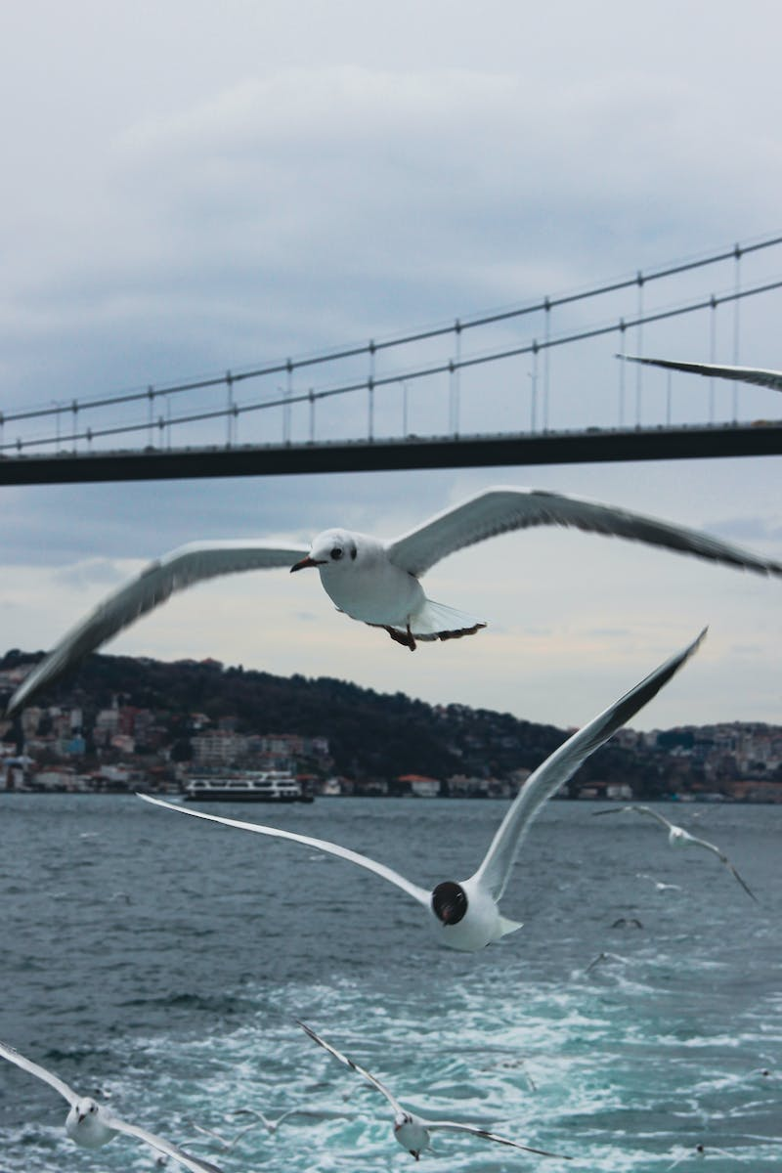
Slide 5: Call to Action
• Support local and global conservation organizations
• Reduce personal carbon footprint
• Advocate for stronger environmental policies
• Engage in community clean-up and restoration projects
• Educate others about the importance of environmental conservation
Photo by Pexels

