Slide 1
Discovering Hidden Gems: Top 5 Highly Rated Wines Under 3000 円
Unveiling the Best Value Wines with Parker Points

Slide 2
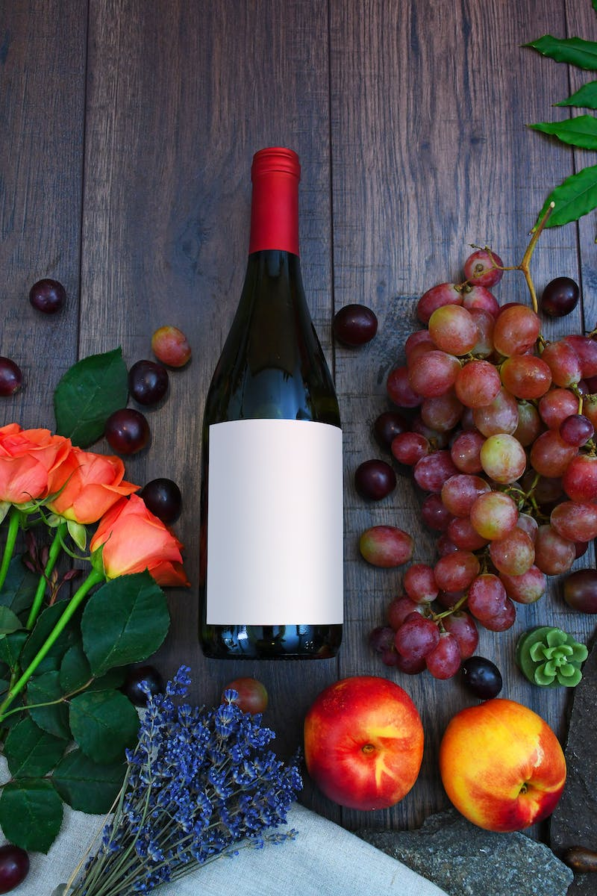
Introduction
• Presenting 5 exceptional wines with Parker Points under 3000 円
• Explore the world of Parker Points and its impact on the wine market
• Understanding the credibility and influence of Parker Points
• Highlighting the authority of Parker Points among other wine ratings
• Introducing the concept of Parker Points as a reliable indicator of wine quality
Photo by Pexels

Slide 3
ワイン1: 砂糖モンペラブラン
• Price: 2200 円
• Origin: Bordeaux, France
• Parker Points: 91/100
• Impressive white wine with notes of white peaches and green apples
• Great value for money, compared to similar highly-rated white wines
• Ideal pairing with chicken dishes

Slide 4
ワイン2: スラムダンクワインズ
• Price: 2500 円
• Origin: California, USA
• Parker Points: 90/100
• Collaboration between wine experts David Green and the acclaimed wineries of Screaming Eagle and Dominus
• A red wine with bold flavors of black cherries and spices
• Perfect gift for basketball and wine enthusiasts

Slide 5
ワイン3: パスティードミラフロン
• Price: 1680 円
• Origin: Languedoc-Roussillon, France
• Parker Points: 92/100
• Crafted by Domaine Lafage, a top winemaker from Southern France
• Impressive complexity and intensity with flavors of blackberries and herbs
• Exceptional value for money with a rich and silky mouthfeel

Slide 6
ワイン4: エボディア
• Price: 1300 円
• Origin: Polygala, Spain
• Parker Points: 90/100 to 91/100
• Affordable wine with consistent high ratings from 2014 onwards
• Taste profile includes ripe cassis, blackberries, and a touch of spiciness
• A well-rounded, flavorful wine available at Lawson stores

Slide 7
ワイン5: ピーターシック ルシー
• Price: 3900 円
• Origin: Ribera del Duero, Spain
• Parker Points: 90-95/100
• Exceptional wine crafted by Peter Sisseck, a renowned winemaker
• Intense flavors of cassis, blueberry jam, and hints of vanilla
• Unbelievable value for money for a wine of this quality

Slide 8
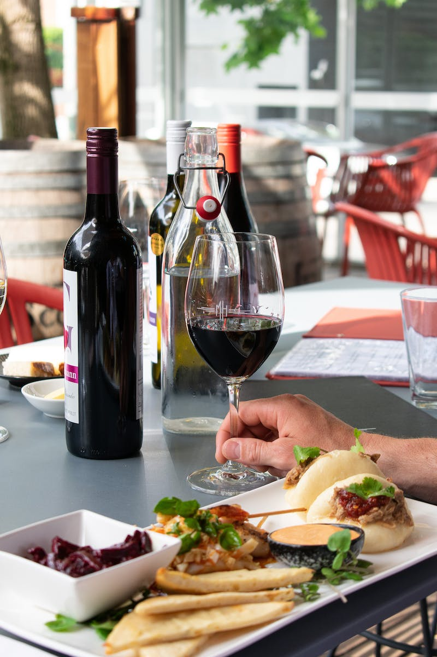
Conclusion
• Highlighting the quality and affordability of these highly-rated wines
• Emphasizing the impact of Parker Points on pricing
• Encouraging wine enthusiasts to explore and enjoy these hidden gem wines
• Reminding the audience to consider Parker Points as one of several indicators when selecting wines
• Closing with an invitation to try the featured wines and expand their wine experience
Photo by Pexels

