Slide 1
The Power of Artificial Intelligence
Transforming industries and shaping the future

Slide 2
Introduction to Artificial Intelligence
• AI refers to the simulation of human intelligence in machines
• It enables machines to learn, reason, and make decisions
• AI has wide application in various industries
• Significant advancements have been made in AI research
Photo by Pexels

Slide 3
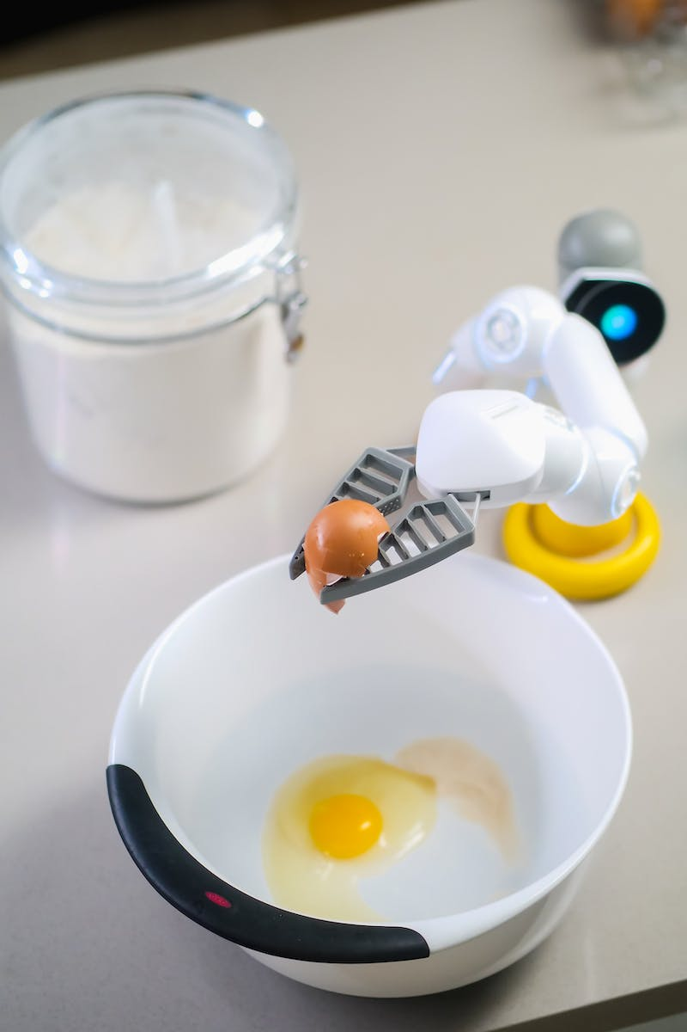
Machine Learning
• Machine learning is a subset of AI
• It focuses on giving machines the ability to learn from data
• Supervised learning, unsupervised learning, and reinforcement learning are common types of machine learning algorithms
• Machine learning is used in various domains such as healthcare, finance, and marketing
Photo by Pexels

Slide 4
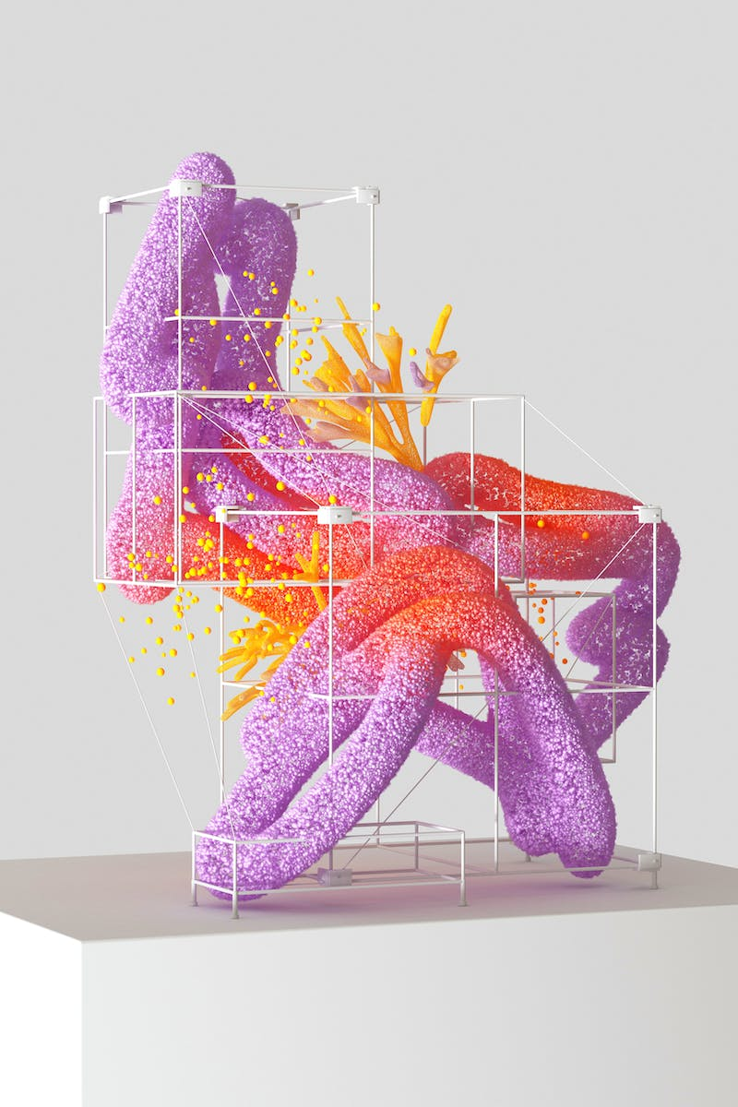
Deep Learning
• Deep learning is a subset of machine learning
• It involves the use of artificial neural networks to model and understand complex patterns
• Deep learning has revolutionized image recognition and natural language processing
• Applications of deep learning include self-driving cars, voice assistants, and healthcare diagnostics
Photo by Pexels

Slide 5
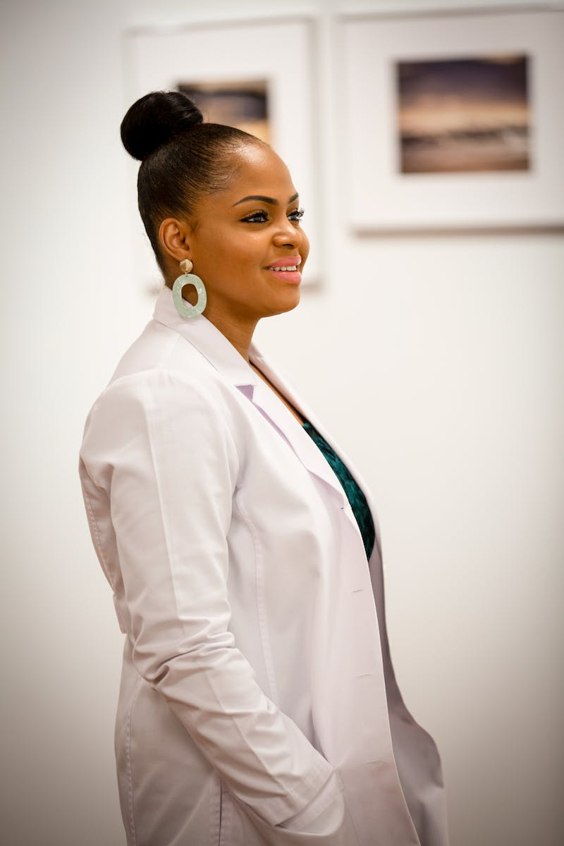
AI in Healthcare
• AI has the potential to revolutionize healthcare
• It can aid in early disease detection and diagnosis
• AI-powered systems can analyze medical images and provide accurate insights
• Precision medicine and personalized treatment are made possible with AI
Photo by Pexels

Slide 6
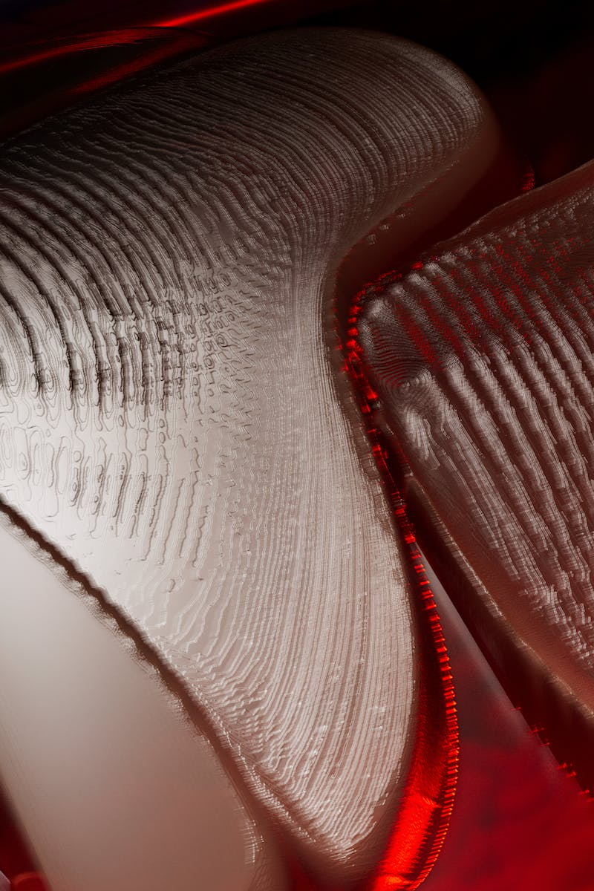
Ethical Considerations of AI
• AI raises ethical concerns related to privacy and data protection
• There is a potential for biases and discrimination in AI algorithms
• Ethical guidelines and regulations are needed to govern AI development and deployment
• AI should be used responsibly, considering its impact on society
Photo by Pexels

Slide 7
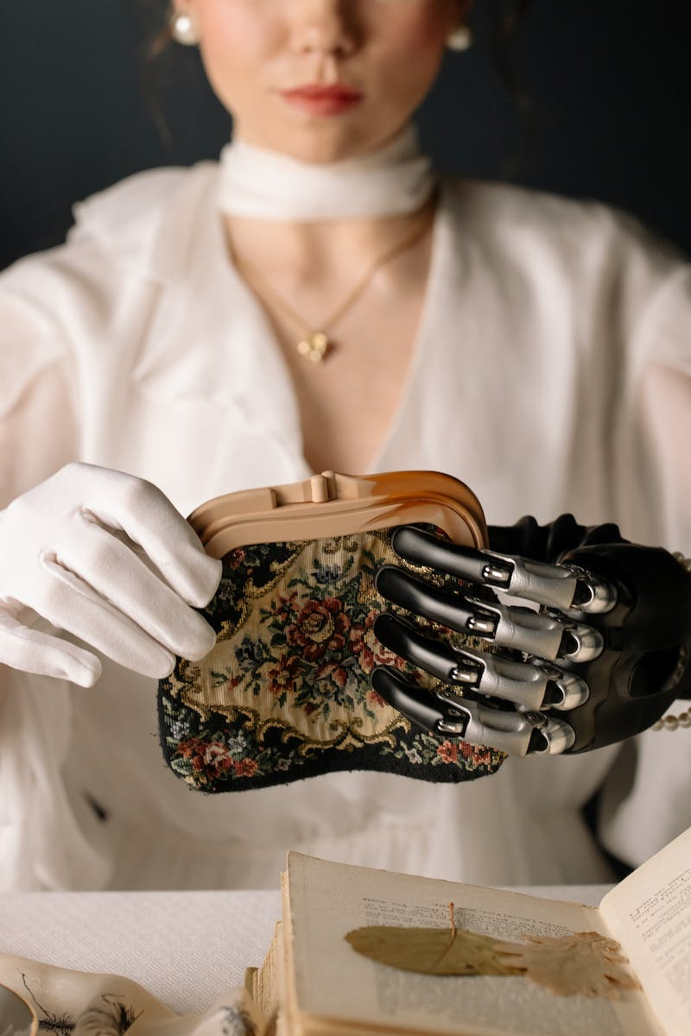
Future of AI
• AI is expected to continue advancing rapidly
• Increased automation may impact job markets and require reskilling
• AI-driven innovations will shape industries and improve efficiency
• Collaboration between humans and AI will be crucial for future developments
Photo by Pexels

