Slide 1
The History of China
From Ancient Times to the Present

Slide 2
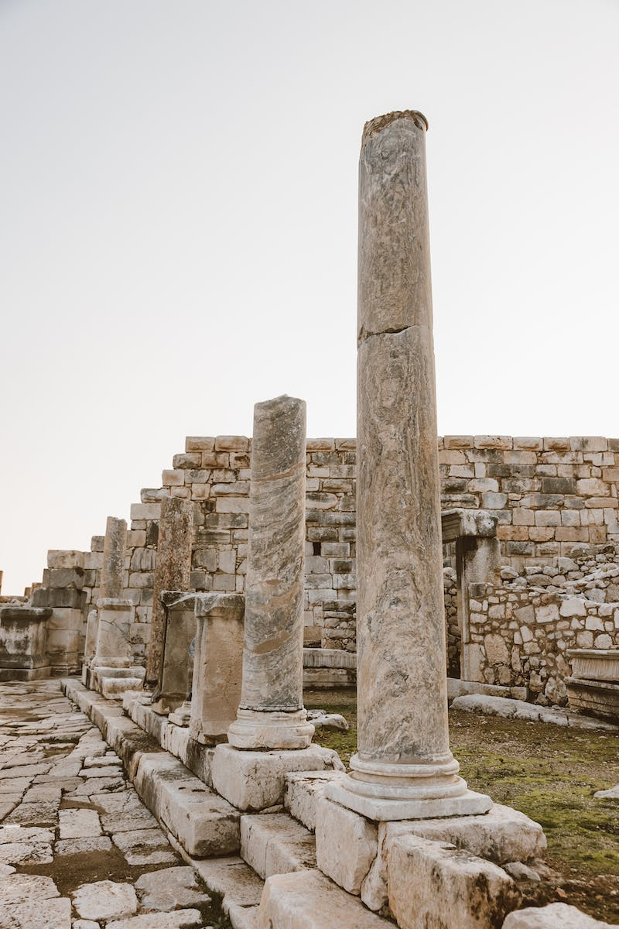
Introduction
• China's rich history spans thousands of years
• Archaeologists continue to discover hidden artifacts
• Ancient Roman objects are frequently found
• Graphic design has become a highly sought-after profession
• Russian Academy of National Economy and Public Administration launches new online bachelor's program in graphic design
Photo by Pexels

Slide 3
Ancient China
• China's history dates back to ancient times
• Early inhabitants include Homo erectus and Denisovans
• Chinese evolution branches are not isolated, but connected to other regions
• Distinctive physical features like narrow eyes are due to evolutionary adaptation
• First evidence of agriculture and alcohol production found in ancient China
Photo by Pexels

Slide 4
Founding of Dynasties
• First known dynasty is the Shang Dynasty
• Bronze weapons and human sacrifices were common
• Zhou Dynasty emerged as the dominant power in 1600 BCE
• Philosophies like Confucianism and Taoism were born
• Great achievements included the construction of the Great Wall
Photo by Pexels

Slide 5
Golden Age of China
• The Han Dynasty marked a golden age for China
• Trade along the Silk Road flourished
• Inventions like paper, printing, and compass were introduced
• Tea became an essential part of Chinese identity
• Technological advancements positioned China ahead of other empires
Photo by Pexels

Slide 6
Challenges and Decline
• China faced internal conflicts and invasions
• Periodic warfare and power struggles weakened the empire
• Mongol and Manchu rulers influenced Chinese culture
• Opium Wars and foreign interventions caused further decline
• The Qing Dynasty was the last Chinese dynasty
Photo by Pexels

Slide 7
Modern China
• The Republic of China was established in 1912
• Political divisions led to the Chinese Civil War
• Communist Party of China (CPC) came to power in 1949
• Taiwan's separation from China and ongoing tensions
• China's economic rise and impact on the global stage
Photo by Pexels

Slide 8
Conclusion
• China's history is rich and diverse
• From ancient times to modern era, the country has faced triumphs and challenges
• China's influence on art, culture, and technology is significant
• The history of China continues to shape its present and future
Photo by Pexels

