Slide 1
The Soweto Uprising and the Struggle Against Apartheid
Exploring the pivotal events and lasting impact of June 16, 1976

Slide 2
Introduction
• The June 16, 1976 Soweto Uprising was a pivotal moment in the history of South Africa
• The Uprising began as a student protest against the imposition of Afrikaans as the medium of instruction in schools
• It quickly escalated into a mass movement demanding an end to racial segregation and injustice
• This presentation aims to provide a comprehensive analysis of the events leading up to the Uprising, the unfolding of the protest, the killing of Hector Peterson, and the long-term impact of this historic event
Photo by Pexels

Slide 3
Historical Context of Apartheid
• Apartheid was a system of institutionalized racial segregation in South Africa.
• It was enforced by the South African government under the National Party from 1948 to the early 1990s.
• The roots of apartheid can be traced back to the colonial era and the policies of white minority rule established by European powers.
• The colonial powers implemented policies that reinforced racial divisions and white superiority.
Photo by Pexels

Slide 4
Policies of Apartheid
• Apartheid classified South Africans into different racial groups, determining their legal status and rights.
• The Group Areas Act of 1950 segregated residential areas based on race, leading to forced removals of non-white populations.
• The Bantu Education Act of 1953 established a separate and inferior education system for black Africans.
• The Act perpetuated educational inequality and limited black Africans' prospects for higher education and socio-economic advancement.
Photo by Pexels

Slide 5
Black Consciousness Movement
• The Black Consciousness Movement played a significant role in the Soweto Uprising.
• It emphasized self-awareness, empowerment, and the rejection of white supremacy.
• The movement challenged the Bantu Education Act and called for a more relevant and liberating curriculum.
• It fostered political consciousness and unity among black Africans, empowering them to resist apartheid.
Photo by Pexels

Slide 6
Soweto Uprising and Student Protests
• The student-led protests in Soweto against the imposition of Afrikaans as a language of instruction became the catalyst for the Soweto Uprising.
• Thousands of students marched peacefully on June 16, 1976, demanding equal educational rights.
• The police responded with force, leading to clashes and widespread violence.
• The events of the Uprising gained international attention and condemnation, leading to increased pressure on the apartheid government.
Photo by Pexels

Slide 7
The Tragic Death of Hector Peterson
• Hector Peterson, a 12-year-old boy, was fatally shot by the police during the Soweto Uprising.
• His death became an iconic symbol of innocent lives lost and the brutality of the apartheid regime.
• The photograph of Hector Peterson's lifeless body being carried by a fellow student became a powerful image that drew global attention to the struggle against apartheid.
• His death inspired further resistance and solidarity against the oppressive regime.
Photo by Pexels

Slide 8
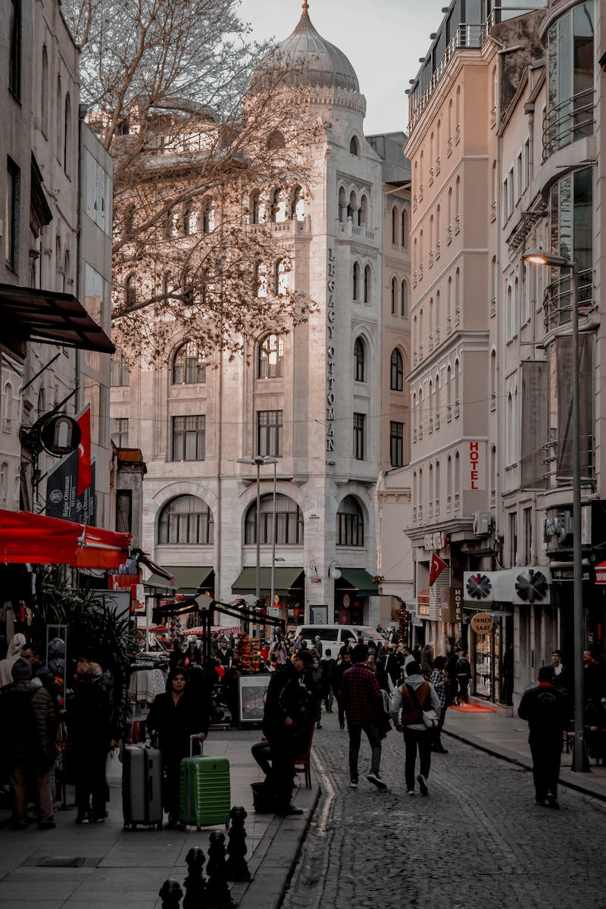
Legacy and Impact
• The Soweto Uprising galvanized further resistance and solidarity against apartheid in South Africa.
• It brought international attention to the oppressive policies of the apartheid regime.
• The Uprising led to reforms in education policies and served as a springboard for the anti-apartheid movement.
• Today, June 16 is commemorated as Youth Day in South Africa, honoring the students who lost their lives and celebrating the ongoing fight for justice and equality.
Photo by Pexels

Slide 9
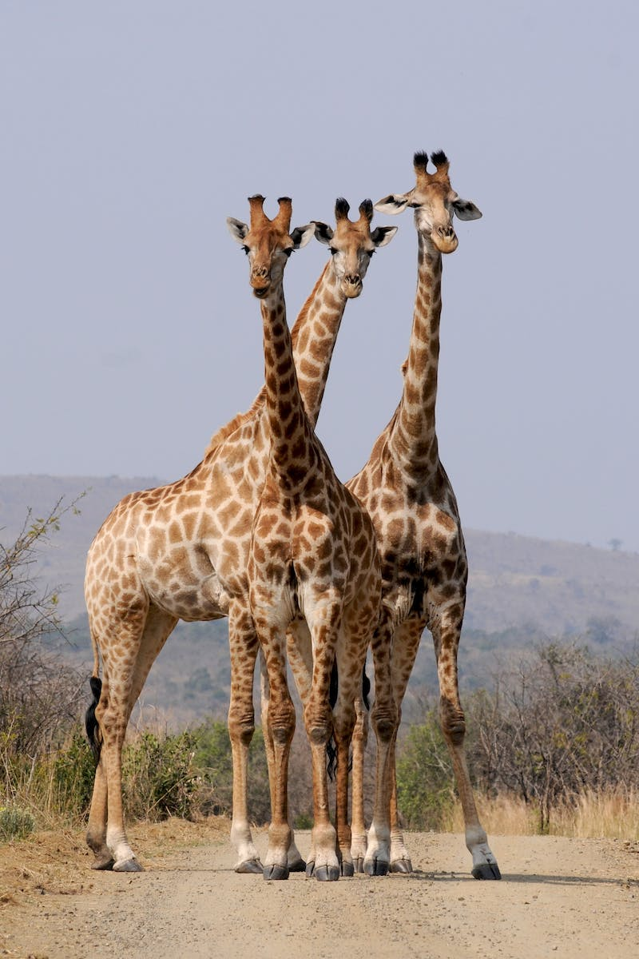
Transition to Democracy
• In the late 1980s, domestic resistance and international pressure led to negotiations between the apartheid government and anti-apartheid leaders.
• Apartheid was dismantled, and South Africa transitioned to a non-racial democracy.
• Nelson Mandela, among other anti-apartheid leaders, played a crucial role in the journey towards reconciliation and equality.
• The first non-racial elections were held in 1994, marking the beginning of a new era in South Africa's history.
Photo by Pexels

Slide 10
Challenges of the Post-Apartheid Era
• The legacy of apartheid continues to impact South Africa today.
• The country faces challenges of social and economic inequality, racial reconciliation, and addressing historical injustices.
• Efforts are ongoing to build a more inclusive and equitable society.
• The Soweto Uprising serves as a reminder of the ongoing struggle for freedom and equality.
Photo by Pexels

