Slide 1
La balade argentique photo et cinéma avec Stavros Diamantakis
Une histoire de l'entreprise Verax et de ses appareils photo

Slide 2
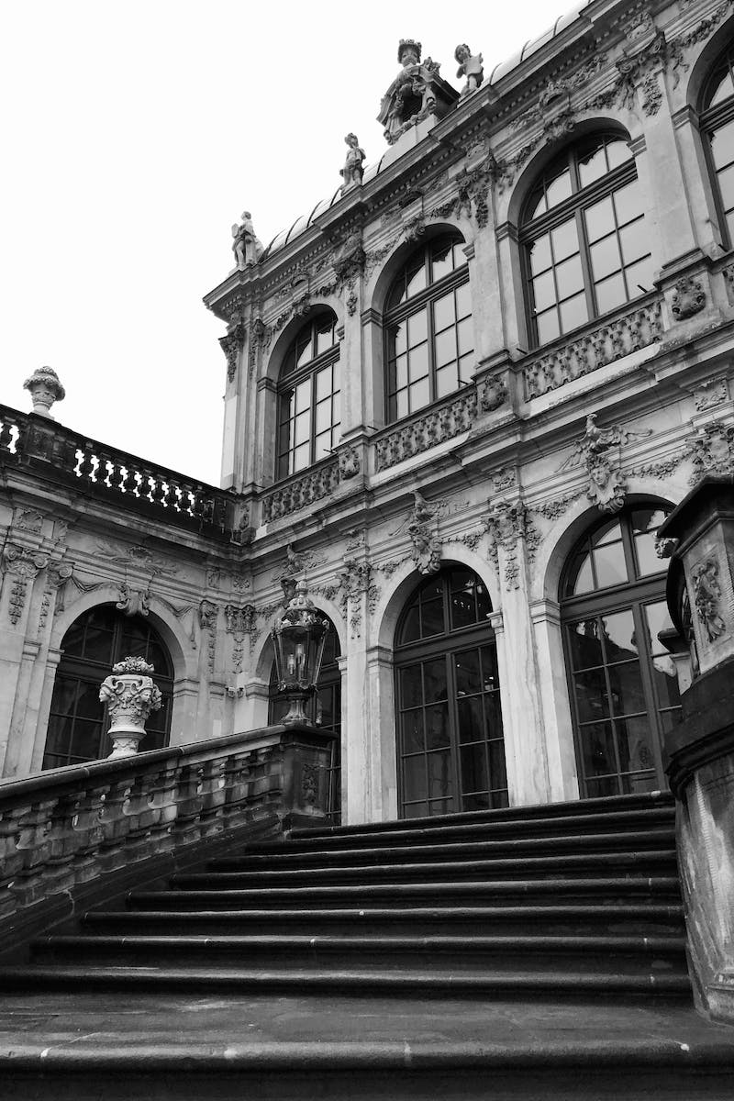
Introduction
• Bonjour, je m'appelle Stavros Diamantakis
• Promenade photo analogique dans le fief de l'ancienne industrie photo, à Dresde
• Présentation de l'appareil photo Verax, 9x12
Photo by Pexels

Slide 3
Verax Camera and Unger & Hoffmann
• Unger & Hoffmann, founded in 1878, was a major photo industry player in Dresden
• Initially produced photo paper and plates
• Success led to the production of cameras and projectors
• Verax brand introduced for photo paper, cameras, projectors, and lenses
• Unger & Hoffmann was the only German factory manufacturing photochemical and phototechnical products
Photo by Pexels

Slide 4
Apollo Verlag and Projection Series
• Apollo Verlag established as a subsidiary
• Produced photo and slide series for schools and institutions
• Around 100 series with 100,000 images available for projection
• Promoted with the slogan 'projection for all'
Photo by Pexels

Slide 5
The Verax Camera
• Production of Verax cameras ceased around 1950
• Camera purchased from Heinrich Feitzinger in Vienna
• Built in 1920, format of 9x12 cm for glass plates
• 135mm lenses with 1/100 second shutter speed
• Adjustable optics for optical improvements and framing
• Wood and metal construction with a bright viewfinder
Photo by Pexels

Slide 6
Conclusion
• Verax camera represents the old photo industry in Dresden
• Transition from paper and plates to camera production
• Legacy of producing photochemical and phototechnical products
• Thank you for watching!
Photo by Pexels

