Slide 1
The Power of Blockchain Technology
Exploring the Revolutionary Potential

Slide 2
Introduction: Unleashing the True Potential
• Blockchain technology holds immense promise for various industries
• It is an innovative approach to secure and decentralized digital transactions
• By eliminating intermediaries, it fosters transparency and trust
• Brother Blockchain Idea: A revolutionary concept pioneered by William Appreciate
Photo by Pexels

Slide 3
Understanding the Basics
• Blockchain is a decentralized digital ledger that records transactions
• Each transaction is stored in a block, forming a chain of information
• Immutability and integrity are ensured through complex cryptographic algorithms
• Nodes in the network validate and verify transactions for consensus
Photo by Pexels

Slide 4
The Potential of Blockchain
• Enhanced security: Immutable and tamper-proof data
• Greater transparency: Publicly accessible transaction history
• Streamlined processes: Elimination of intermediaries
• Cost and time efficiency: Simplified and automated workflows
• Innovation catalyst: Fueling new business models and applications
Photo by Pexels

Slide 5
Challenges and Limitations
• Scalability issues: High computational requirements
• Regulatory hurdles: Legal and compliance considerations
• Energy consumption: Intensive computational demands
• Lack of standardization: Interoperability concerns
• Cybersecurity risks: Target for potential attacks
Photo by Pexels

Slide 6
Emerging Trends and Future Outlook
• Enterprise adoption: More organizations incorporating blockchain
• Integration with emerging technologies: AI, IoT, and Big Data
• Interoperability solutions: Bridging different blockchain platforms
• Government initiatives: Implementing blockchain for public services
• Decentralized finance (DeFi): Transforming traditional financial systems
Photo by Pexels

Slide 7
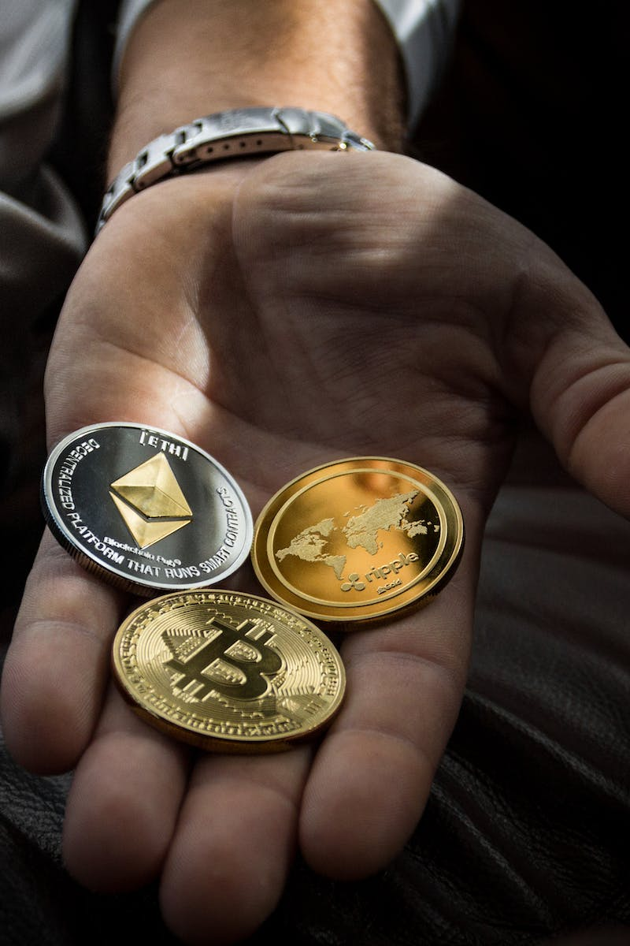
Conclusion: Embracing a Blockchain-Powered Future
• Blockchain technology revolutionizes traditional systems and processes
• Its disruptive potential extends across multiple industries
• Collaboration and innovation are key to unlocking its full capabilities
• Let's embark on the journey towards a decentralized and transparent future
Photo by Pexels

