Slide 1
The Power of Collaboration
Unlocking Creativity and Innovation Together

Slide 2
Introduction
• Collaboration drives success
• Harnessing the collective knowledge
• Breaking down silos
• Empowering diverse perspectives
Photo by Pexels

Slide 3
The Power of Inclusion
• Embracing diversity
• Fostering inclusivity
• Enhancing problem-solving
• Driving innovation
Photo by Pexels

Slide 4
Building Strong Relationships
• Effective communication
• Establishing trust
• Encouraging open dialogue
• Fostering mutual respect
Photo by Pexels

Slide 5
Overcoming Challenges
• Managing conflicts
• Embracing constructive feedback
• Resilience and adaptability
• Finding common ground
Photo by Pexels

Slide 6
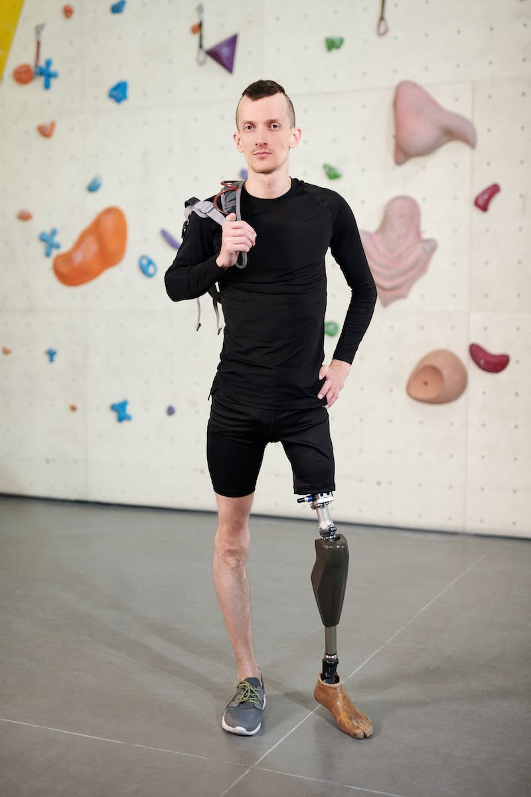
Driving Innovation
• Creative problem-solving
• Inspiring new ideas
• Iterative improvement
• Embracing experimentation
Photo by Pexels

Slide 7
Conclusion
• Achieving greatness together
• Unleashing untapped potential
• Creating lasting impact
Photo by Pexels

