Slide 1
The Problem Chamber: A Smart Workflow Pipeline
Unlocking the Power of Advanced Motion Bread

Slide 2
Introduction
• Problem Chamber - A smart workflow pipeline
• Unchecking the thirteen No.
• Stopping blocking after after That z inclusion
• Working on timing and absolute motion
Photo by Pexels

Slide 3
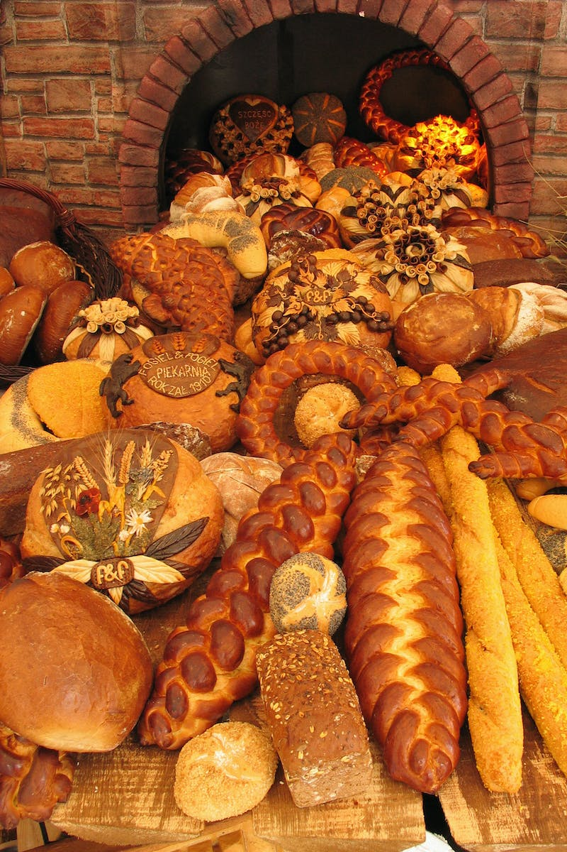
Advanced Motion Bread
• Solution for motion attack
• Super pretty and advanced
• Showing the correct three-time switch
• Storing good molecule state
Photo by Pexels

Slide 4
Animation Control
• Deleting animation
• Control through media control
• Trial and error with controller
• Applying control to graphics and stores
Photo by Pexels

Slide 5
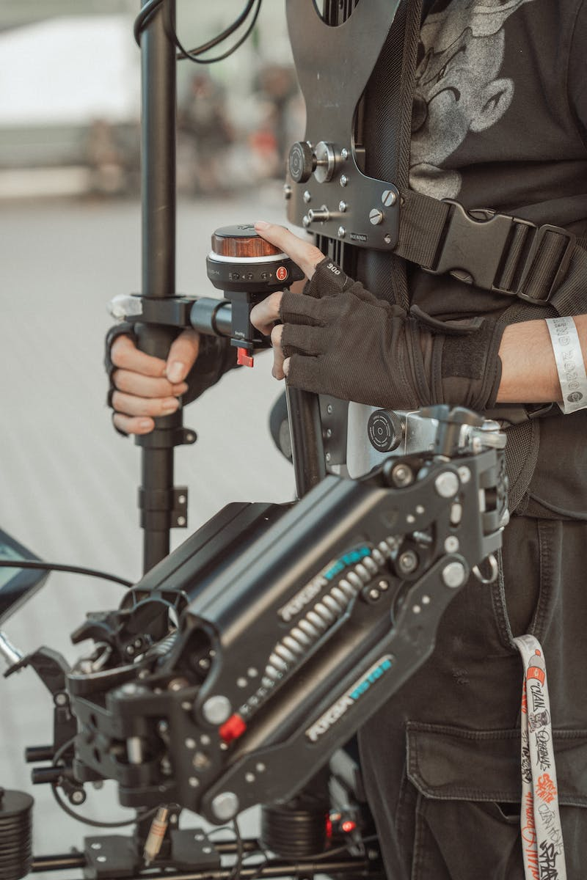
Machine Translation
• Translating in machine and blue chip key
• Auto-rotation in space
• Exploring noise and auto-rotation
• Understanding space translation
Photo by Pexels

Slide 6
Top Level Outline
• Viewing the outline at the top level
• Moving to another page
• Applying certain group constraints
• Becoming the main constraint
Photo by Pexels

Slide 7
Shrimp Busy War
• Stopping the shrimp
• Busy war as a known state
• Answering some questions
• Editing control on the network
Photo by Pexels

Slide 8
Smart Access
• Smart access control
• Twelve smart ways to access
• Exploring smart control
• Editing control on the network
Photo by Pexels

