Slide 1
The Mind-Boggling Quantum Mechanics
Exploring the Double Slit Experiment and the Dual Nature of Light

Slide 2
Introduction
• Quantum mechanics is a mind-blowing theory in physics
• Cats can be simultaneously alive and dead
• Outcome of experiments depends on observation
• But these explanations have been abandoned
Photo by Pexels

Slide 3
The Double Slit Experiment
• The simplest experiment to understand quantum mechanics
• Shine light on two slits and observe the pattern on a screen
• Interference of light waves creates bright and dark lines
• Similar behavior can be observed with water waves
Photo by Pexels

Slide 4
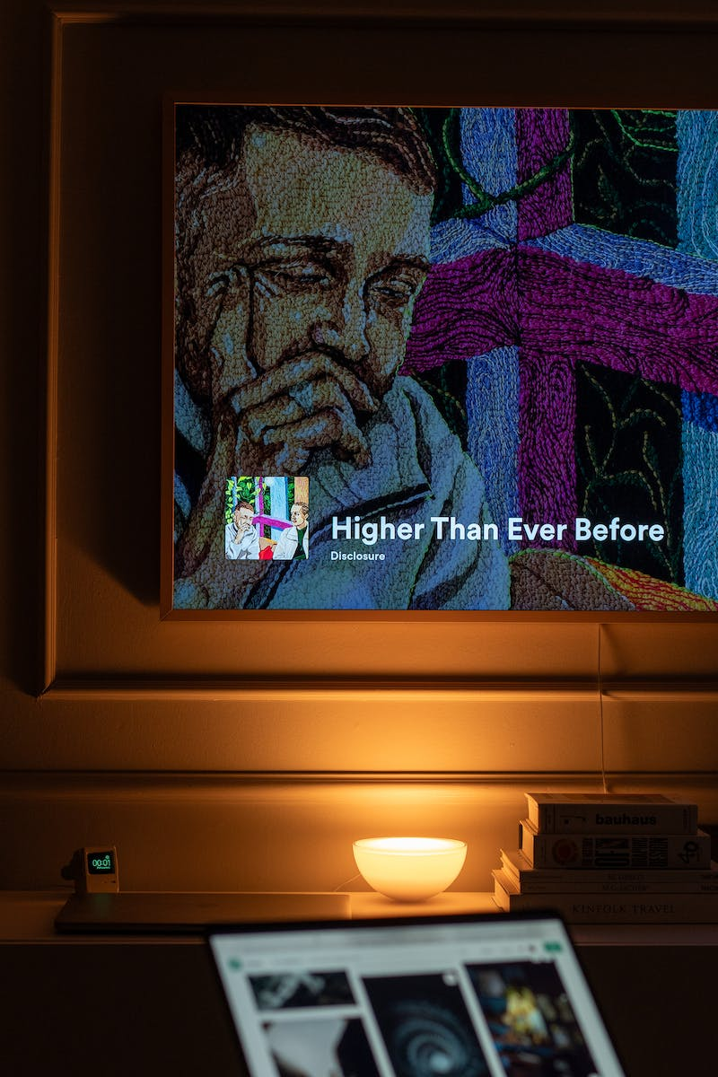
Particle Nature of Light
• Light is also composed of particles known as photons
• Particles go through one slit or the other, not both
• Expected outcome: two patches on the screen
• Actual outcome: interference pattern like waves
Photo by Pexels

Slide 5
Detecting Photons
• Setting up a detector around the slits reveals particle behavior
• Pattern on the screen resembles particle-like distribution
• Interpretations: waves when unobserved, particles when observed
• Scientific community has rejected consciousness influence on quantum mechanics
Photo by Pexels

Slide 6
Single Photon Behavior
• Experimental setup with low-intensity light source
• Sending individual photons through the double slits
• Each photon detected at a single spot on the screen
• Interference pattern emerges with multiple photon experiments
Photo by Pexels

Slide 7
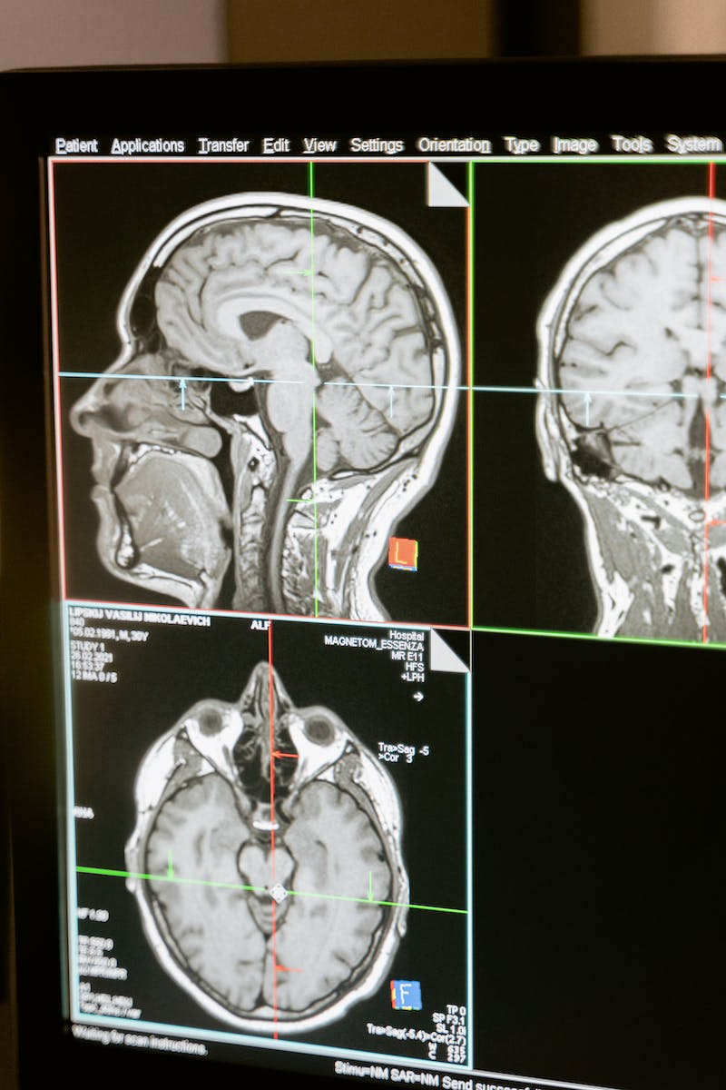
Interpretations and Future Directions
• Many interpretations exist to explain this quantum behavior
• No consensus yet: shut up and calculate, pilot wave theory, many worlds
• Plausible options for interpretation of quantum mechanics
• The jury is still out as to which interpretation is correct
Photo by Pexels

Slide 8
Conclusion
• Quantum mechanics reveals the dual nature of light
• Experimental evidence supports both wave and particle behavior
• The field of quantum mechanics is complex and open to interpretation
• The double slit experiment is just one mind-bending phenomenon
Photo by Pexels

