Slide 1
Ending the Cat Population Crisis in Brooklyn
Building a High-Volume, Affordable Space Clinic

Slide 2
Rescuing Kittens in Brooklyn
• Rescued a family of kittens from under a porch
• Finding them forever homes
• Preventing new litters
• Keeping cats off the street and out of shelters
Photo by Pexels

Slide 3
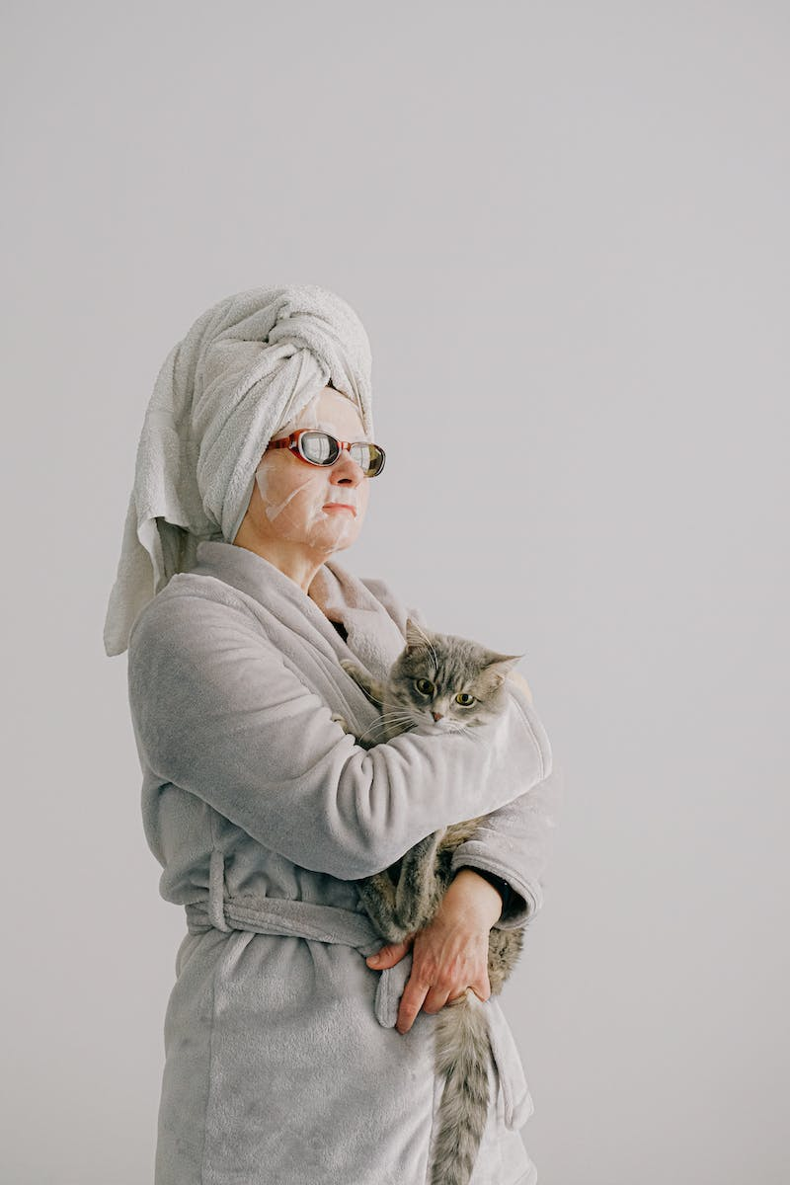
The Current Challenge
• Tens of thousands of cats still fighting to survive outdoors in NYC
• Shelters remain full
• Lack of affordable access to vet care
• 50% of pet owners unable to afford a basic visit
Photo by Pexels

Slide 4
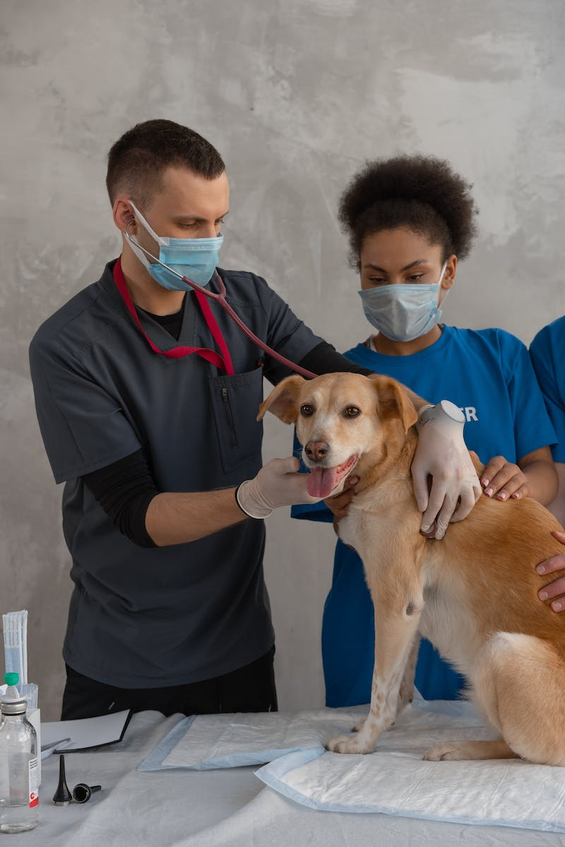
Introducing Flat Bush Cats Space Clinic
• Building a high-volume, affordable clinic
• Serving the community and rescue volunteers
• Providing thousands of Spin surgeries each year
• Keeping families together and reducing population
Photo by Pexels

Slide 5
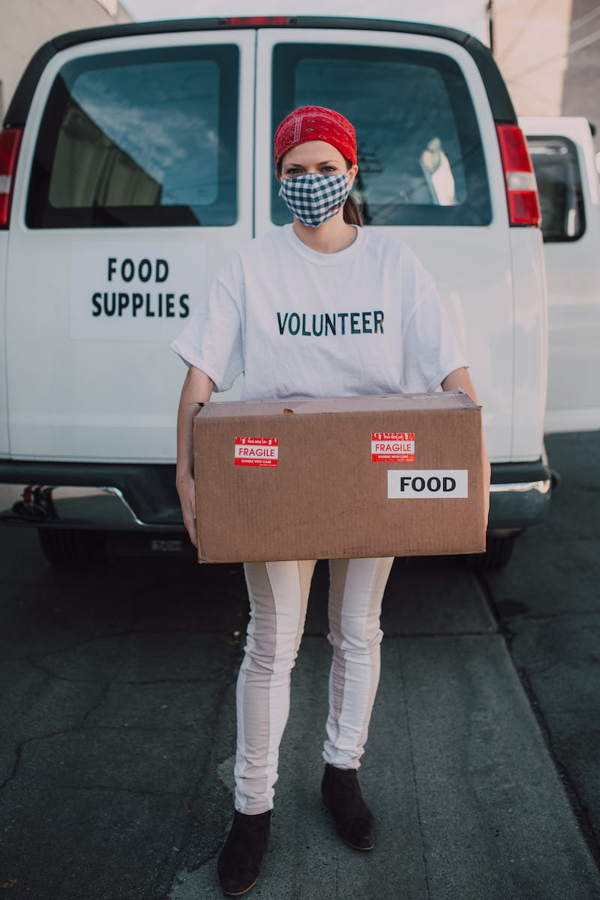
The Goal: $1.5 Million
• Raising $1.5 million in the next few months
• Covering the costs of the clinic
• Already receiving tremendous support
• Need additional help to make it happen
Photo by Pexels

Slide 6
The Solution: Your Help
• Everyone can contribute to solving the crisis
• Direct approach through donations
• Focus on creating affordable vet care
• Ending the cat population crisis once and for all
Photo by Pexels

