Slide 1
Stages of Change Model
Understanding behavior change through the temporal aspect

Slide 2
Introduction
• The Stages of Change model is a unique model of behavior change
• It emphasizes the temporal aspect of change
• People are at different stages of change
• Approach should vary based on the stage
• Goal is to help move towards the stage of maintenance
• Maintenance is the hardest stage to stay changed
Photo by Pexels

Slide 3
Pre-contemplation Stage
• People in this stage are resistant to change
• They do not want to quit or make any changes
• Approach should involve raising consciousness
• Provide health education about the dangers of the behavior
• Evaluate how behavior affects other people
• Relieve underlying causes of the behavior
Photo by Pexels

Slide 4
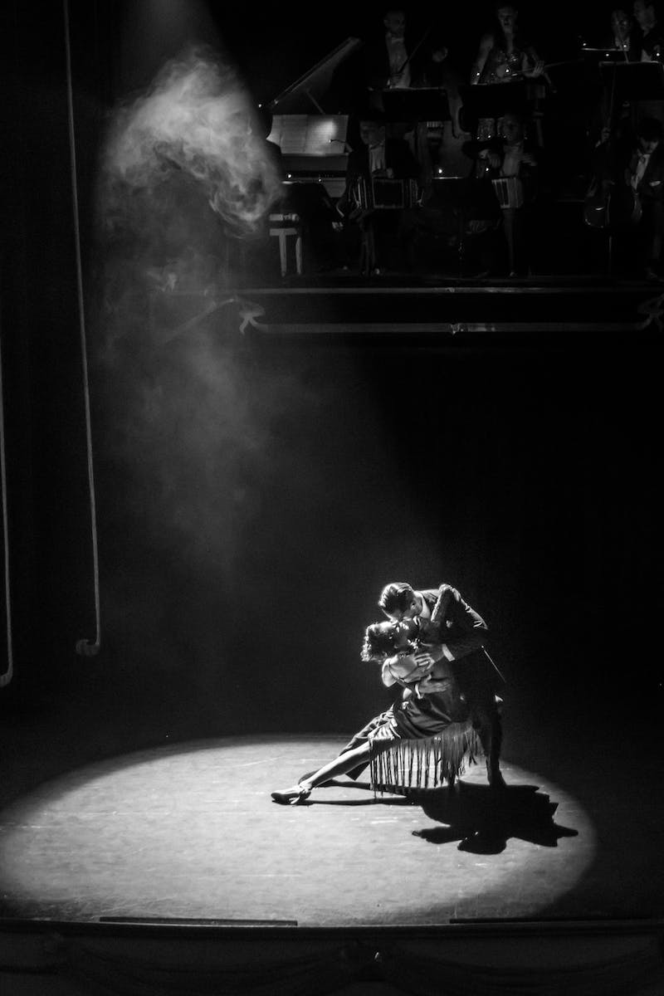
Contemplation Stage
• People in this stage acknowledge the need for change
• They are considering making a change but unsure
• Approach should involve self-evaluation
• Identify barriers and motivating factors
• Encourage self-reflection and introspection
• Minimize underlying barriers to change
Photo by Pexels

Slide 5
Preparation Stage
• People in this stage are ready to make a change
• They need help in planning and knowing how to change
• Approach should involve social liberation
• Tap into social conditions that support change
• Help in making a concrete plan
• Build self-efficacy and affirmations
Photo by Pexels

Slide 6
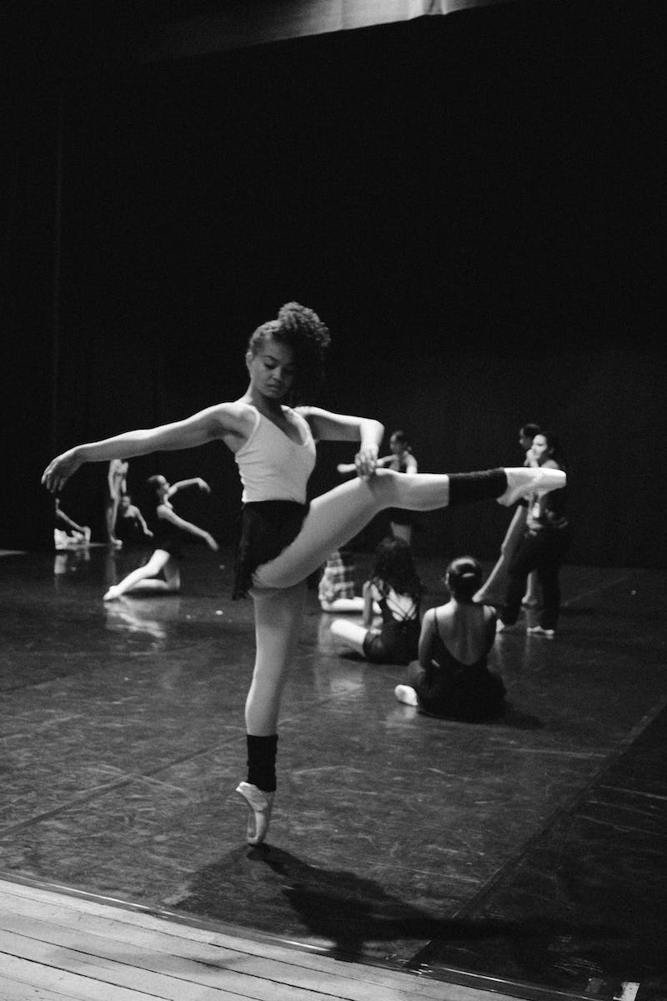
Action Stage
• People in this stage are actively making the desired change
• They are engaged in the behavior or have stopped the negative behavior
• Approach should involve social support
• Provide encouragement and reinforcement
• Create an environment conducive to the behavior change
• Focus on counter conditioning and reinforcement management
Photo by Pexels

Slide 7
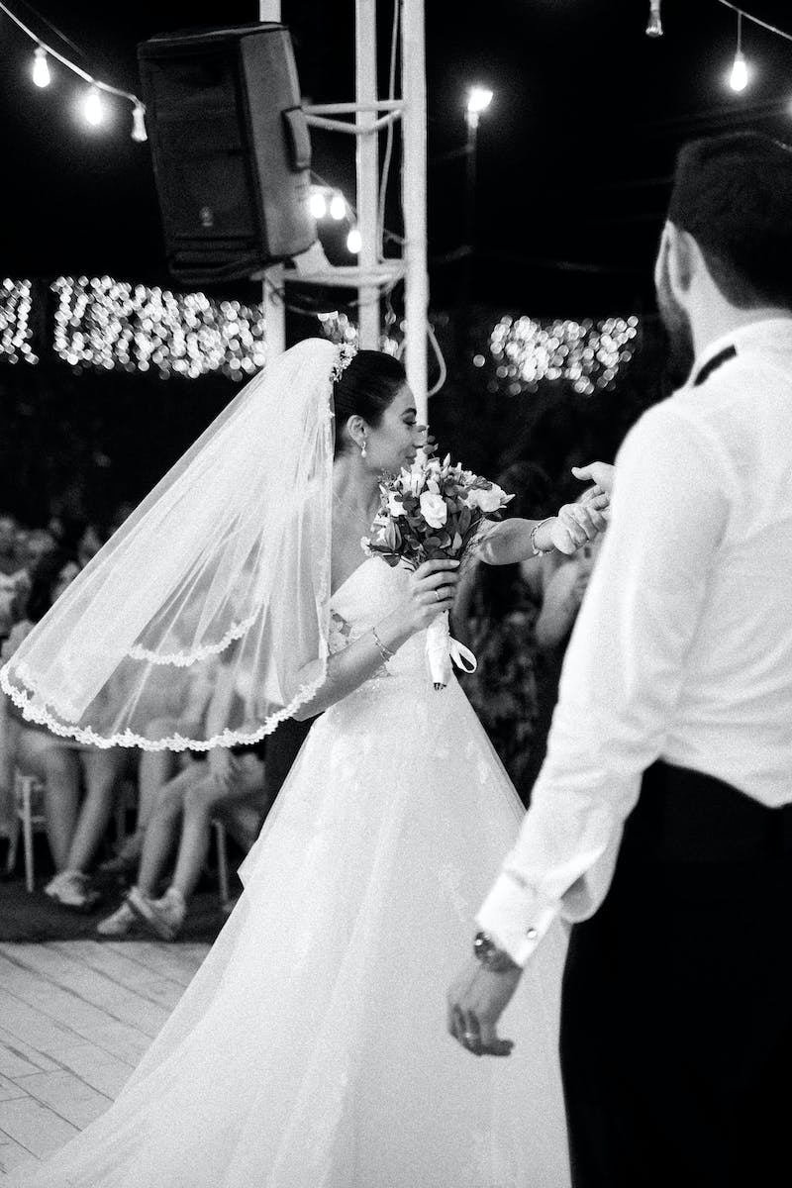
Maintenance Stage
• Staying changed is the challenge in this stage
• Effort is required to maintain the behavior change
• Approach should involve environmental control
• Manage stimuli that may trigger relapse
• Reinforce positive behaviors and experiences
• Address barriers to long-term maintenance
Photo by Pexels

Slide 8
Conclusion
• The Stages of Change model is not linear
• Relapse is part of the process, not a failure
• Learn from failures and reassess approach
• Help individuals overcome barriers and build self-efficacy
• The goal is to keep the upward spiral of change
Photo by Pexels

