Slide 1
Colonialism and Urban Change in India
Exploring the Impact of British Rule on Indian Cities

Slide 2
Introduction
• Welcome to my Youtube channel!
• This presentation focuses on the major chapter of colonialism and urban change in India.
• We will explore the key themes and important highlights of this chapter.
• The impact of British rule on Indian cities will be discussed.
Photo by Pexels

Slide 3
Chapter: Colonialism and Urban Change
• Colonialism and urban change is an important chapter in understanding the development of Indian cities.
• The themes of this chapter revolve around the changes in lifestyle and the impact on cities.
• The main focus of this chapter is the introduction to colonialism and its impact on urban areas.
• The chapter also highlights the transformation of Indian cities and the change in fortunes of these cities.
Photo by Pexels

Slide 4
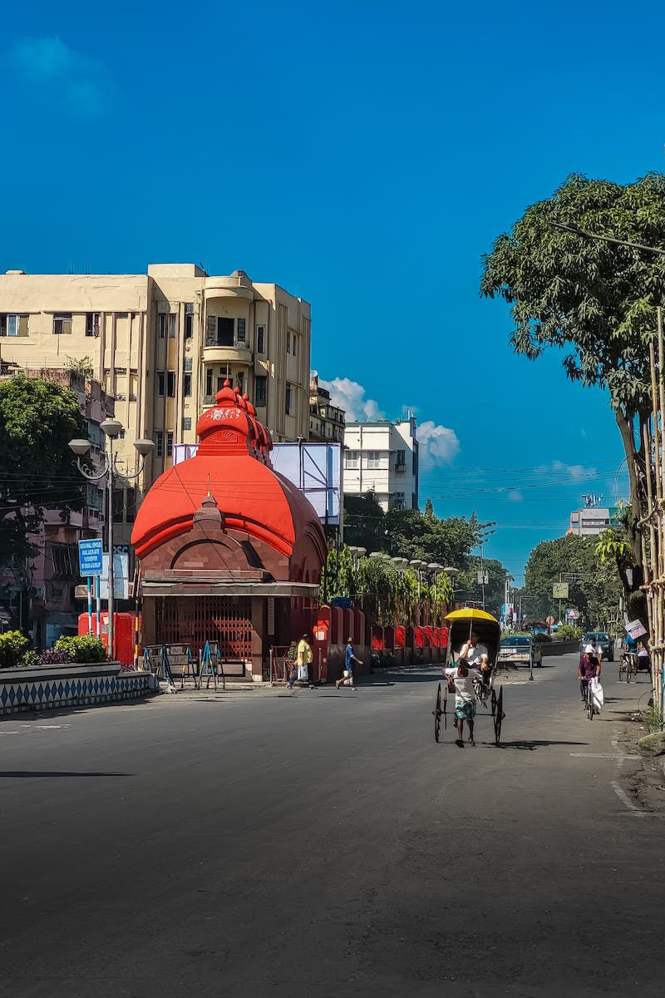
British Capital Cities in India
• Bombay became the British capital and a major center for business and industry.
• Delhi has been the capital of several empires throughout history.
• Shahjahanabad in Delhi was a seventeenth-century city with a large area and significant features.
• After 1857, Delhi became the capital of British India, leading to further development and transformation.
Photo by Pexels

Slide 5
Transformation of Delhi
• Delhi went through significant changes before and after the 1857 revolt for independence.
• The British recaptured Delhi in 1857 and made it the imperial capital.
• After the partition, Delhi witnessed a transformation with different camps and shelters for the displaced.
• The new capital, New Delhi, introduced improvements in infrastructure, population management, and municipal services.
Photo by Pexels

Slide 6
New Delhi and Delhi Improvement Trust
• New Delhi was planned as the new capital of India after the partition.
• It brought changes in population, drainage systems, and maintenance.
• Delhi Improvement Trust was established in 1936 to enhance the city's infrastructure.
• Housing plans were introduced, focusing on providing different economic backgrounds.
Photo by Pexels

Slide 7
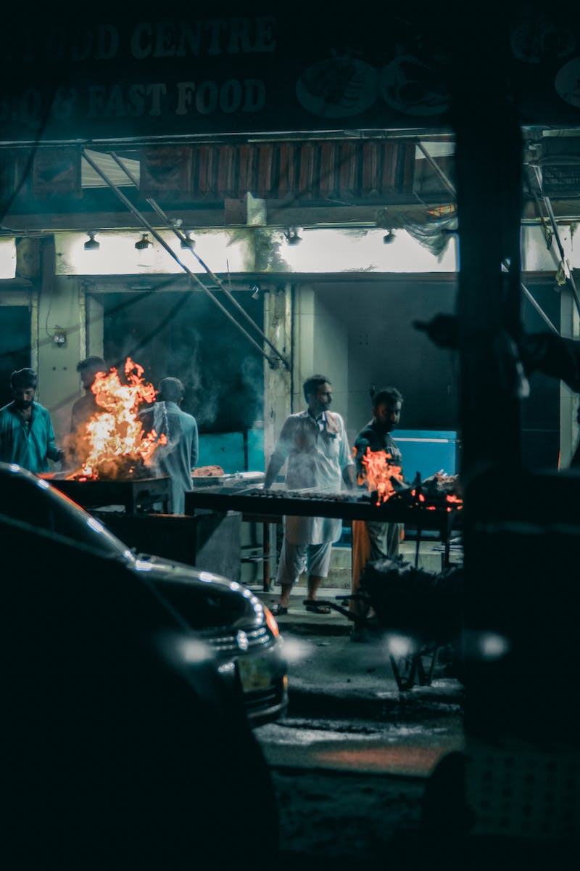
Conclusion
• The impact of colonialism on Indian cities has been significant.
• The transformation of cities like Bombay and Delhi shaped their growth and development.
• New Delhi's role as the capital post-partition brought further changes and improvements.
• The history of urban change in India reflects the complex and evolving nature of cities.
Photo by Pexels

