Slide 1
The Quest for Oil: Uncovering the Black Gold
Exploring the Methods and Challenges of Oil Exploration

Slide 2
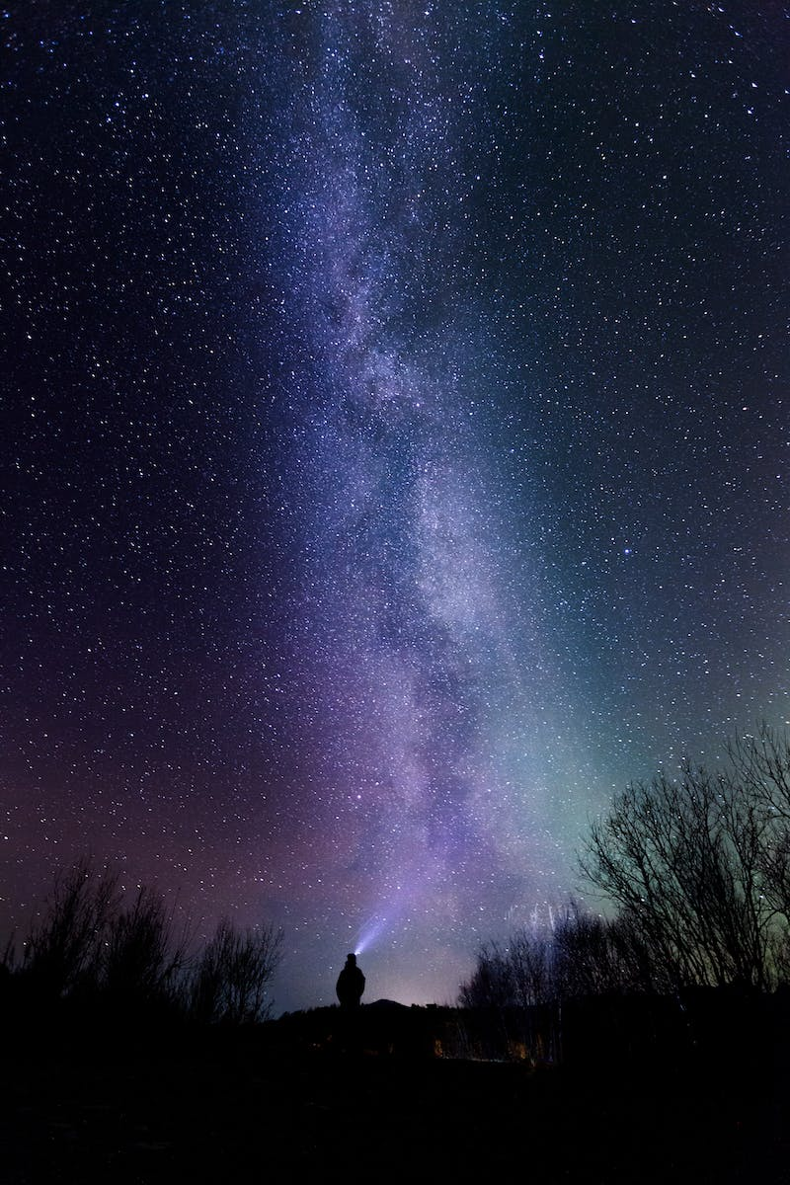
Introduction
• Oil, often referred to as black gold and the lifeblood of civilization
• Used in a wide range of products from film to gasoline
• Oil exploration is essential to meet the demands of modern society
• But how is oil actually found?
Photo by Pexels

Slide 3
Azerbaijan: The Birthplace
• In 1848, industrial oil extraction began in Azerbaijan
• Azerbaijan boasts 9 different climate zones within its small territory
• Ancient traces of oil extraction date back to the 5th century AD
• Oil naturally seeps to the surface in some areas
Photo by Pexels

Slide 4
Formation and Migration
• The exact process of oil formation is still not fully understood
• Oil accumulates in porous sandstones or fractured limestone
• Underground geological processes can lead to oil migration
• Pressure differences cause oil to move towards the surface
Photo by Pexels

Slide 5
Seismic Surveys: Unveiling the Subsurface
• Seismic surveys are similar to ultrasound scans in medicine
• Smart sensors are used to detect and analyze underground reflections
• Data from seismic profiles help create detailed subsurface images
• Structural traps can indicate potential oil reservoirs
Photo by Pexels

Slide 6
Field Work in Azerbaijan
• Field work in Azerbaijan involves complex logistics and extreme temperatures
• Geo-geophysical parties set out to search for potential oil reservoirs
• Precise profiling and GPS navigation aid exploration
• Seismic vibrators create powerful underground pulses
Photo by Pexels

Slide 7
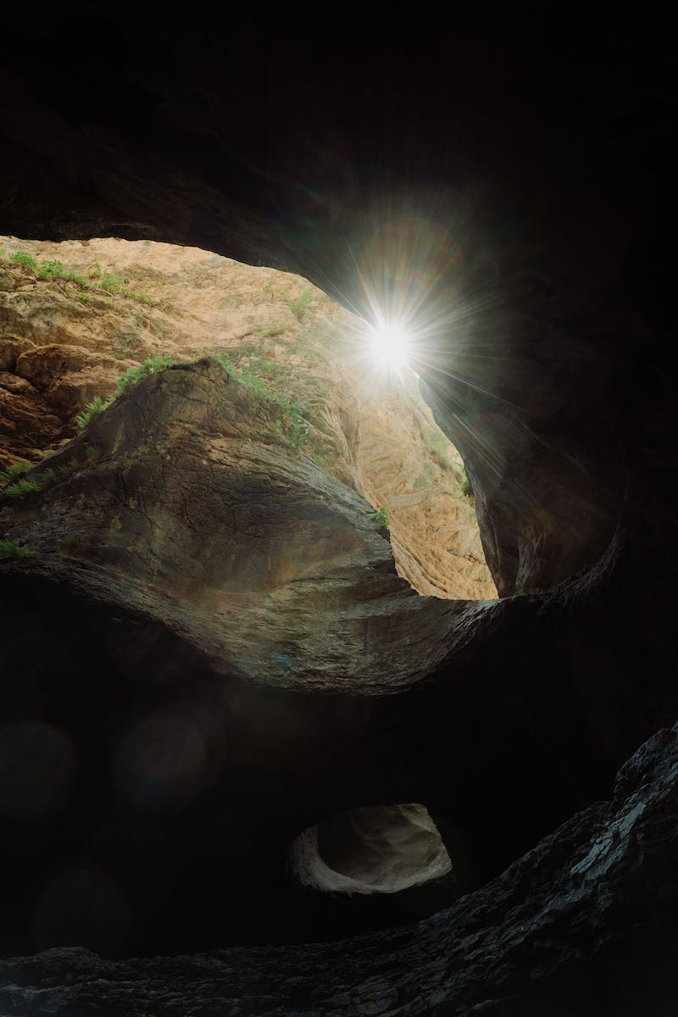
The Quest for Oil: A Geological Puzzle
• Unraveling the geological composition beneath the Earth's surface
• Understanding the stratigraphy and geological history
• Analyzing rock layers, fault lines, and folds for potential oil reservoirs
• Combining data from seismic profiles to find the perfect location
Photo by Pexels

