Slide 1
The Battle of Warcraft: A Clash of Champions
Exploring an Epic Match in World of Warcraft

Slide 2
Introduction
• Welcome to my channel!
• Today, we will be watching an exciting match in World of Warcraft.
• Featuring interesting players and their unique strategies.
• Let's dive into the action!
Photo by Pexels

Slide 3
Player Analysis: Frog from Singapore
• The player, known as Frog, hails from Singapore.
• He has a marine or aquatic theme in his gameplay, often switching between a fish and a frog persona.
• Frog is currently playing as an Undead on the Catapult map.
• He is a highly skilled player with a significant rating.
Photo by Pexels

Slide 4
Strategy Analysis: Undead vs Alliance
• The Undead faction, particularly the Lich, is a popular and powerful choice against the Alliance.
• The Undead player strategizes by building a Barracks first, followed by an Altar.
• This grants an advantage in terms of infantry units, as the Hero Tavern allows immediate recruitment.
• The Undead's central position on the map also allows for various scouting options.
Photo by Pexels

Slide 5
Heroes and Units
• The Undead player chooses the Alchemist as their first hero.
• The Alchemist is a versatile and underrated hero, particularly in the starting phase of the game.
• Interestingly, the Alchemist starts at the center of the map, making it easier to engage the enemy.
• The Undead player does not deviate from their plan, prioritizing early unit production.
Photo by Pexels

Slide 6
Battle Engagement
• The Undead player engages in battles, utilizing the Alchemist's abilities.
• The Alchemist quickly eliminates enemy units, while benefiting from the Ritual Dagger's healing properties.
• Meanwhile, the Undead continues to recruit additional units and expand their base with a Gold Mine.
• The battle consists of various infantry units, providing different tactical options.
Photo by Pexels

Slide 7
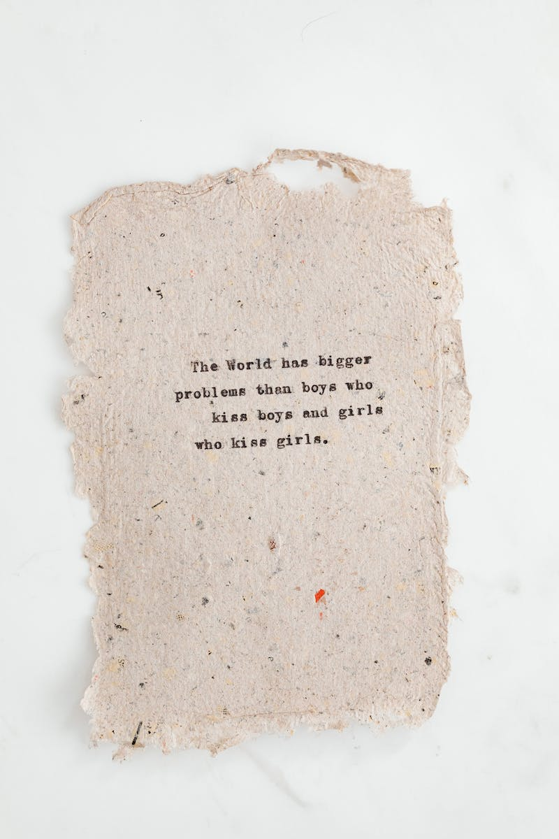
Base Defense and Expansion
• The Undead player focuses on defending their base with multiple towers and Necropolises.
• They also acquire additional Crypts to produce more Skeleton Warriors.
• The strategy includes the purchase of defensive artifacts, such as Rings of Protection.
• Although the Undead player faces challenges, their base remains intact.
Photo by Pexels

Slide 8
Griffons and Aerial Assault
• The Alliance player diversifies their army by incorporating Gryphons into the battle.
• Their plan involves using Gryphons and Grifon Riders to engage the Undead player.
• Additionally, the Alliance player does not opt for a second hero, aiming to quickly level up the Alchemist.
• However, the engagement does not go as planned due to the Undead's defenses.
Photo by Pexels

Slide 9
Final Showdown and Continuous Defense
• The Undead player continues to defend their base, successfully selling enemy units using the Alchemist's ultimate ability.
• This provides a significant gold advantage, enabling the Undead player to sustain their defense.
• Despite a strong effort from the Alliance, the Undead player manages to hold their ground and repel attacks.
• The usage of a secret base and continuous unit production play a crucial role.
Photo by Pexels

Slide 10
Conclusion
• The battle showcased the skill and unique strategies of both players.
• The Undead player demonstrated the effectiveness of their marine-themed gameplay and strong defensive tactics.
• The Alliance player showcased diverse army composition and the importance of hero leveling.
• Overall, it was an exciting match that exemplified the depth and complexity of World of Warcraft.
Photo by Pexels

