Slide 1
Norilsk: Building a Sustainable Arctic City
Exploring the Unique Challenges and Innovations

Slide 2
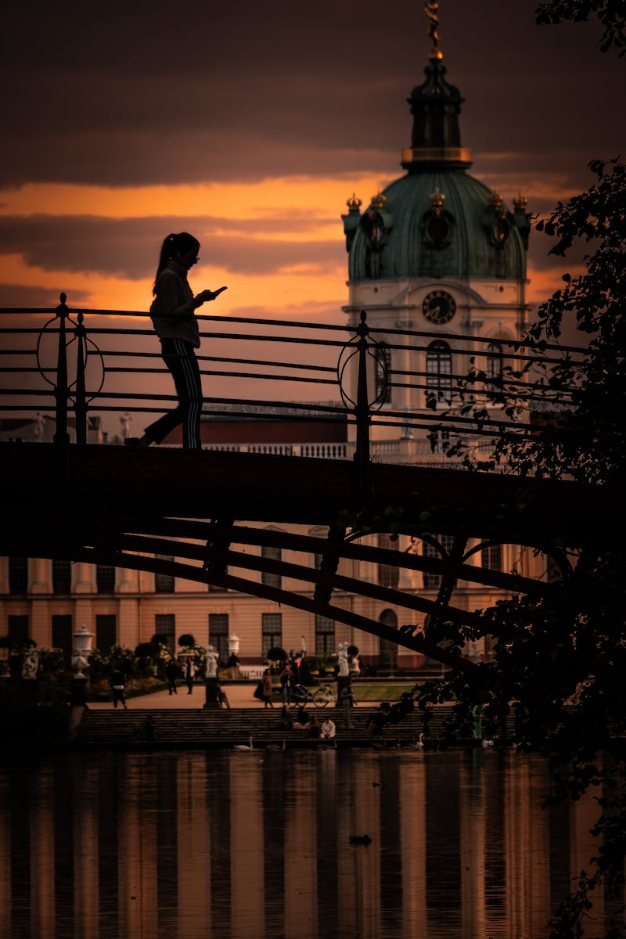
Introduction
• Norilsk: A city born in the extreme Arctic region
• One of the largest Arctic cities and industrial centers
• Known for its mining and metallurgical industry
• Unique challenges and opportunities for sustainable development
Photo by Pexels

Slide 3
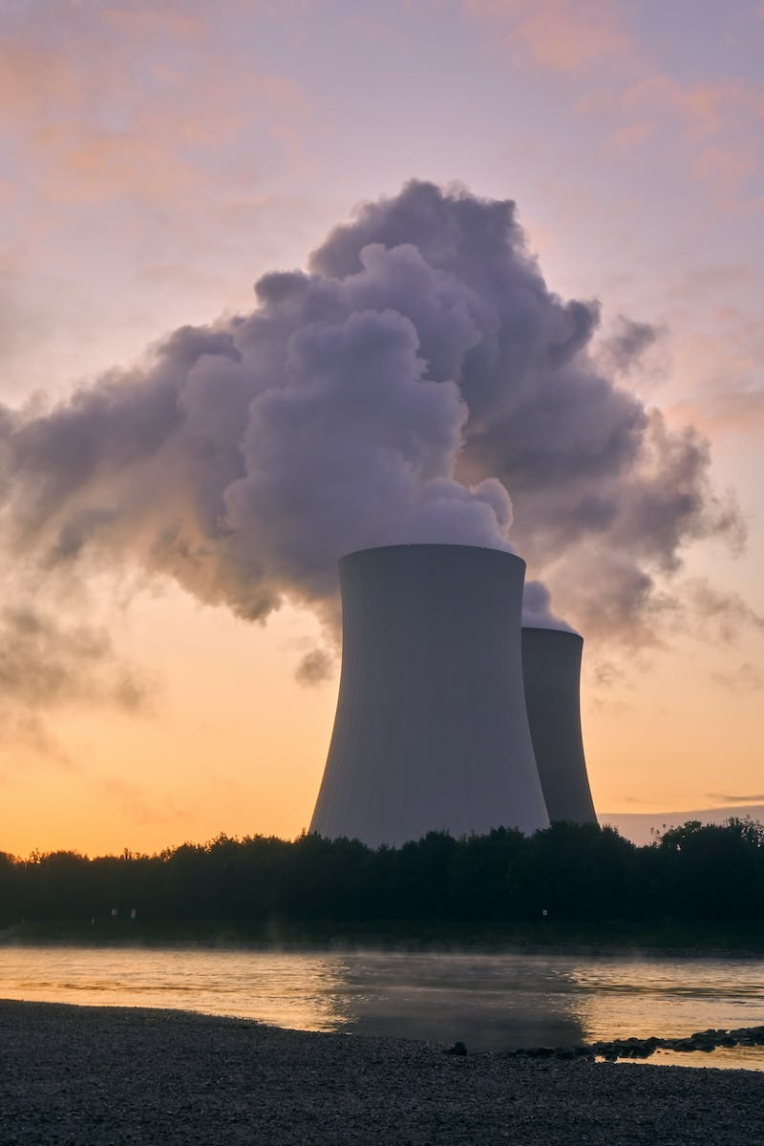
Norilsk's Industrial Legacy
• Norilsk owes its existence to rich metal deposits
• Flourished as a mining and metallurgical center
• Two-dimensional growth: Above and below ground
• Indispensable link to mining and metallurgical industries
Photo by Pexels

Slide 4
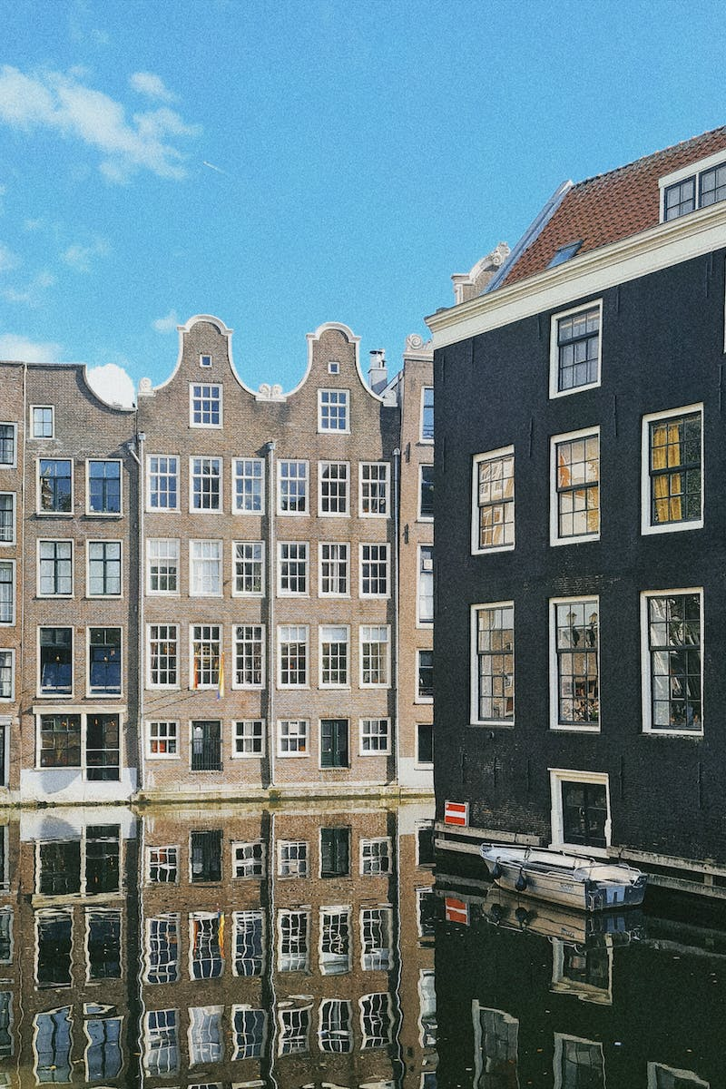
Architectural Solutions for Extreme Conditions
• Urban planning to mitigate harsh polar conditions
• Designing residential quarters to protect against snowdrifts
• Preserving spacious boulevards and public spaces
• Incorporating architectural practices from St. Petersburg
Photo by Pexels

Slide 5
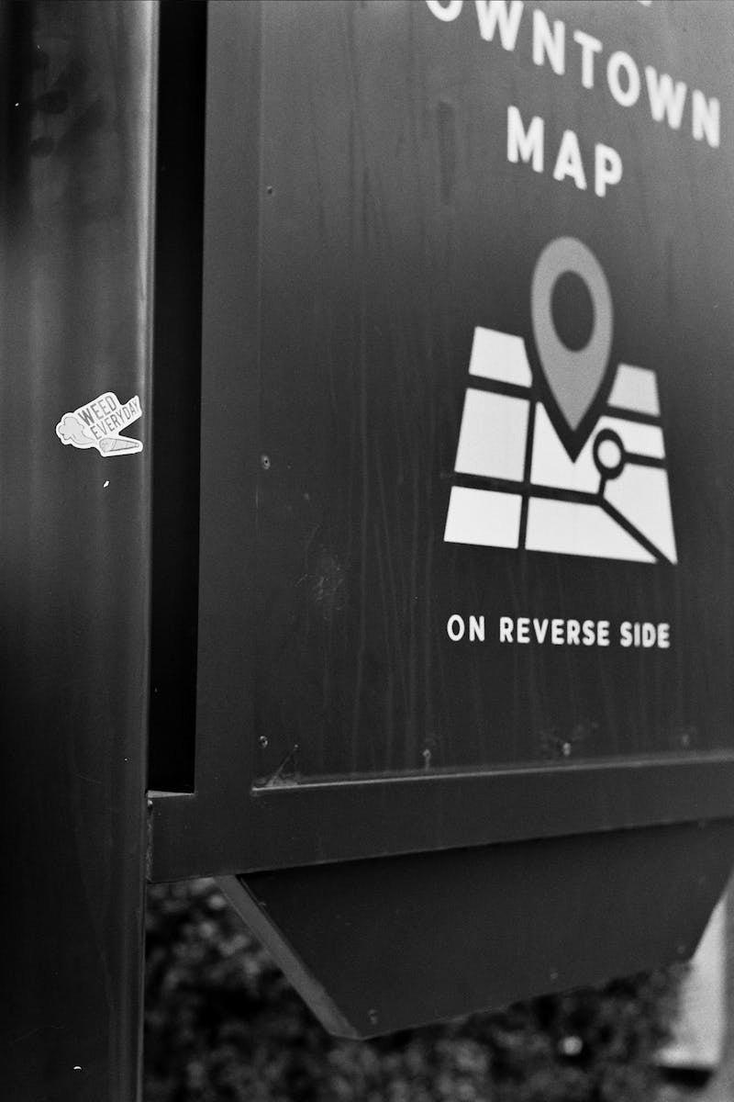
Creating Livable Environment
• Attention to social infrastructure and public amenities
• Ensuring comfortable living conditions in a challenging environment
• Health and safety of residents at the center of focus
• Promoting well-being and opportunities for all age groups
Photo by Pexels

Slide 6
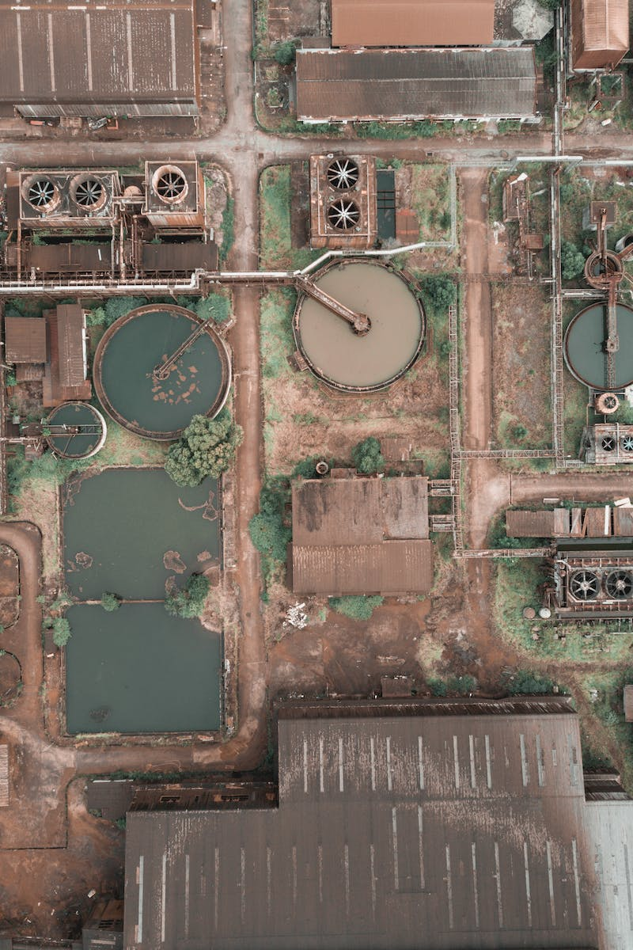
Towards a Sustainable Future
• Economic development tied to urban rejuvenation
• Systematic urban renewal and demographic policies
• Focus on health, safety, and job creation
• Transforming Arctic territories into tourism hotspots
Photo by Pexels

