Slide 1
The Cuban Missile Crisis: The Battle for Nuclear Supremacy
A Dangerous Showdown Between Superpowers

Slide 2
Introduction
• The Cuban Missile Crisis was the closest the world has come to nuclear apocalypse
• Escalating arms race led to Soviet missiles in Cuba aimed at US
• 120,000 soldiers gathered in Florida
• 3,000 American nuclear weapons locked onto Soviet targets
• A battle for nuclear superiority just 90 miles from US coast
Photo by Pexels

Slide 3
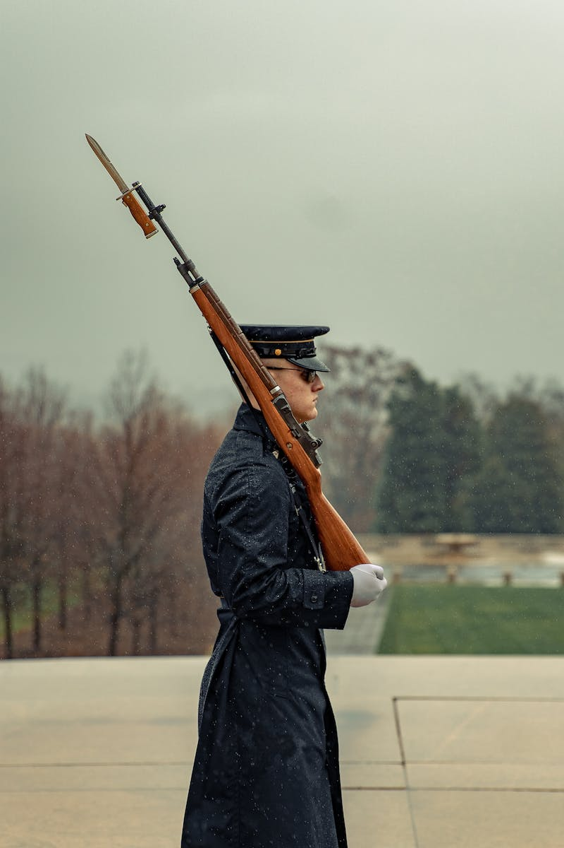
Background: Cold War Tensions
• United States had a significant lead in the arms race
• Installed Jupiter nuclear missiles in Italy and Turkey
• American advantage allowed upper hand in cold war confrontations
• Soviet leader Nikita K relied on threats and bluff for control
Photo by Pexels

Slide 4
Cuba's Communist Victory
• Cuban communist revolutionary Fidel Castro gained power in 1959
• Surprising victory for US officials as Cuba was popular among Americans
• American-owned banks, casinos, and plantations nationalized
• Castro turned to Soviet Union for help and protection
Photo by Pexels

Slide 5
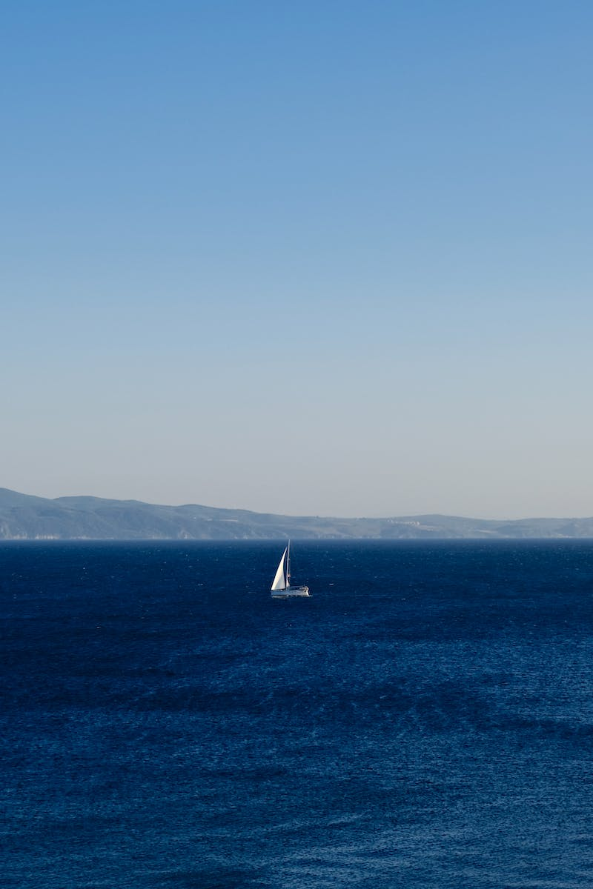
Bay of Pigs Invasion
• In April 1961, the US launched the Bay of Pigs invasion
• CIA-trained Cuban exiles invaded to oppose Castro and eliminate communism
• Invasion turned into a disaster with little support from the Cuban people
• Kennedy refused air support to hide American involvement
Photo by Pexels

Slide 6
Khrushchev's Missile Deployment
• Soviet leader Khrushchev decided to deploy nuclear missiles to Cuba in 1962
• Complete secrecy was insisted upon
• Plan involved announcing a defense agreement with Castro
• Troops were crammed beneath cargo ships and submarines for transportation
Photo by Pexels

Slide 7
Discovery of Missiles by US
• In October 1962, CIA presented Kennedy with evidence of missile sites in Cuba
• Medium-range ballistic missiles capable of striking US cities
• Threatened millions of civilian casualties
• X com group of advisors established
Photo by Pexels

Slide 8
Kennedy's Response: Naval Blockade
• Kennedy had two options: naval blockade or air strikes
• Naval blockade chosen to avoid provoking war
• Implemented on October 22, 1962
• Kennedy's televised announcement rallied public support
Photo by Pexels

Slide 9
Critical Moments: Black Saturday
• October 27, 1962 - Black Saturday
• Castro urges Khrushchev to consider a nuclear first strike
• Khrushchev proposes a deal to Kennedy to end the crisis
• American spy plane shot down, tensions escalate
Photo by Pexels

Slide 10
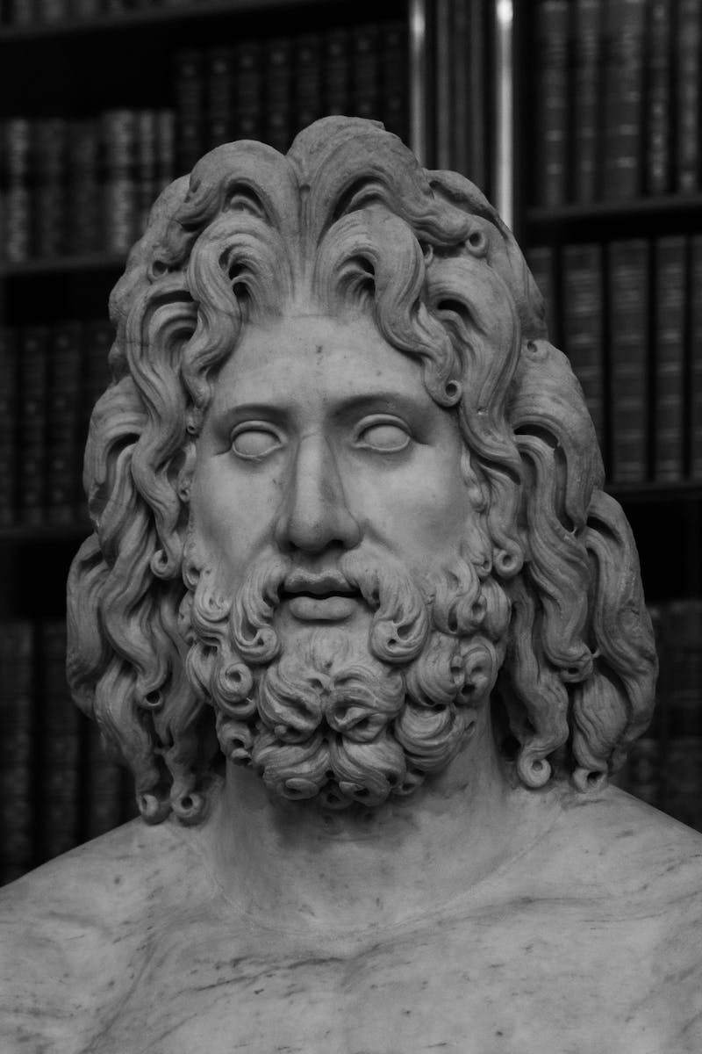
Kennedy's Last Hope
• Kennedy turns to his brother Bobby for help
• Negotiates a deal that meets the demands of X com
• Offer includes removal of Jupiter missiles in Turkey
• Bobby delivers the message to the Soviet ambassador
Photo by Pexels

Slide 11
A Diplomatic Solution
• Khrushchev accepts Kennedy's deal
• Soviet forces ordered to dismantle missiles in Cuba
• US blockade formally ended on November 20, 1962
• Cuban Missile Crisis comes to an end
Photo by Pexels

Slide 12
Aftermath and Lessons Learned
• Castro angered by deal and doubts Soviet commitment
• US military critical of the resolution
• Hotline established for better communication
• Steps taken to avoid similar crises in the future
Photo by Pexels

