Slide 1
Exploring the Underwater World
Unveiling the Secrets of Marine Life

Slide 2
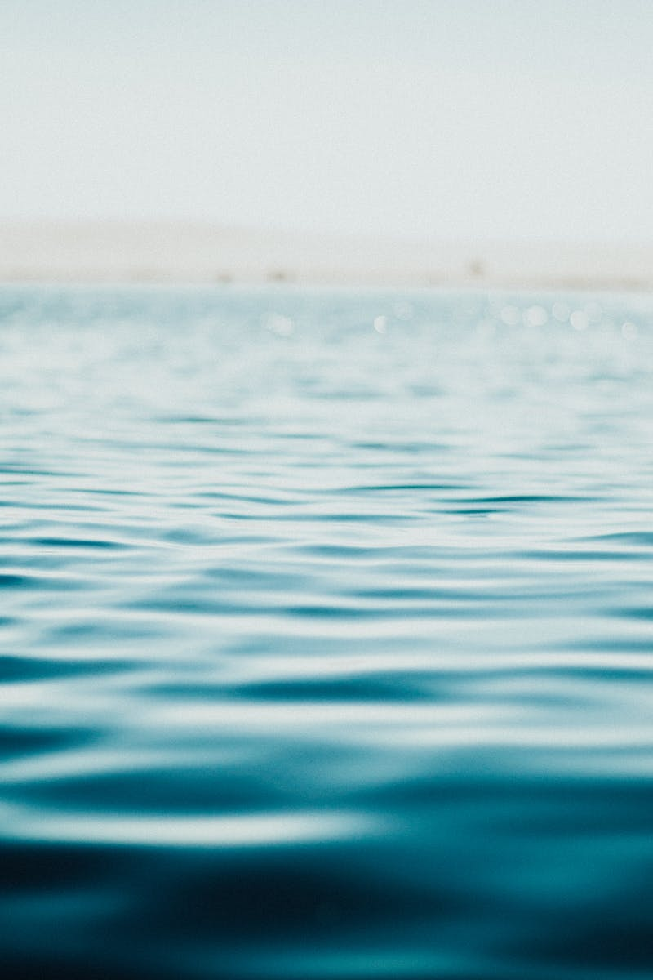
Introduction to the Ocean
• The ocean covers more than 70% of the Earth's surface.
• It is home to a diverse range of fascinating marine species.
• Exploring the ocean allows us to discover new insights into its vast ecosystem.
• The ocean plays a crucial role in maintaining the planet's balance.
Photo by Pexels

Slide 3
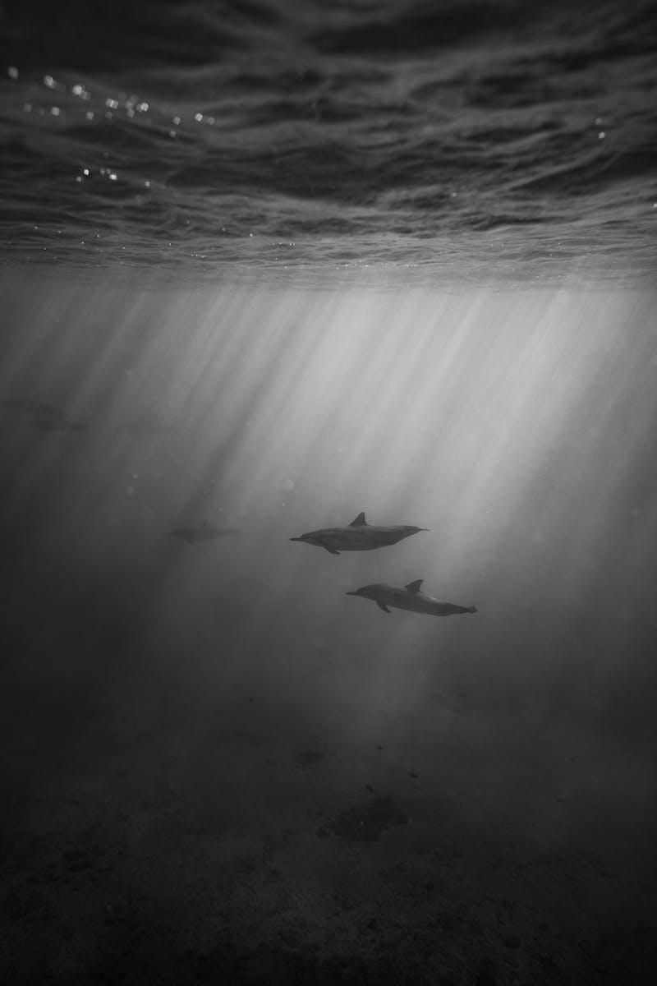
Unusual Marine Creatures
• Starfish, also known as sea stars, are fascinating creatures with multiple arms.
• Jellyfish, despite their delicate appearance, possess unique survival mechanisms.
• Various fish species inhabit the ocean and exhibit diverse behaviors.
• This slide highlights a few of the many extraordinary marine creatures.
Photo by Pexels

Slide 4
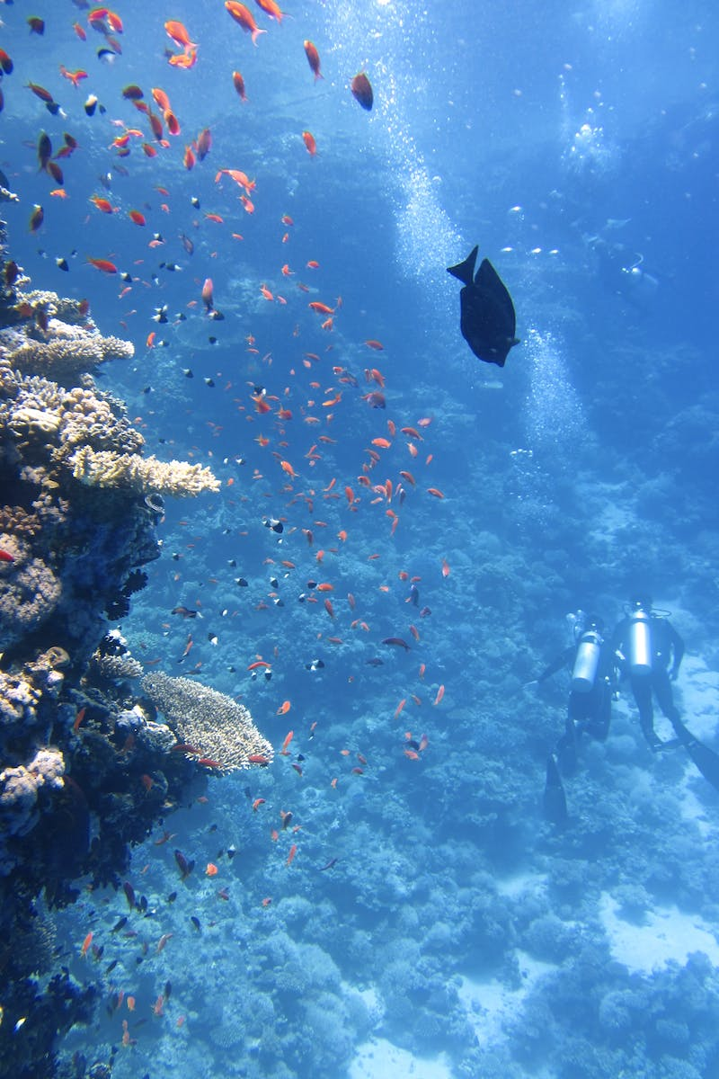
The Wonders of Coral Reefs
• Coral reefs are vibrant underwater ecosystems formed by coral polyps.
• They harbor a multitude of marine species and provide vital habitats.
• Coral reefs are currently facing numerous threats, including climate change and pollution.
• Efforts to conserve and protect coral reefs are essential for their future survival.
Photo by Pexels

Slide 5
The Impact of Copper Electronic Waste
• Copper electronic waste poses environmental hazards when not properly managed.
• Improper disposal of electronic waste can lead to soil and water contamination.
• Recycling copper from electronic waste helps reduce resource depletion.
• Awareness and responsible disposal are crucial in mitigating the negative impact of copper electronic waste.
Photo by Pexels

