Slide 1
The Cool Hips: Unveiling the Trendy Dance Moves
Master the Art of Hip Dance

Slide 2
Introduction to Hip Dance
• Hip dance is a dynamic and expressive form of movement.
• It originated in urban communities as a form of self-expression.
• Incorporates various styles such as popping, locking, and breaking.
• Designed to showcase fluidity, rhythm, and creativity.
Photo by Pexels

Slide 3
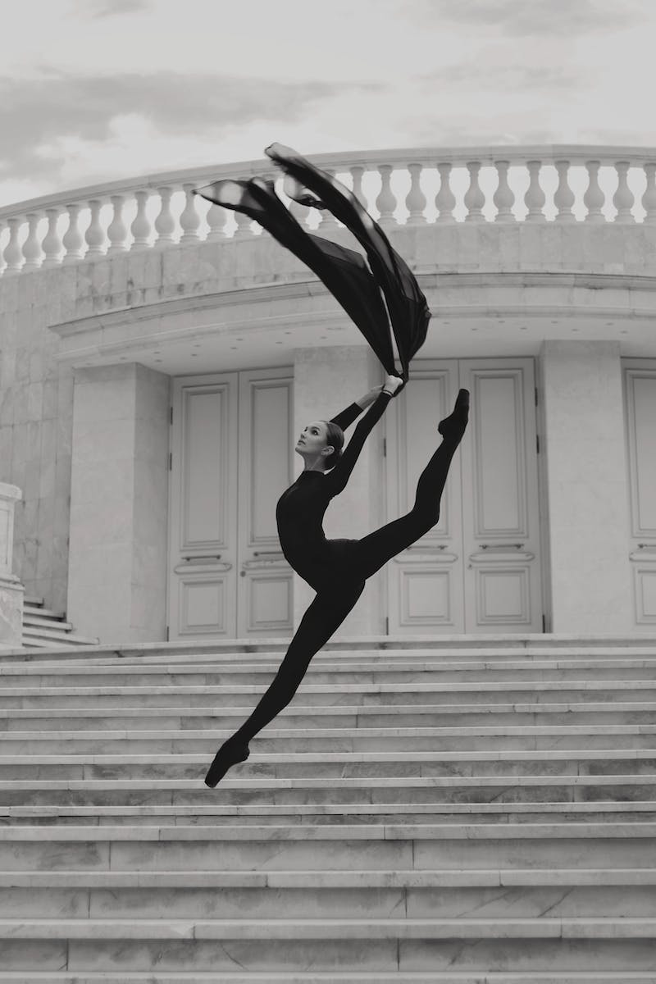
Popping: The Foundation of Hip Dance
• Popping is a distinct technique within hip dance.
• Involves contracting and releasing muscles to create a popping effect.
• Requires precise control and isolation of body parts.
• Popularized by styles like waving, ticking, and robot.
Photo by Pexels

Slide 4
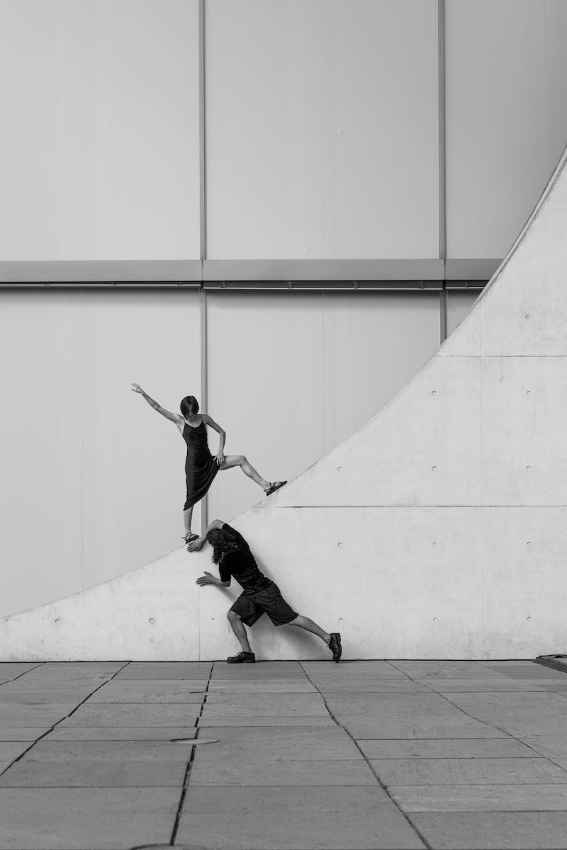
Locking: Adding Funk and Groove
• Locking is a lively and energetic style within hip dance.
• Characterized by sudden pauses or 'locks' in movement.
• Incorporates elements of funk, soul, and rhythm.
• Popularized by pioneers like Don Campbell and Tony Go-Go.
Photo by Pexels

Slide 5
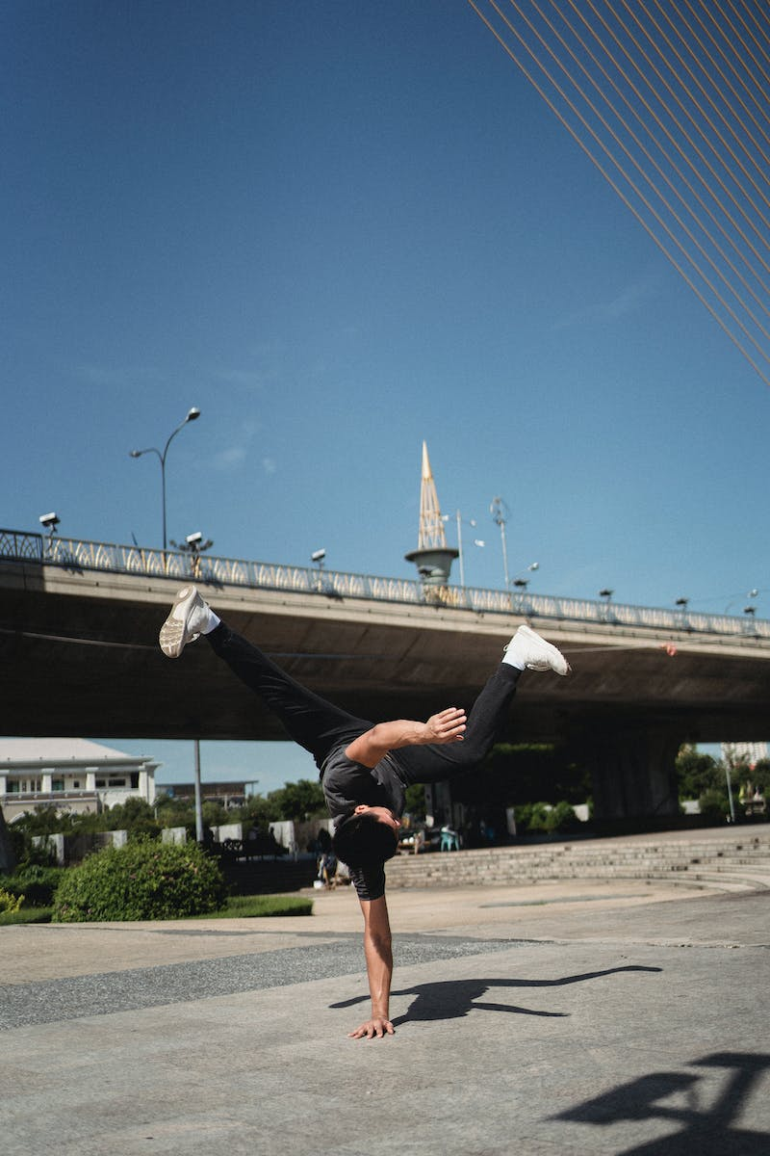
Breaking: The Power Moves
• Breaking is an acrobatic style within hip dance.
• Incorporates floor-based moves like toprocks, downrocks, and freezes.
• Involves impressive power moves like windmills and headspins.
• Birthed from street battles and improvisation in the 1970s.
Photo by Pexels

Slide 6
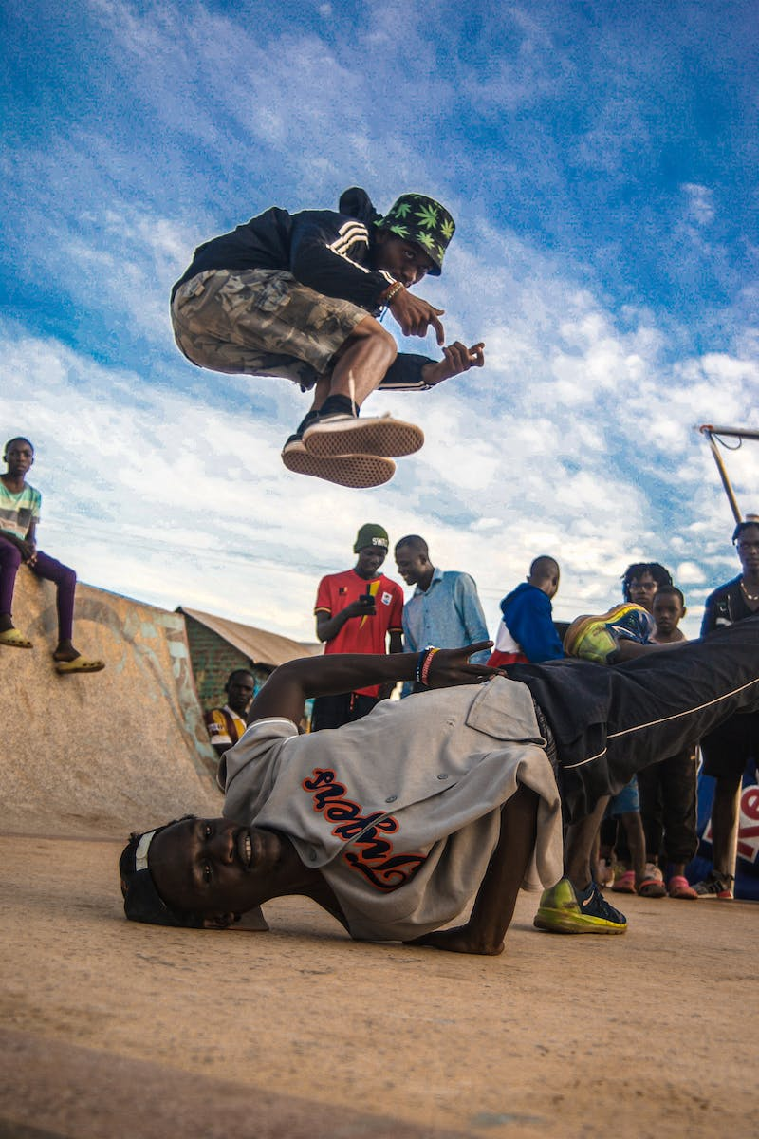
Hip Dance: Expression of Urban Culture
• Hip dance serves as a representation of urban culture.
• Originated in marginalized communities as a form of creative expression.
• Reflects the struggles, aspirations, and identity of urban youth.
• Continues to evolve and shape popular culture today.
Photo by Pexels

