Slide 1
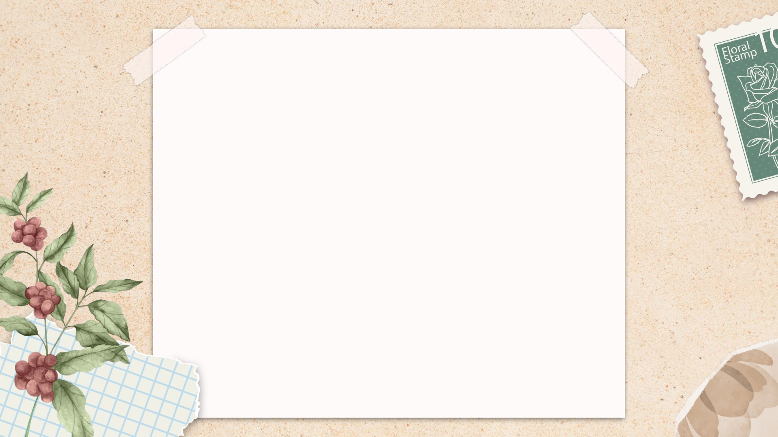
Thank You
Feeling gratitude and not expressing it is like wrapping a present and not giving it.

